Slide 1
Lessons 37 and 38
Electron Domains and Molecule Shape
Key Questions:
How do electrons affect the shape of a molecule?
How can you predict the shape of a molecule?

Slide 2
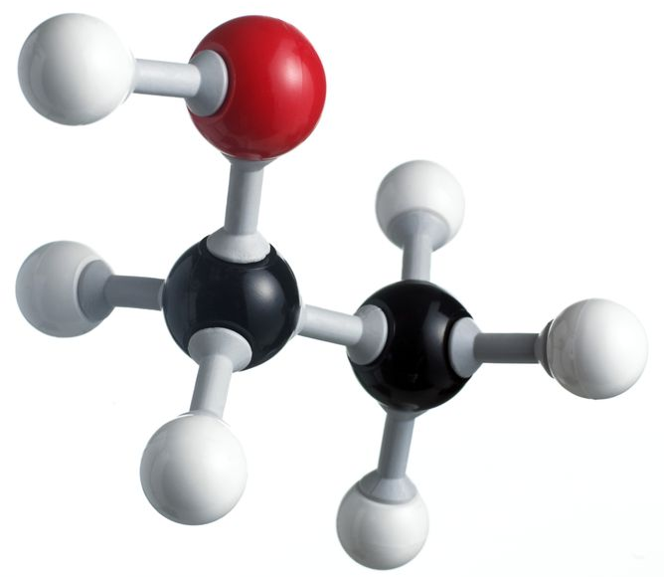
Entry Task
The image below shows a ball-and-stick model of an ethanol molecule. Predict why the bonds coming from the oxygen atom (red) are angled.

Slide 3
You will be able to:
  determine the shapes of small molecules
  explain how lone pairs of electrons influence molecular shape
  describe electron domain theory and how it relates to molecular shape

Slide 4
Vocabulary: Electron domains
Electron domain: The space occupied by valence electrons in a molecule, either a bonded pair(s) or a lone pair. Electron domains affect the overall shape of a molecule.
Electron domain theory: The idea that every electron domain in a molecule is as far as possible from every other electron domain in that molecule.

Slide 5
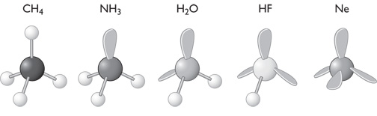
Discussion Notes (cont.)
Even though the molecules you created today have different numbers of atoms, they all have a similar underlying shape.
CH4 NH3 H2O HF Ne
Lone-pair paddles

Slide 6
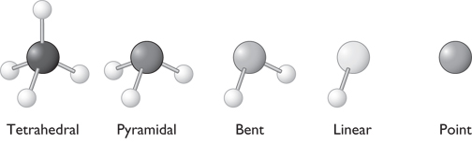
Discussion Notes (cont.)
Most molecular models do not include lone pair paddles in their representations.

Slide 7
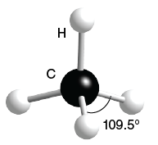
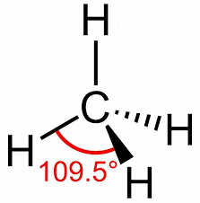
Vocabulary: Tetrahedral shape
The shape around an atom with four bonded pairs of electrons. This is the shape of a methane molecule (CH₄).

Slide 8
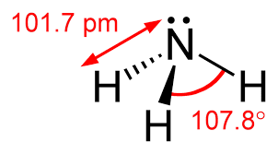
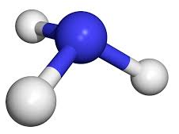
Vocabulary: Pyramidal shape
Pyramidal shape: The shape around an atom with one lone pair of electrons. This is the shape of an ammonia molecule.

Slide 9
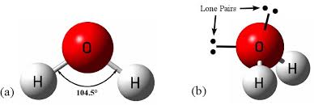
Vocabulary: Bent shape
Bent shape: The shape around an atom with two lone pairs of electrons. This is the characteristic shape of a water molecule.

Slide 10
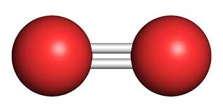
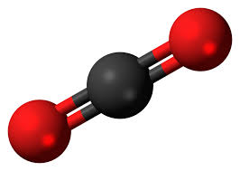
Vocabulary: Linear shape
A geometric shape found in small molecules with two electron domains surrounding the central atom.
carbon dioxide (CO₂)
oxygen (O₂)

Slide 11
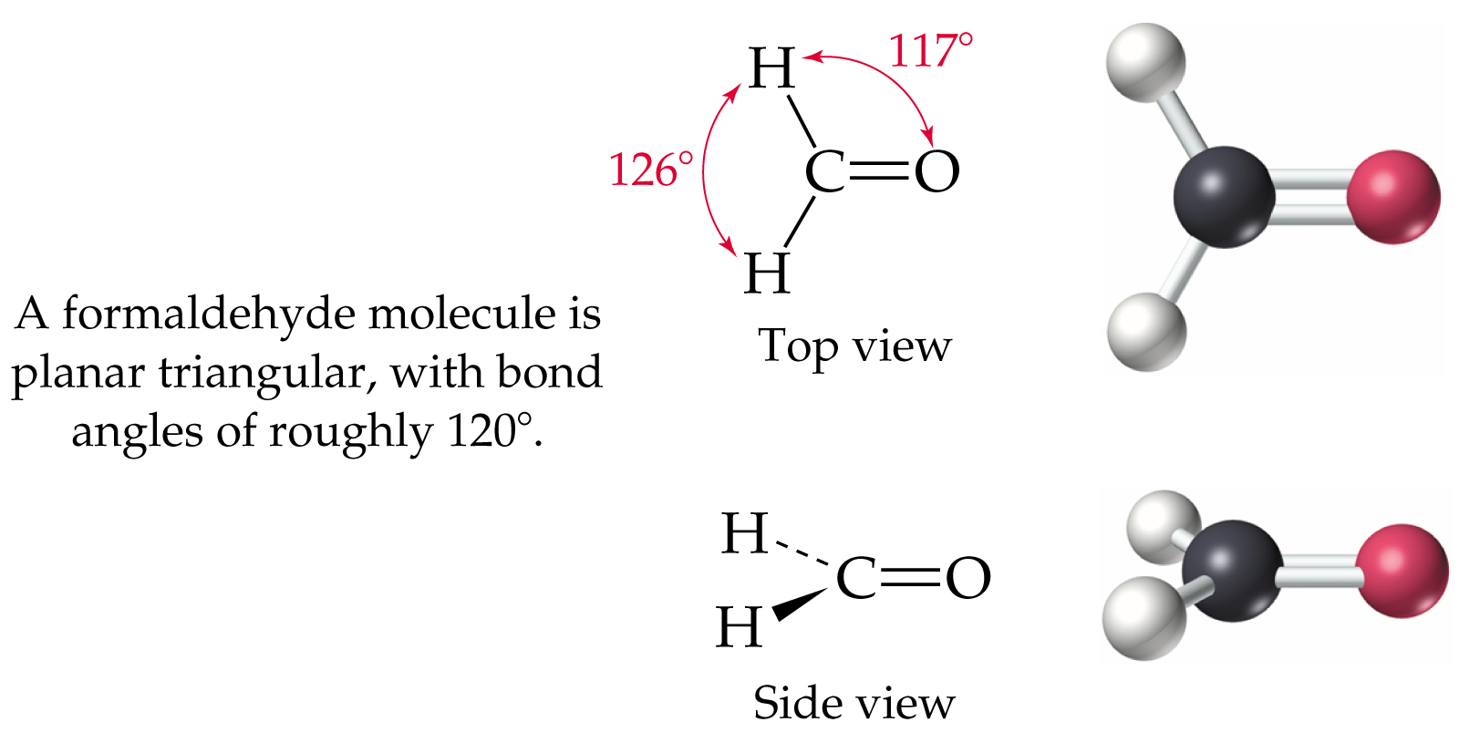
Vocabulary: Trigonal Planar shape
A flat triangular shape found in small molecules with three electron domains surrounding the central atom.

Slide 12
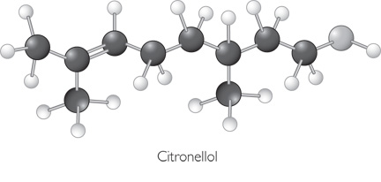
More atoms = More Shapes
The more atoms in a molecule, the more combinations of shapes you might see together.

Slide 13
How do electrons affect the shape of a molecule?
  Electron domains represent the space occupied by bonded electrons or a lone pair.
  Electron domains are located as far apart from one another as possible. This is referred to as electron domain theory.
  The three-dimensional shape of a molecule is determined by the valence electrons, both bonding electrons and lone pairs.

Slide 14
How can you predict the shape of a molecule?
  Drawing the Lewis dot structure of a molecule allows us to predict its three- dimensional shape.
  The presence of double or triple bonds changes the number of electron domains around an atom, which in turn affects the overall shape of the molecule.
  The shape of large molecules is determined by the smaller shapes around individual atoms.

