Slide 1
Lesson 32: Eight is Enough
Octet Rule

Slide 2
Entry Task
Draw the Lewis dot structure for the two covalently bonded molecules shown here. Explain how you arrived at your answer.
a. Cl₂ b. O₂

Slide 3
You will be able to:
Key Question
How do atoms bond to form molecules?
  apply the octet rule to predict bonding in molecules
  draw Lewis dot structures and structural formulas for molecules that contain double and triple bonds

Slide 4

Lesson 32 Vocabulary
Each atom in the molecule has an “octet” of valence electrons. Note that the hydrogen atoms do not follow the octet rule. They have a total of two electrons, similar to the noble gas helium, He.
Octet rule: Nonmetal atoms combine so that each atom has a total of eight valence electrons by sharing electrons.
After bonding, each chlorine atom has a total of eight valence electrons surrounding it.
Cl2
PCl3
H2S

Slide 5
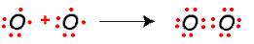

Lesson 32 Vocabulary
Double bond: A covalent bond in which two electron pairs (four electrons) are shared between two atoms.

Slide 6
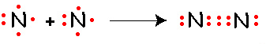
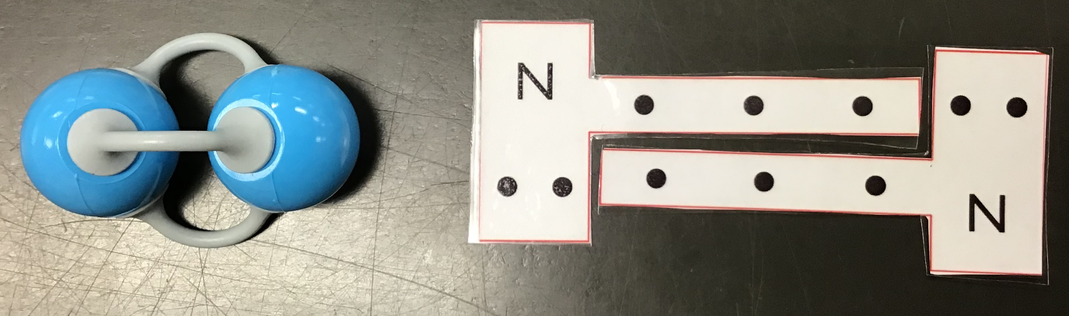
Lesson 32 Vocabulary
Triple bond: A covalent bond in which three electron pairs (six electrons) are shared between two atoms.

Slide 7
Discussion Notes
The HONC 1234 rule and the octet rule both help you figure out Lewis dot structures and structural formulas.
Both the HONC 1234 rule and the octet rule can be satisfied by using double and triple bonds appropriately.
It is not possible to create a triple-bonded oxygen compound, according to the HONC rule.
There are exceptions to the bonding rules laid out here.

Slide 8
Wrap Up
How do atoms bond to form molecules?
  Elements form covalent bonds by sharing electrons until each atom has eight valence electrons. This is called the octet rule. Hydrogen is an exception. It forms bonds such that it has two valence electrons.
  Atoms can form double and triple bonds to satisfy the octet rule.
  When covalent bonds form, each atom resembles a noble gas in its electron configuration.

Slide 9
Check-In
1. One of these compounds has multiple bonds in it. Which one is it? Explain.
C4H10 C4H6
2. Draw one possible structural formula for C₄H₆.

