Slide 1
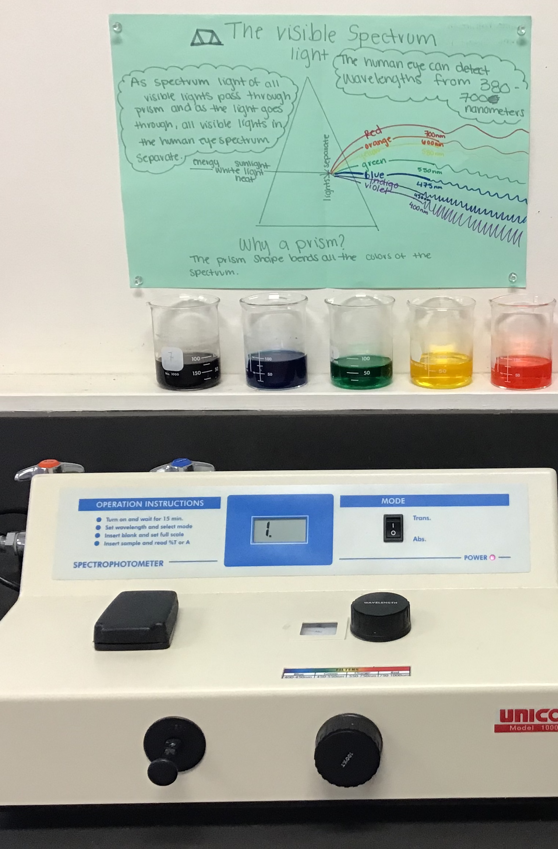
Spectrophotometry of Solutions Colored with Food Coloring

Slide 3
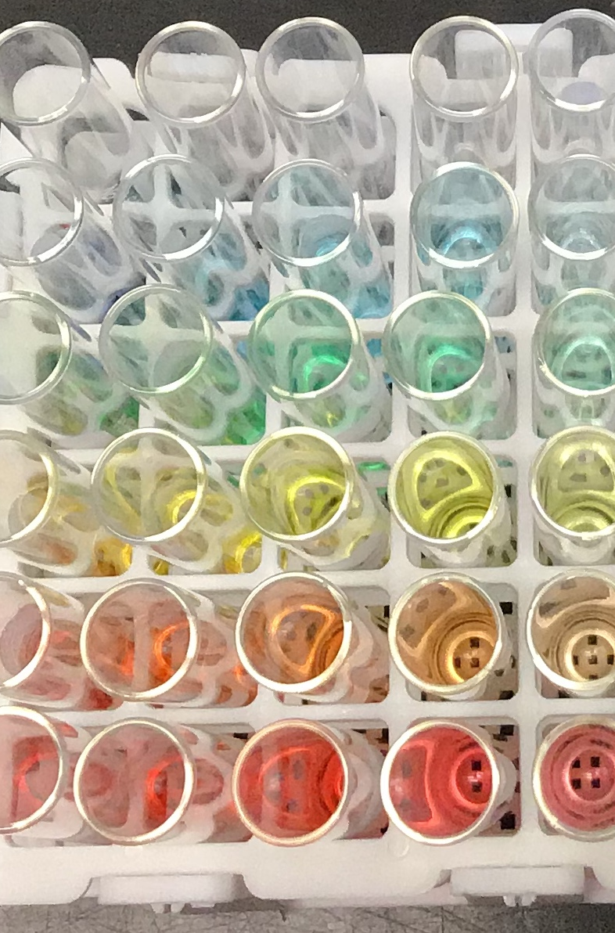
Food Coloring Solutions Dilution Series

Slide 4
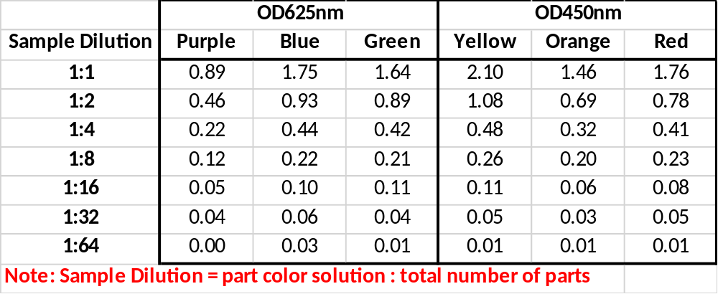
Absorbance Values of Diluted Color Samples

