Slide 1
Lesson 80: Bearly Alive
Solution Concentration

Slide 2
ChemCatalyst
Gummy bears have been placed overnight in two different aqueous solutions. One solution contains sugar in water. The other solution is just water.
Predict what will happen to the gummy bears after sitting overnight in the two solutions. Explain your thinking with a drawing.

Slide 3
Key Question
How can you keep track of compounds when they are in solution?

Slide 4
You will be able to:
  define the terms solution, solute, solvent, saturated solution, concentration, and molarity
  explain what the concentration and molarity of a solution represent
  complete calculations involving molarity

Slide 5
Important Vocabulary
Solution: A mixture of two substances that is uniform throughout.
Solute: The substance dissolved in a solution.
Solvent: The substance in which the solute dissolves in a solution.

Slide 6
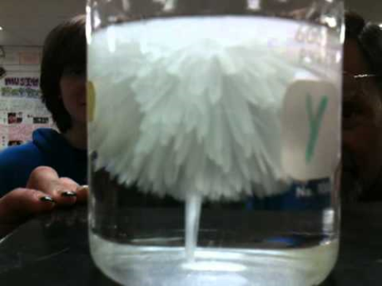
Important Vocabulary
A solution is saturated when no more solute will dissolve.
Saturated solution: A solution that contains the maximum amount of solute for a given amount of solvent.

Slide 7
Important Vocabulary
Concentration refers to the amount of solute that is dissolved in a solution.
Molarity (M) =
Concentration: A measure of the amount of solute dissolved in a specified volume of solution.
Molarity: The concentration of a solution expressed in moles of solute per liter of solution.
n (moles)
V (liters of solution)

Slide 8
Discussion Notes (cont.)
The gummy bears changed size depending on the concentration of the solution they were soaked in.
Molecules move from areas of higher concentration to areas of lower concentration.

Slide 9
Wrap Up
How can you keep track of compounds when they are in solution?
  When two or more substances mix together uniformly at a molecular, ionic, or atomic level, they form a solution.
  The concentration of a solution can be expressed in moles per liter. This is also called the molarity of the solution, or M.
  The concentration of a solution can also be expressed in moles per kilogram.
  This is called the molarity of the solution, or m.

Slide 10
Check-In
Suppose 10.0 g of salt, NaCl, are dissolved in 0.50 L of water. What is the molarity of this solution?

