Slide 1
Lesson 27: Electrons on the Move
Electroplating Metals

Slide 2
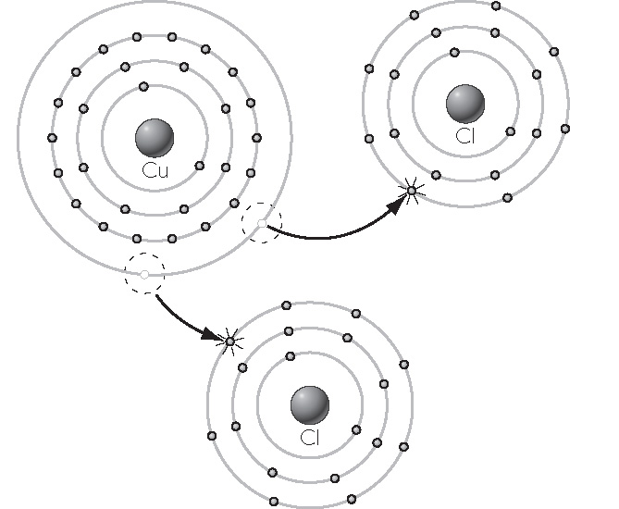
ChemCatalyst
1. What is the charge on the copper ions in this copper chloride compound?
2. How do you think we could get solid copper from a sample of copper (II) sulfate, CuSO₄?
Copper and chlorine atoms combine to form copper (II) chloride.

Slide 3
Key Question
How can you extract an element from a compound?

Slide 4
You will be able to:
assemble an electroplating apparatus
explain how to extract elemental metal from an ionic compound through electroplating
Electroplating: The process by which a material is coated with a thin layer of metal using electricity passed through a suitable ionic solution.

Slide 5
Discussion Notes
It is possible to transform metal cations in solution into neutral metal atoms, using electricity.

Slide 6
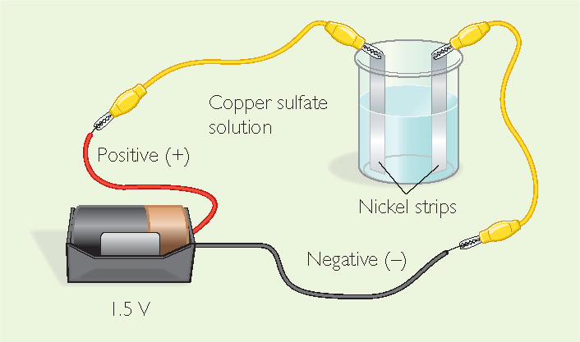
Prepare for the Lab
Work in table groups of 4 students. Wear safety goggles and aprons at all times.
The solution contains acid, which is corrosive. Before handling the nickel strip, rinse it with water.

Slide 7
The Copper-Plating Solution
Use the information below to calculate how much of each reagent your group will have in 200 mL:
Reagent | Stock Solution | Amount in 200 mL
CuSO₄ | 100 g
0.2M HCl | 7 mL
18M H₂SO₄ | 10 mL
H₂O | 1.5 L final volume

Slide 8
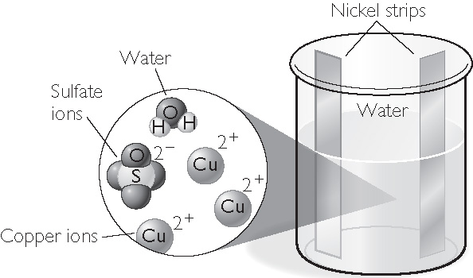
Discussion Notes (cont.)
Aqueous copper (II) sulfate, CuSO₄(aq), is really copper cations, Cu²⁺, and sulfate anions, SO₄^{2–}.
Before connecting to the battery

Slide 9
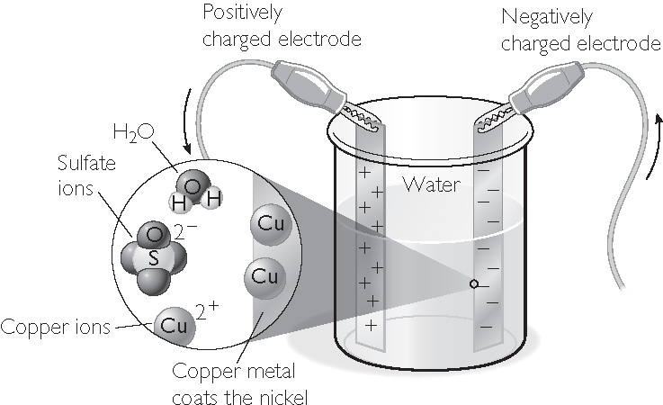
Discussion Notes (cont.)
Once the battery is hooked up, one nickel strip has a positive charge, and the other has a negative charge.
After connecting to the battery

Slide 10
Discussion Notes (cont.)
Many elements are found in nature only in combination with other atoms in compounds.
While you cannot make gold by moving electrons, you can plate thin layers of gold onto jewelry.

Slide 11
Wrap Up
How can you extract an element from a compound?
  Atoms are not destroyed when they combine to form compounds. Matter is conserved.
  Ions are simply atoms or groups of atoms with charges on them because they either are missing electrons or have extra electrons.
  Elements can be extracted from ionic compounds by moving electrons between atoms.

Slide 12
Check-In
What is required to transform CuCl₂(aq) into Cu(s)?
What is required to transform CuCl₂(aq) into Au(s)?

