Slide 1
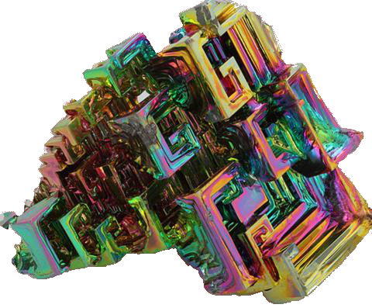
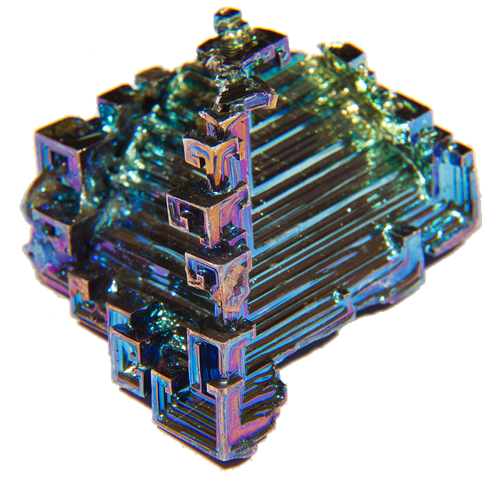
Bismuth

Slide 2
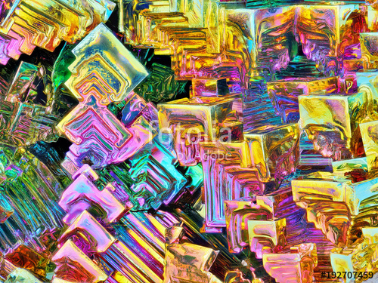
Origins of its Name
The element bismuth gets its name from two conjointed words, one of them from the german word “wissmuth” which means white mass. The second word “bisemutum” come from the latin language.

Slide 3
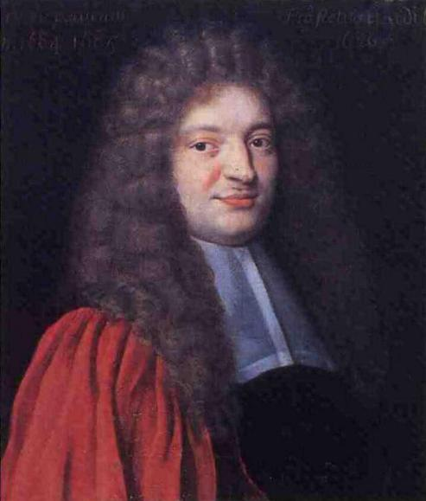
Where was it found, and who discovered it?
Bismuth was discovered by Claude Francois Geoffroy in the 15th century 1753

Slide 4
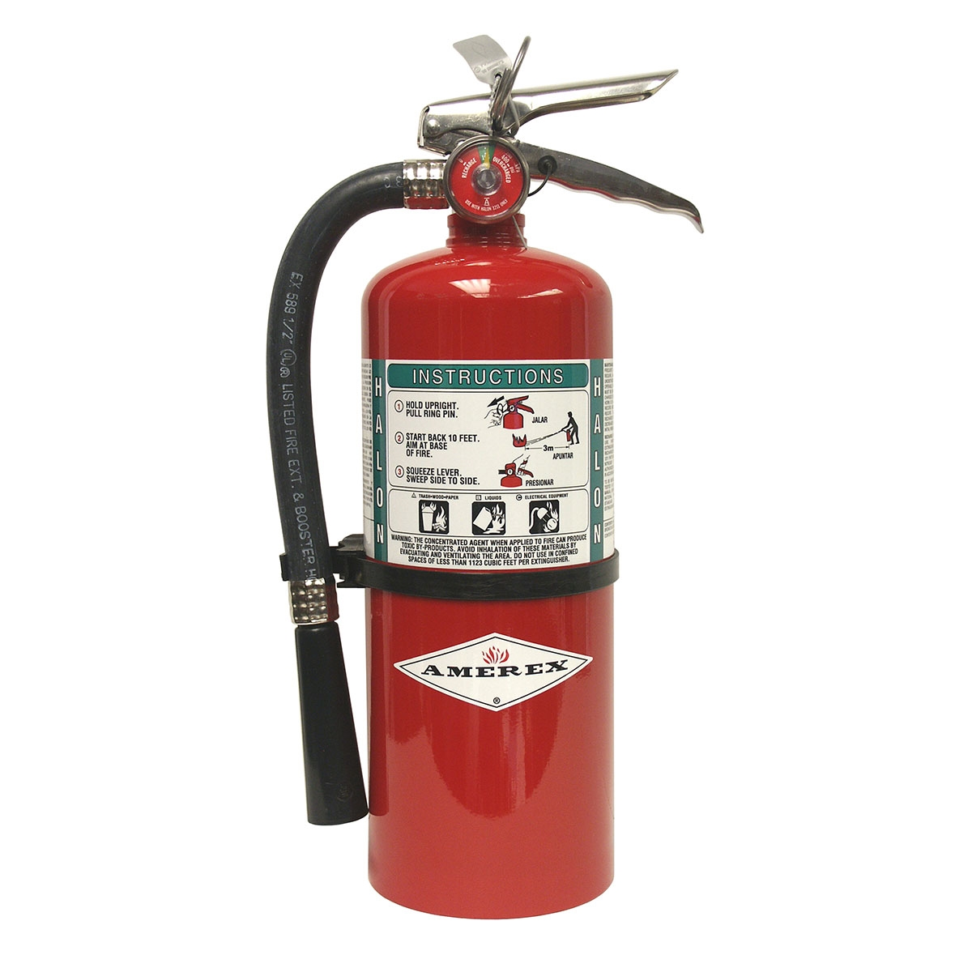
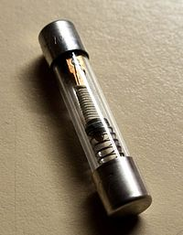
Uses for Bismuth
Bismuth is brittle so its usually combined with other metals to be able to create something. It can be found in common objects such as fire detectors, extinguishers, electrical fuses, and solders.

Slide 5
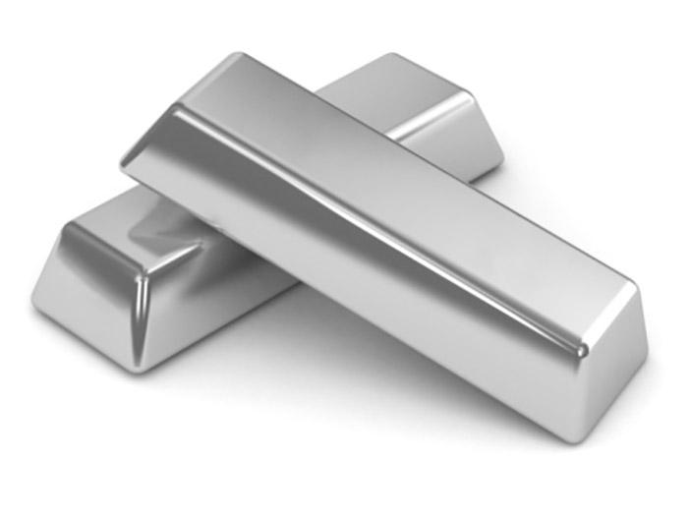
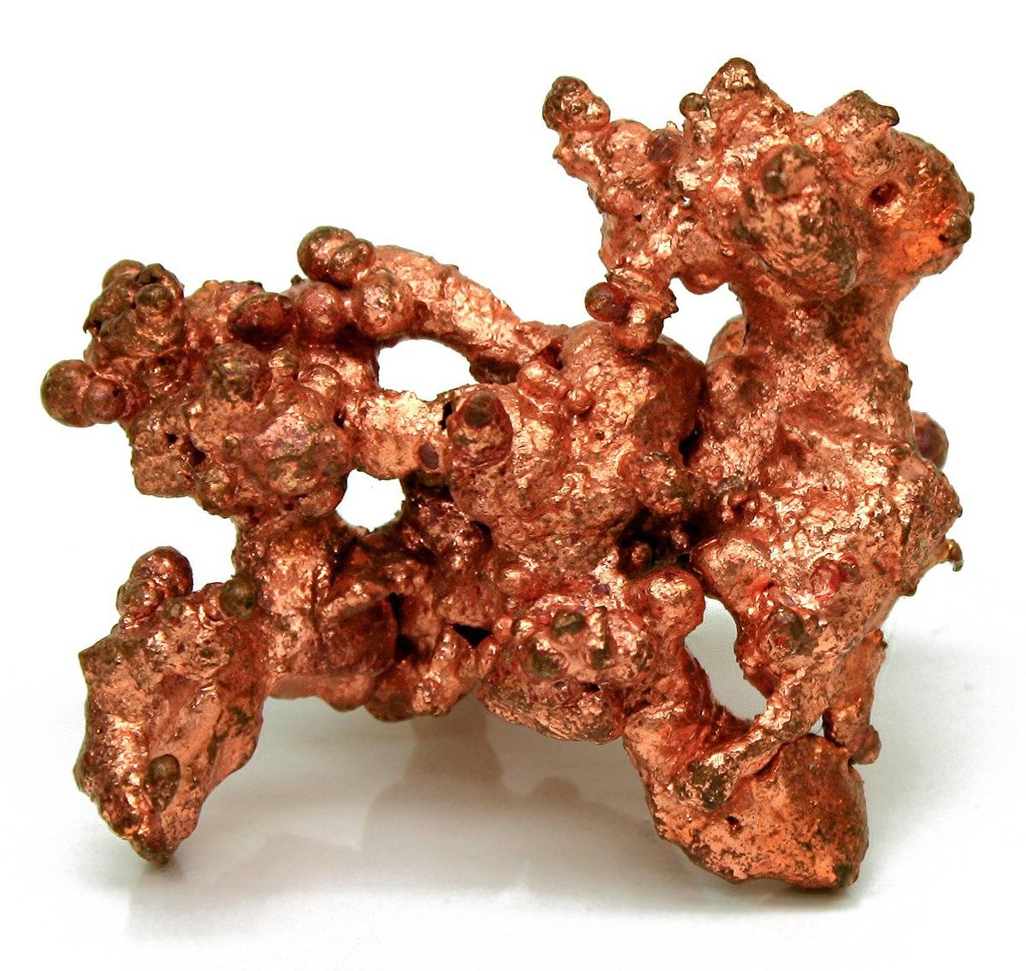
How is Bismuth Obtained?
Bismuth is obtained through small quantities found on the earth’s crust, Its also found through the refining of Lead, copper, tin, silver, and gold ores

Slide 6
Sources
Bismuth - Element information, properties and uses | Periodic Tablewww.rsc.org/periodic-table/element/83/bismuth
https://www.chemicool.com/elements/bismuth.html
https://education.jlab.org/itselemental/ele083.html
Facts About Bismuth - Live Sciencehttps://www.livescience.com/39451-bismuth.html

