Slide 1
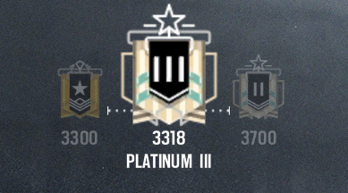

Element
Profile

Slide 2
Platinum
Atomic Number: 78
Symbol: Pt
Atomic Mass: 195.084
Platinum is a Dense, Malleable, Highly Unreactive, Precious, Silverish - White Transition Metal.

Slide 3
How My Element Got Its Name
Platinum got its name from the spanish Term “Platino”, Meaning “Little Silver”
How, where, and whom my element was discovered by
Platinum was discovered by a South American Named Antonio De Vlloa in 1735 who made artifacts out of a White Gold-Platinum Alloy.

Slide 4
Uses With Platinum
Platinum is Widely used as a catalyst for chemical reactions. The most important use of of platinum is in Vehicles as a catalytic Converter, Facilitating the complete combustion of unburned hydrocarbon passing through the exhaust. Platinum is also used in Jewelry, Decoration and dental work.

Slide 5
How is Platinum Mined?
miners usually extract the metal from sperrylite and cooperite, two platinum-containing ores, Extracting platinum from ore is both capital and labor intensive.

