Slide 1
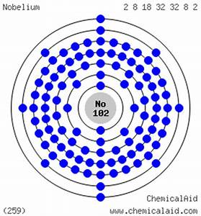
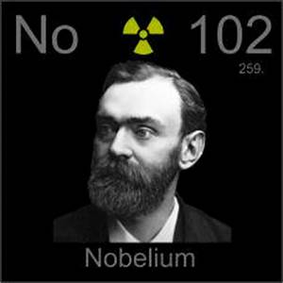
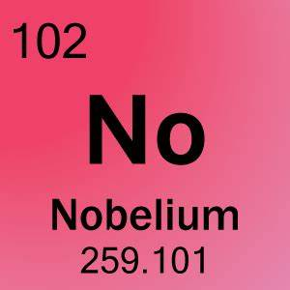

NOBELIUM

Slide 2
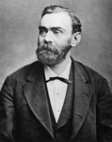
Nobelium was discovered by Georgy Flerov and colleagues and at Dubna, near Moscow, Russia, and independently by Albert Ghiorso and colleagues at Berkeley, California, USA
Nobelium was named after Alfred Nobel, the inventor of dynamite.

Slide 3
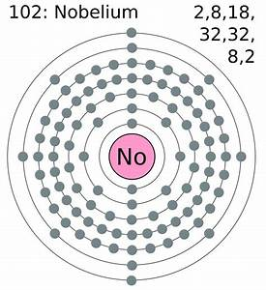
Symbol: No
Atomic number: 102
Atomic mass: 259

Slide 4
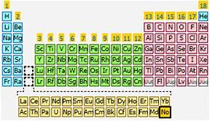
Since only tiny amounts of nobelium have ever been produced, there are currently no uses for it outside of basic scientific research.
The reactions of nobelium are largely unknown because only small amounts have ever been produced.
Nobelium is radioactive and artificially produced.
Nobelium is labeled as a metal, and is solid at room temp.

Slide 5
https://education.jlab.org/itselemental/ele102.html
https://www.webelements.com/nobelium/chemistry.html
https://pubchem.ncbi.nlm.nih.gov/compound/nobelium#section=Top
http://www.softschools.com/facts/periodic_table/nobelium_facts/710/

