Slide 1
Mini-Quiz Prep
Provide the following information for element number 15. For each answer, explain to your partner how you know.
a. The element’s name, symbol, and group number.
b. The number of protons in the nucleus.
c. The number of neutrons in the nucleus.
d. The number of electrons in a neutral atom of the element.
e. The number of electrons that are valence electrons in a neutral atom.
f. The number of electrons that are core electrons in a neutral atom.
g. The names of three other elements with the same number of valence electrons.

Slide 2
Mini-Quiz Prep
For element 15, draw electron shell models of the neutral atom (left) and the ion (right) and write the number of protons, neutrons, and electrons of each. Assume atomic mass = 31.
Protons = Neutrons = Electrons = Neutral atom of element 15 | Protons = Neutrons = Electrons = Ion of element 15

Slide 3
Lesson 20: Getting Connected
Ionic Compounds

Slide 4
ChemCatalyst
Metal elements combine with the nonmetal element chlorine, Cl, to form compounds. The formulas are given in the tables.
Compare the three tables. What do you notice?
Predict the formula of a compound formed between lithium, Li, and chlorine, Cl. Which table would you put it in?
Element | Compound
Na | NaCl
K | KCl
Element | Compound
Mg | MgCl₂
Ca | CaCl₂
Element | Compound
Ne | none
Ar | none

Slide 5
Key Question
How can valence electrons be used to predict chemical formulas?

Slide 6
You will be able to:
predict the chemical formulas of compounds that will form between metal and nonmetal atoms
explain how an ionic compound forms and determine whether it follows the rule of zero charge

Slide 7
Vocabulary!
Ionic compound: An ionic compound is a compound composed of positive and negative ions, formed when metal and nonmetal atoms combine.

Slide 8
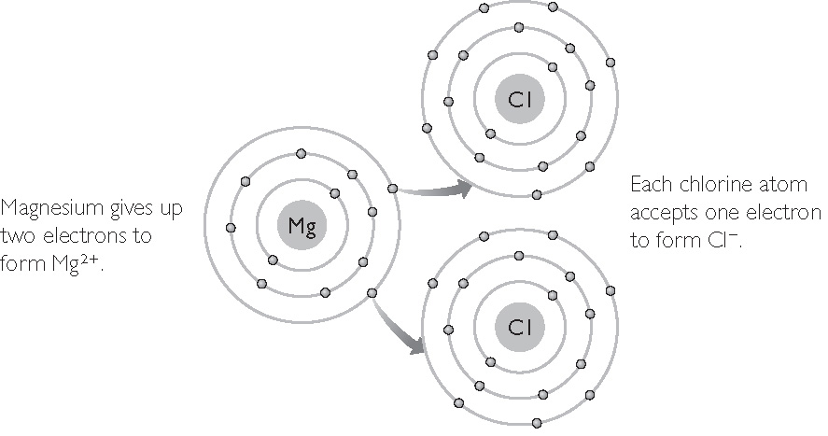
Discussion Notes
  Mg²⁺ + Cl– + Cl– produces MgCl₂ with zero charge.

Slide 9
Discussion Notes (cont.)
Metal and nonmetal elements combine to form ionic compounds.
The electron arrangements of the cations and anions resemble the arrangements of a noble gas atom.

Slide 10
More Vocabulary!
The rule of zero change can be used to determine the chemical formulas of ionic compounds.
Rule of zero charge: In an ionic compound, the positive charges on the metal cations and the negative charges on the nonmetal anions sum to 0.

Slide 11
Discussion Notes (cont.)
Chemical Formulas of Ionic Compounds
Example | Number of valence electrons for the metal | Number of valence electrons for the nonmetal | Total number of valence electrons | Total positive charge | Total negative charge | Total charge
NaF | 1 | 7 | 8 | +1 | –1 | 0
MgO | 2 | 6 | 8 | +2 | –2 | 0
AlN | 3 | 5 | 8 | +3 | –3 | 0
K₂Se | 1 | 6 | 8 | 2(+1) | –2 | 0
MgCl₂ | 2 | 7 | 16 | +2 | 2(–1) | 0
AlF₂ | 3 | 7 | 24 | +3 | 3(–1) | 0
AL₂O₂ | 3 | 6 | 24 | 2(+3) | 3(–2) | 0

Slide 12
Discussion Notes (cont.)
The number of electrons associated with the atoms of an ionic compound generally totals 8 or a multiple of 8.

Slide 13
Wrap Up
How can valence electrons be used to predict chemical formulas?
  Metal atoms and nonmetal atoms combine to form ionic compounds.
  In ionic compounds, the metal is considered a cation, and the nonmetal is considered an anion.
  The charges on the cations and the anions in ionic compounds sum to 0.
  Metal atoms and nonmetal atoms usually combine in ratios that result in a total of eight valence electrons or a multiple of eight valence electrons.

Slide 14
Check-In
What elements will combine with strontium, Sr, in a 1:1 ratio? Explain your thinking.

