Slide 1
Lesson 17: Technicolor Atoms
Flame Tests

Slide 2
Discussion Notes
The metal element in each chemical formula appears to be responsible for the flame colors.
Only certain elements produce colorful flames.
Flame test: A test used in the laboratory to look for the presence of certain metal atoms. A sample of a compound is heated in a flame, and the resulting color is noted.

Slide 3
Discussion Notes (cont.)
Elements and compounds are collections of atoms.
The only way to change one atom into another is to change the nucleus through a nuclear reaction.

Slide 4
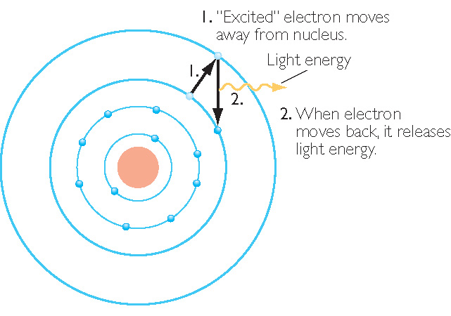
Discussion Notes (cont.)
Sodium Atom, Na

Slide 5
Discussion Notes (cont.)
The illustration indicates that the flame colors are associated with movements of the electrons within the sodium atom.
Bohr’s model of the atom came directly from evidence similar to that produced in class today.

Slide 6
Wrap Up
What evidence is there that certain atoms are present in a compound?
  Many metal atoms produce a characteristic colored flame when compounds containing those atoms are heated in a flame.
  Flame tests are evidence that elements and compounds are collections of atoms.

Slide 7
Check-In
Given: Each compound consists of a metal and non-metal.
Copper chloride (CuCl₂) burns blue-green
Sodium chloride (NaCl) burns bright orange
Strontium chloride (SrCl₂) burns red
Potassium chloride (KCl) burns pink lilac
Find:
What part of each compound above is responsible for producing the change in flame color?
Predict what color a solution containing a mixture of CuCl₂ and SrCl₂ will burn in a flame test. Support your explanation with scientific thinking!

Slide 8
Flame Test Analysis Qs
OK to skip analysis questions 1-4 if data table 1 is complete and correct
Complete Qs 5-7, make sure your name is on the packet, and turn it in now.

