Slide 1
Lesson 13: Subatomic Heavyweights
Isotopes

Slide 2
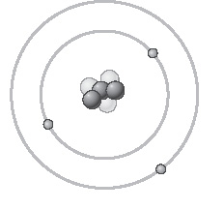
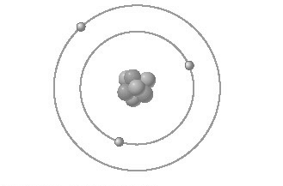
ChemCatalyst (cont.)
A chemist investigating a sample of lithium found that some lithium atoms have a lower mass than other lithium atoms.
What is different about the two atoms?
What is the atomic number of each atom?
What is the atomic mass of each atom?

Slide 3
Key Question
How can atoms of the same element be different?

Slide 4
You will be able to:
define isotope and write and interpret the symbol for a specific isotope
determine the average atomic mass of an element based on the natural abundance of isotopes of that element
predict the number of protons, neutrons, and electrons in the most abundant isotope of an atom, based on average atomic mass

Slide 5
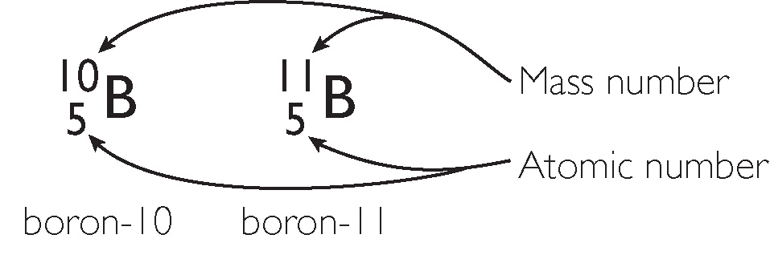
Discussion Notes
Atoms of the same element that have different numbers of neutrons are called isotopes.
Atomic number = # of protons
Mass number = # of protons + # of neutrons
Symbols Associated with Isotopes

Slide 6
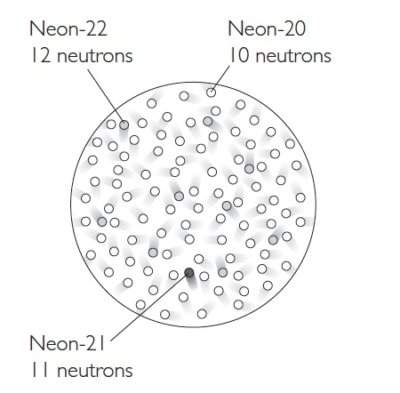
Discussion Notes (cont.)
All Neon atom have 10 protons. By definition, an atom with 10 protons is named Neon. The number of protons defines the identity of the atom.

Slide 7
Discussion Notes
The percentage of each isotope of an element that occurs in nature is called the natural percent abundance of the isotope.
Example: A sample of Lithium is found to consist of 7.6% Lithium-6 (3 protons + 3 neutrons) and 92.4% Lithium-7 (3 protons + 4 neutrons).
To determine the average atomic mass of lithium:
Convert the percentages to decimal form (%/100), then:
(6 x 0.076) + (7 x 0.924) = 0.456 + 6.468 = 6.924 amu

Slide 8
Discussion Notes (cont.)
The average atomic mass of an element is the weighted average of the masses of the isotopes in a sample of the element.
The most common isotope of an element, frequently has a mass that is close to the average atomic mass given in the periodic table.

Slide 9
Prepare for the Activity
Work in pairs.

Slide 10
Wrap Up
How can atoms of the same element be different?
Isotopes of an element have the same number of protons and electrons but different numbers of neutrons.
The average atomic mass of an element listed in the periodic table is the weighted average mass of the naturally occurring isotopes of that element.
Isotopes are referred to by their mass numbers, as in carbon-12.

Slide 11
Check-In
Nitrogen has two naturally occurring isotopes. Predict the number of neutrons in the two isotopes of nitrogen, N.
Which isotope do you predict to be more abundant? How do you know?

