Slide 1
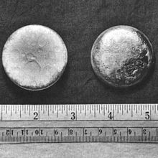
Plutonium

Slide 2
About the element
The element is called Plutonium
Pu with the atomic number 94
This element is an actinide metal of silvery-gray appearance that tarnishes when exposed to air, and forms a dull coating when oxidized.

Slide 3
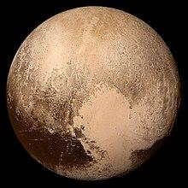
History
Discovered by Enrico Fermi and a team of scientists at the University of Rome reported that they had discovered element 94 in 1934.
The chemistry of plutonium was found to resemble uranium
Can be found
In nature and in uranium ores
The dwarf planet “pluto” which plutonium was named after.

Slide 4
More facts
Some uses of this element are : heat usage
Plutonium-238( radioactive isotope of plutonium) has also been used successfully to power artificial heart pacemakers, to reduce the risk of repeated surgery.
Some facts - the element is very toxicity due to its radiation and heavy metal poison effects

Slide 5

The nuclear properties of plutonium-239 were studied; researchers found that when it is hit by a neutron it breaks apart (fissions) by releasing more neutrons and energy.
In the picture is Glenn T. Seaborg >>>
Plutonium (specifically, plutonium-238) was first produced and isolated on December 14 of 1940, and chemically identified on February 23, 1941, by said chemist.

