Slide 1
| Fluorine |

Slide 2
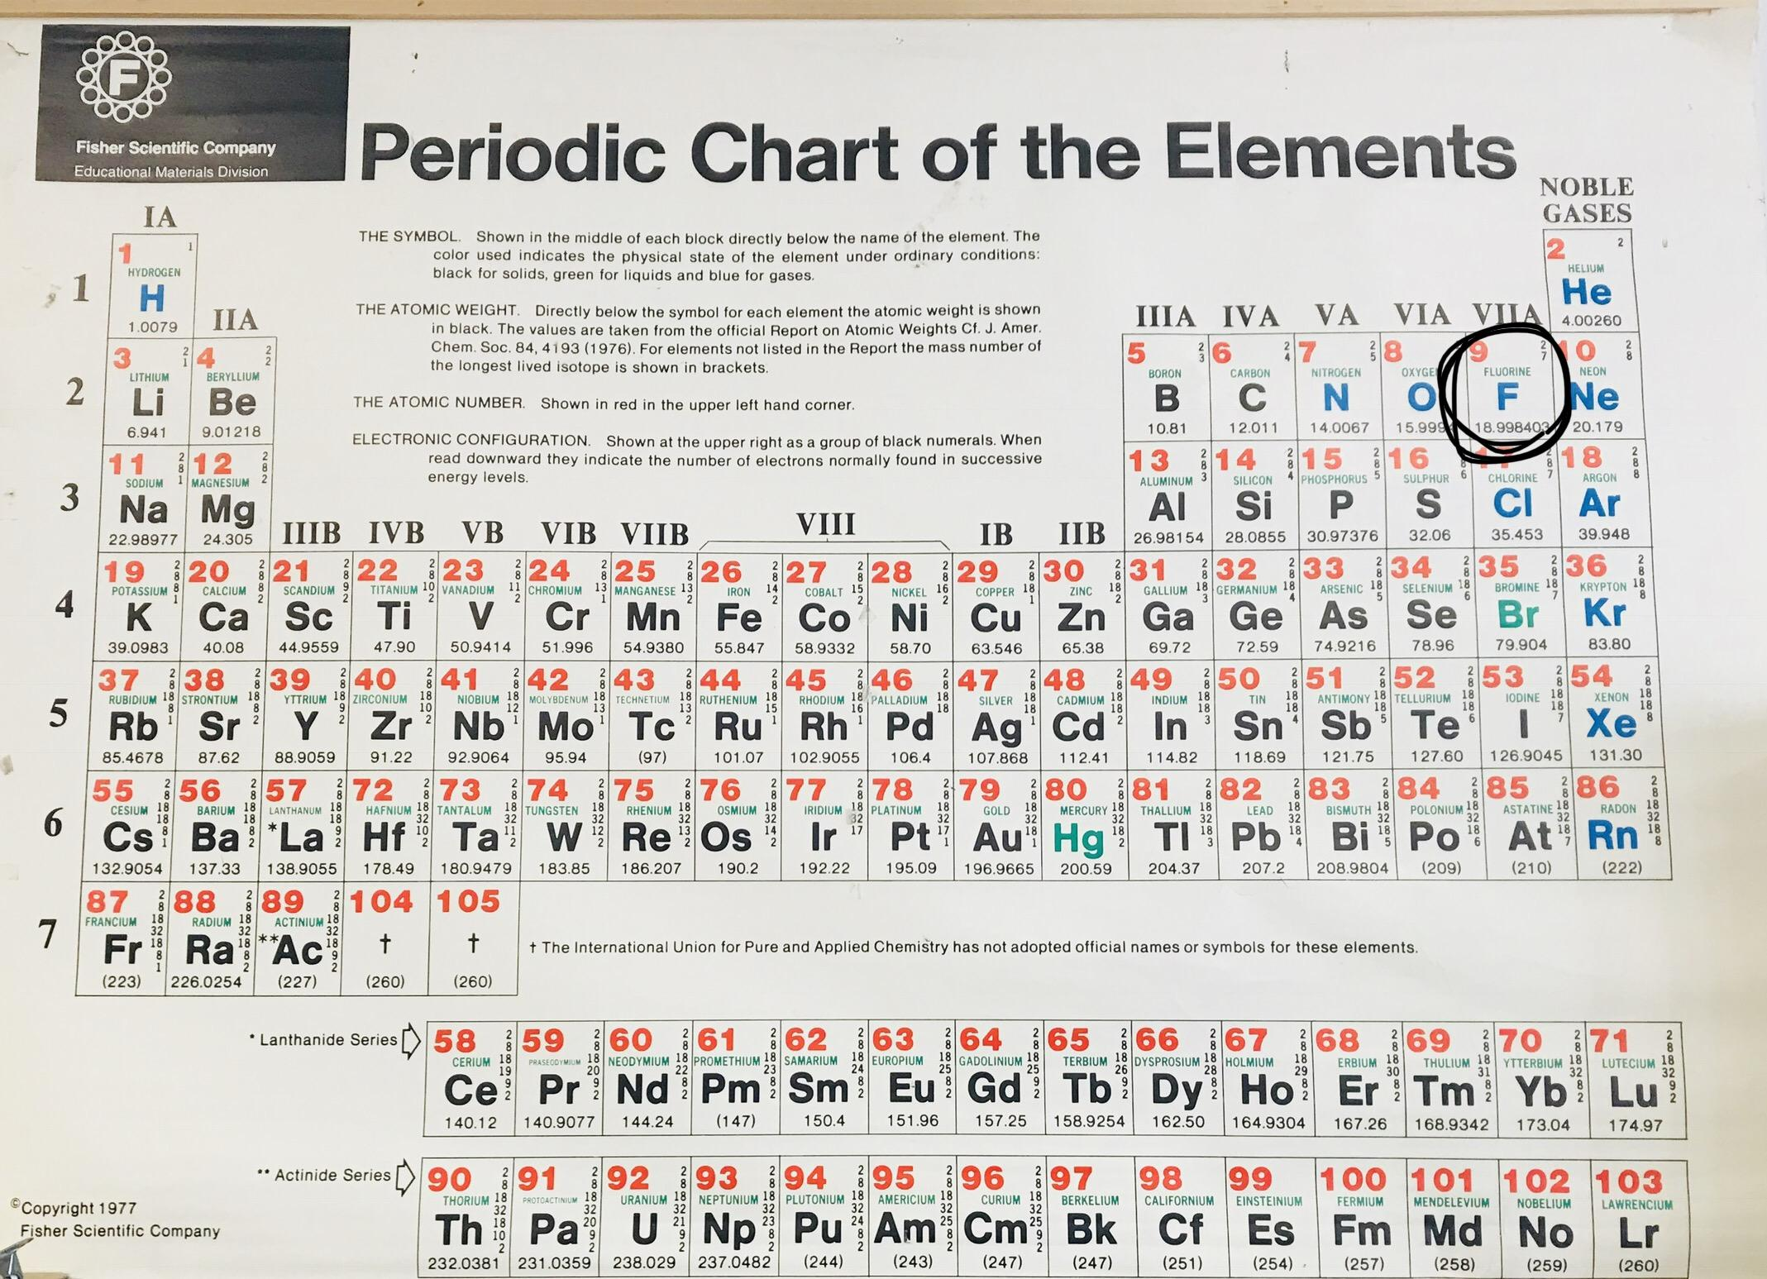
Fluorine Info Card
Name : Fluorine
Symbol : F
Periodic Table : #9
Atomic Mass : 18.998403
Found where : Coal, Clay, Rocks
Found by : Henri Moissan
Found when : 1886
Used In : Toothpaste, Rocket Fuel, Refrigerator Fluids, Etched Glass, Uranium Purification

Slide 3
Citations
Class Periodic Table
https://www.chemicool.com/elements/fluorine.html - Fluorine Element Facts
http://www.chem4kids.com/files/elements/009_speak.html - Fluorine

