Slide 1
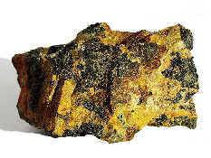
Actinium
Element symbol: Ac
Element number: 89
Actinium can glow in the dark and it’s radioactive
It’s extremely rare

Slide 2
Why Was It Named Actinium?
The name “Actinium” was originated from a greek word aktis or aktinos which means beam or ray.

Slide 3
Who And Where Was Actinium Was Founded?
Andre-louis debierne founded Actinium in the year of 1899.
Actinium is naturally found in uranium.

Slide 4
What are the uses?
It can be used as a medicine to produce Bi-213 in a reusable generator.
It can be used as radiotherapy.
Since this element is rare people are still researching it.
A radiation source.

Slide 5
How is it mined or obtained?
Actinium is produced by the radioactive decay or breakdown from uranium or other unstable elements

Slide 6
Citations
https://www.lenntech.com/periodic/elements/ac.htm
http://www.rsc.org/periodic-table/element/89/actinium
http://www.chemistryexplained.com/elements/A-C/Actinium.html

