Slide 1
Element Profile:
Mercury

Slide 2
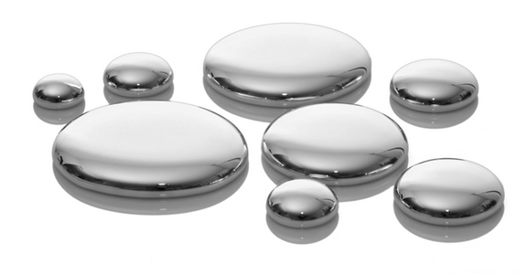
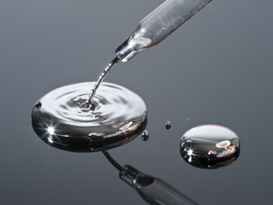
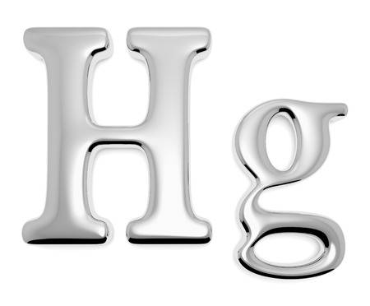
Mercury: Hg
Mercury’s elemental symbol comes from it’s greek name hydrargyrum, which means "liquid silver" to reflect its shiny surface.
The element’s name comes from the fastest moving planet, Mercury, known for its mobility.

Slide 3
Discovery & Uses
Discovery:
Mercury or quicksilver has been known since ancient times. Mercury was known to the ancient Chinese, Egyptians and Hindus and has been found in Egyptian tombs dating back to about 1500 B.C. There is no information about who discovered it.
Usage:
Mercury is a toxic element to humans so its usage has been declining in recent years. However, it is still used in various lab instruments, alarm clocks, thermostats, and more recently, new compact fluorescent light bulbs.

Slide 4
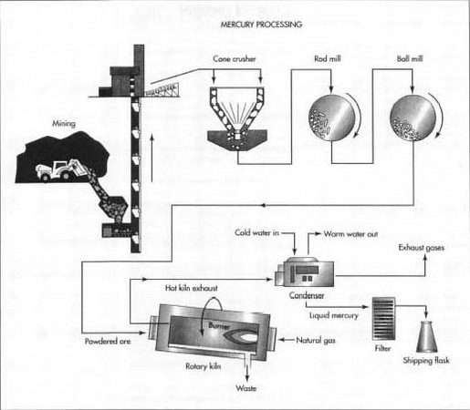
Extraction
Mercury is typically found as an ore of mercury sulfite and is rarely be found on its own. To extract pure mercury, the ore is ground up and heated to the temperature of about 1,076℉ with oxygen present in the process.
The metal is condensed and washed with nitric acid to purify it, and then distilled.

Slide 5
Works Cited
Blaszczak-Boxe, Agata. “Facts About Mercury (Hg).”
LiveScience, Purch, 18 Dec. 2014, www.livescience.com/39232-facts-about-mercury.html.

