Slide 1
GOLD

Slide 2
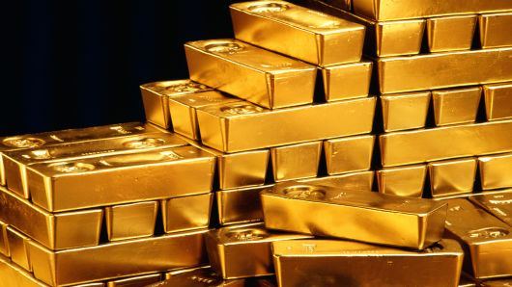
Symbol: Au
In its purest form, it is a bright, slightly reddish yellow, dense, soft, malleable, and ductile metal. Chemically, gold is a transition metal and a group 11 element.

Slide 3
Why “ gold”?
Gold gets its name from the Anglo-Saxon word "geolo" for yellow. The symbol Au comes from the Latin word for gold, "aurum."

Slide 4
Discovery
James W. Marshall on January 24, 1848, who saw something shiny in Sutter Creek near Coloma, California. He had discovered gold unexpectedly while overseeing construction of a sawmill on the American River.

Slide 5
Use of Gold
Jewelry
Coinage
Backing
Bullion
Electronics
Dentistry
Medical
Aerospace
Awards
Structures

Slide 6
How is it obtained ?
Mining is the way gold is retrieved by metal detecting, panning, cradling, sluicing and dredging. Using gravity and water to separate the dense gold from the other materials that surround it, this is the most common gold mining category for amateur gold hunters.

Slide 7
Resources
https://en.m.wikipedia.org/wiki/Gold
https://www.ducksters.com/science/chemistry/gold.php
http://www.americaslibrary.gov/jb/reform/jb_reform_fortyniners_1.html
https://geology.com/minerals/gold/uses-of-gold.shtml
https://www.gold-traders.co.uk/gold-information/how-is-gold-mined.asp

