Slide 1
Iridium

Slide 2
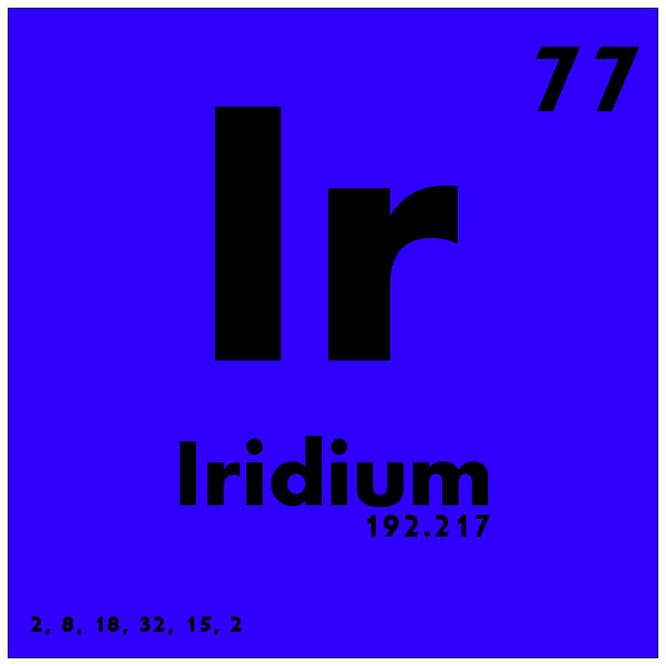
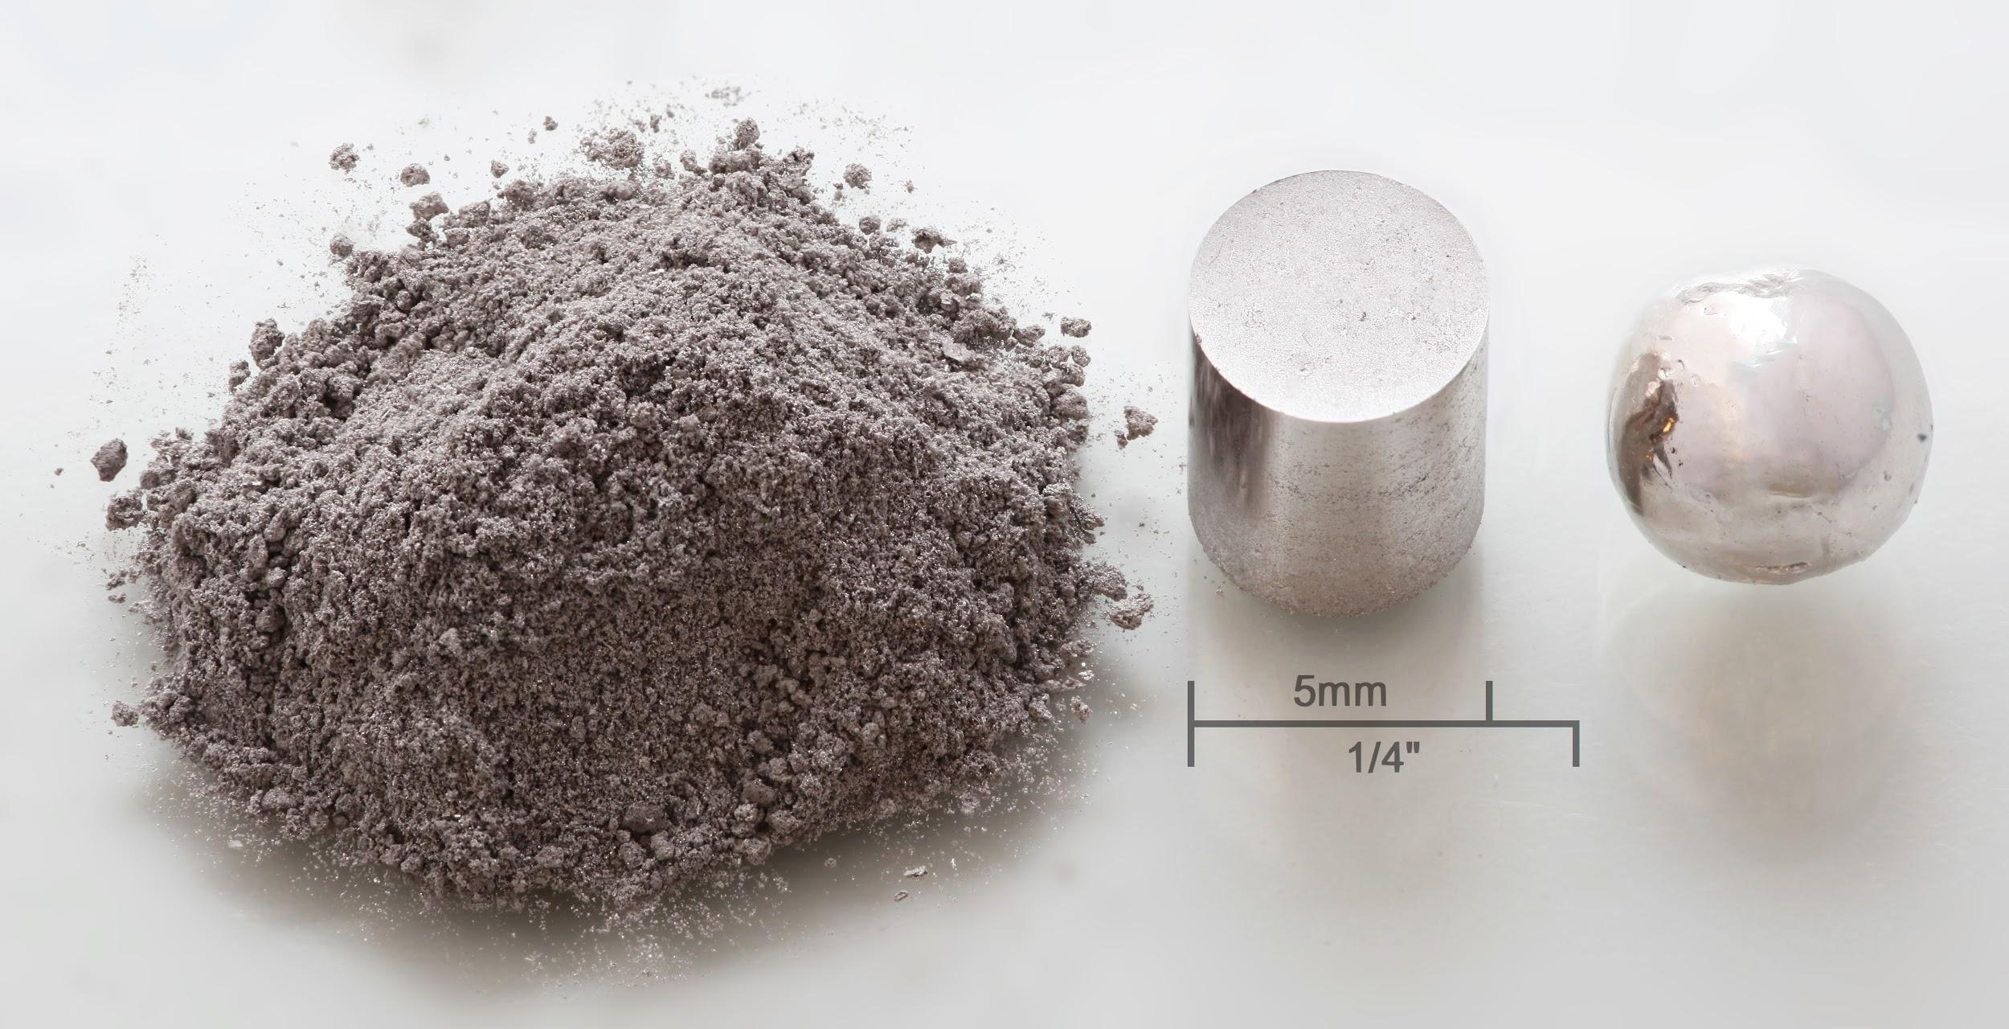
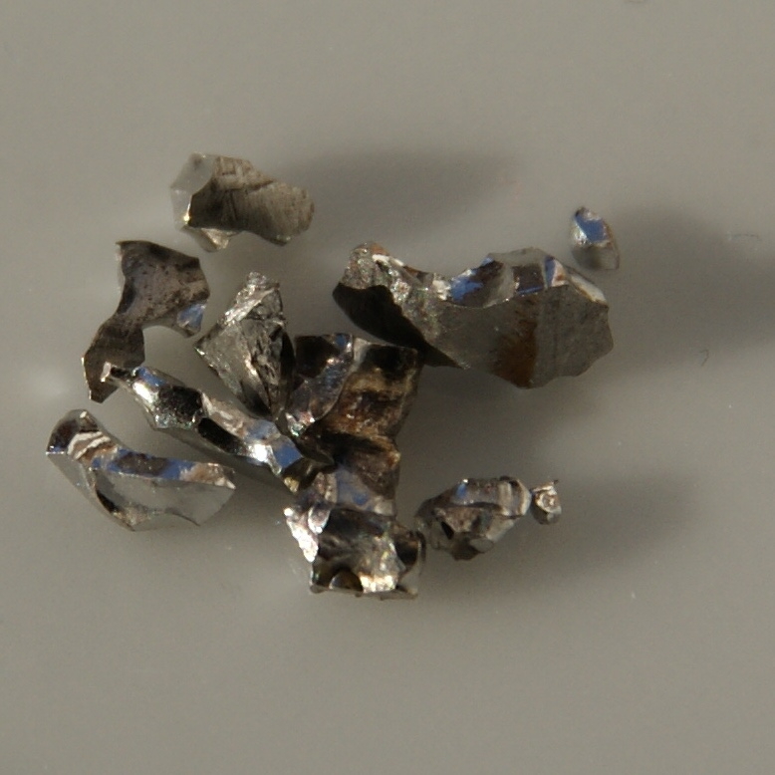
Iridium is number 77 on the periodic table
Transition metal
Hard, dense, brittle, silver, shiny
Melting point is 4,471°F (2,466°C)

Slide 3
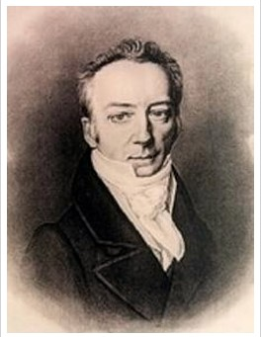
The discovery
1803
English Chemist, Smithson Tennant
London
Found in residue when he dissolved crude platinum in aqua regia
  Aqua regia is a mixture of both hydrochloric and nitric acids
Tennant also discovered osmium at the same time

Slide 4

The name
The word ‘Iridium’ comes from the latin word ‘iris,’ which translates to rainbow. This name was assigned to because of its highly coloured salts

Slide 5
Uses
hardening agent for platinum alloys
With osmium, it forms an alloy that’s used for tipping pens and compass bearings
make heavy-duty electrical contacts
Radioactive isotopes of iridium are used in radiation therapy for cancer treatment

Slide 6
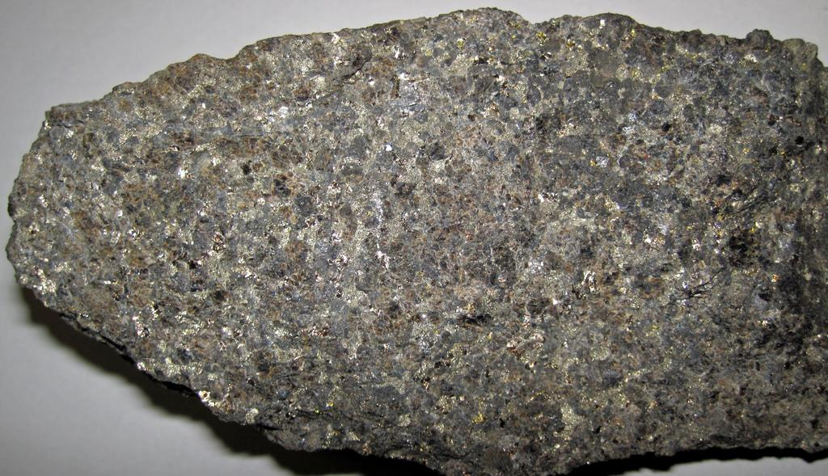
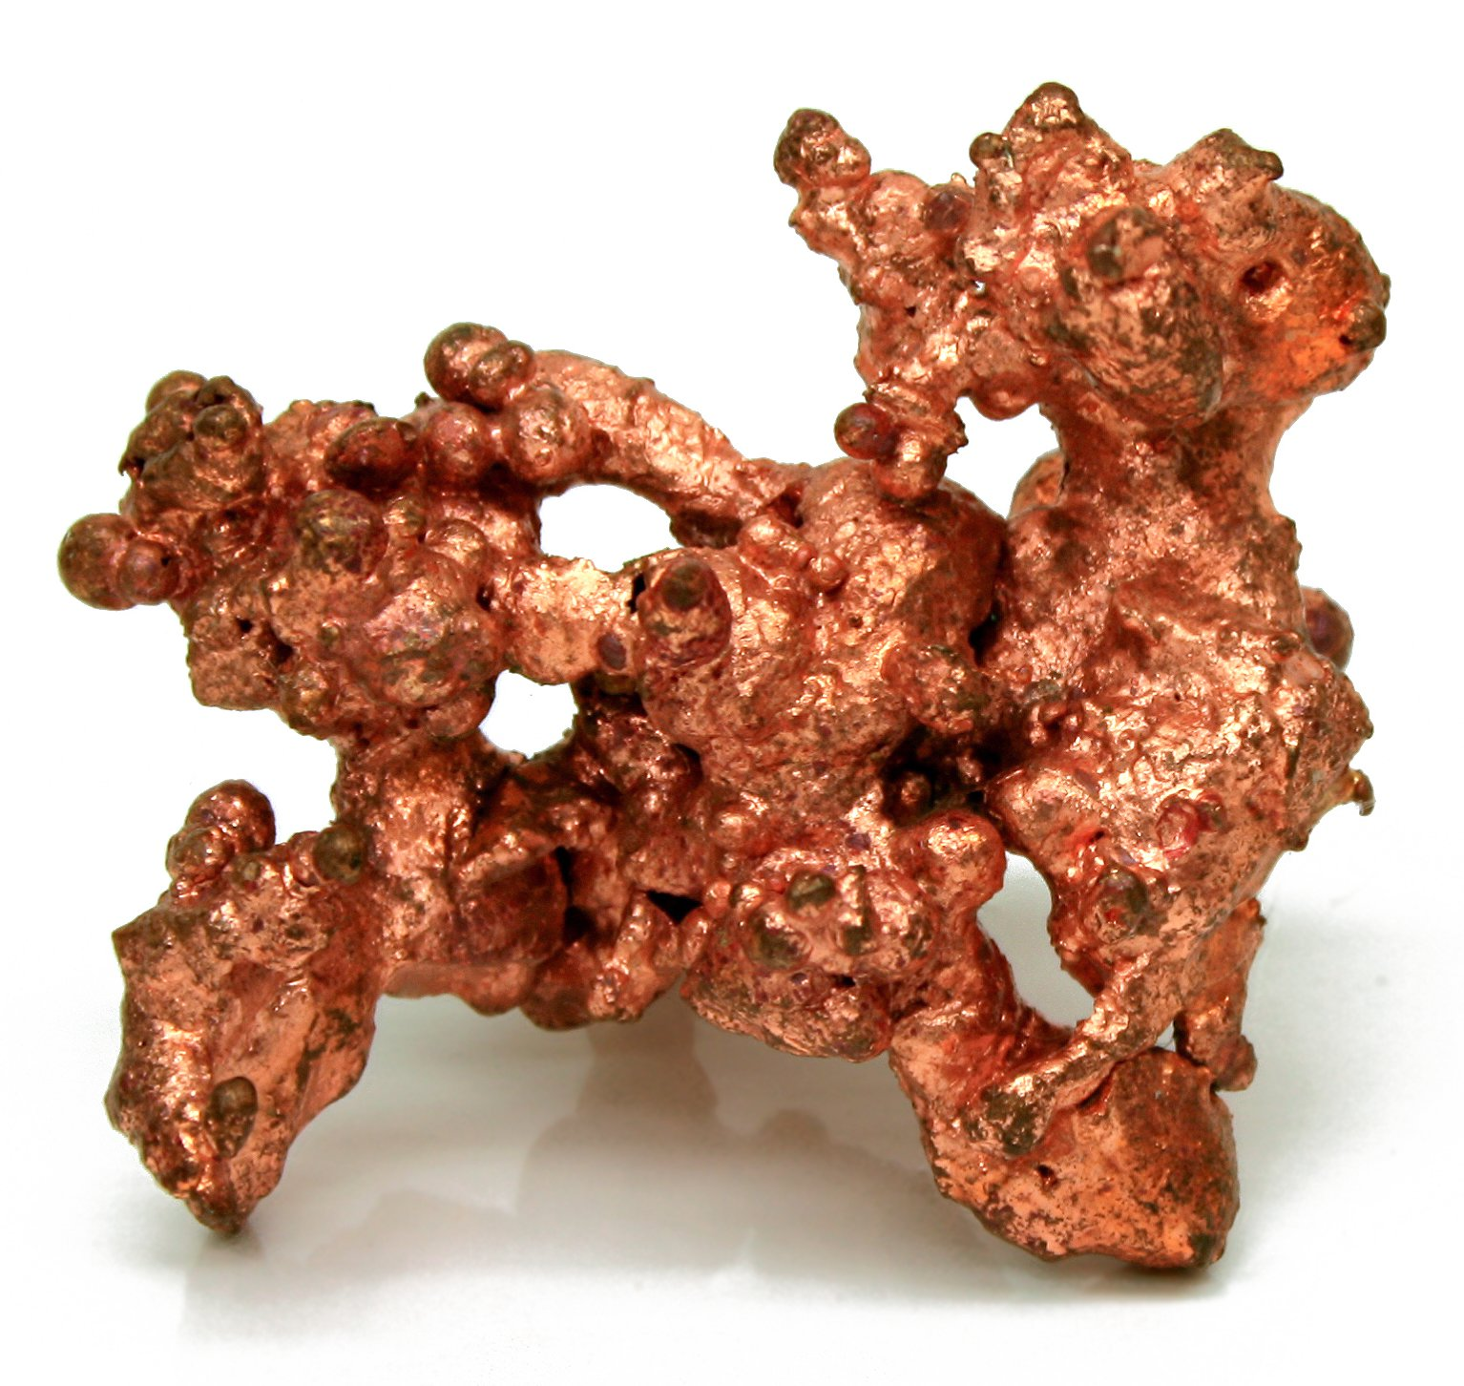
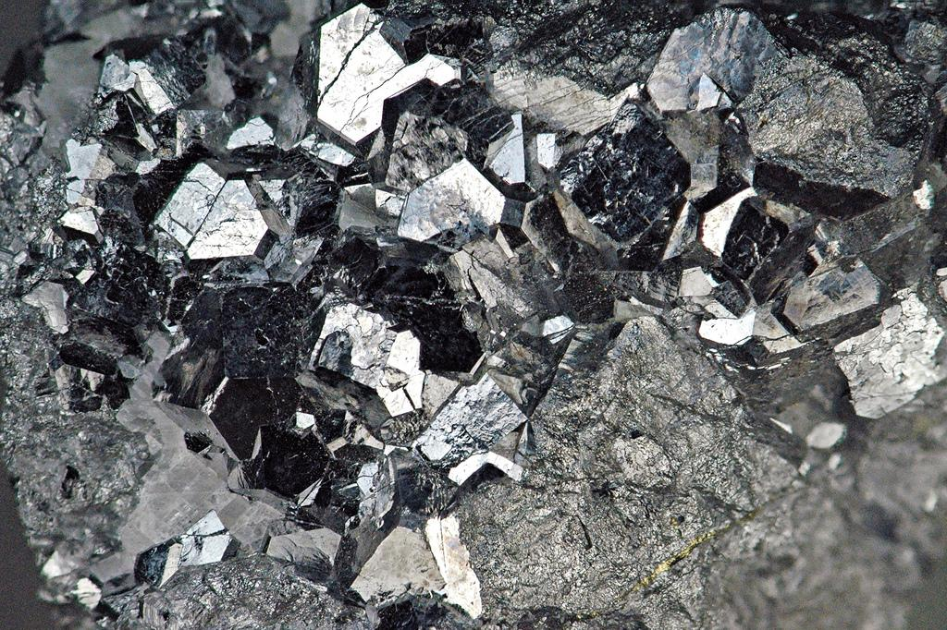
How it’s obtained
From Platinum ores or a by-product of mining nickel/ copper

Slide 7
Citations
https://www.chemicool.com/elements/iridium.html
http://www.rsc.org/periodic-table/element/77/iridium
https://education.jlab.org/itselemental/ele077.html

