Slide 1
Osmium

Slide 2
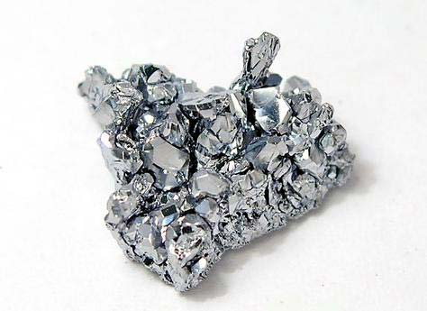
Description of my element
Name: Osmium
Symbol: Os
Description:
It is a hard white transition metal.
Atomic Number is 76
Can be found in Platinum Ore

Slide 3
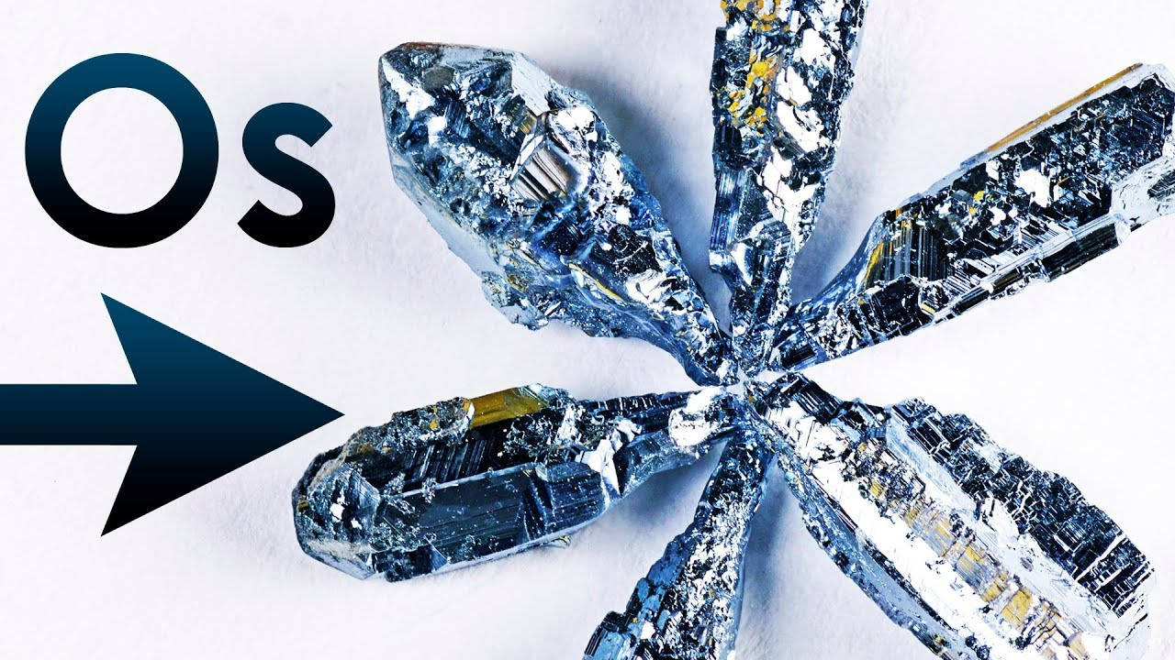
Why was Osmium called Osmium?
In 1804’s, the chemist Smithson Tennant which founded Osmium and why he called the element Os or Osmium was for the usual smell of the element which came from a greek word called Osme means odor.

Slide 4
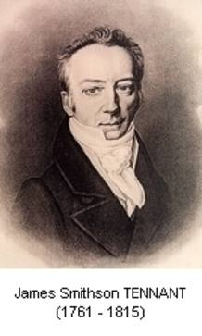
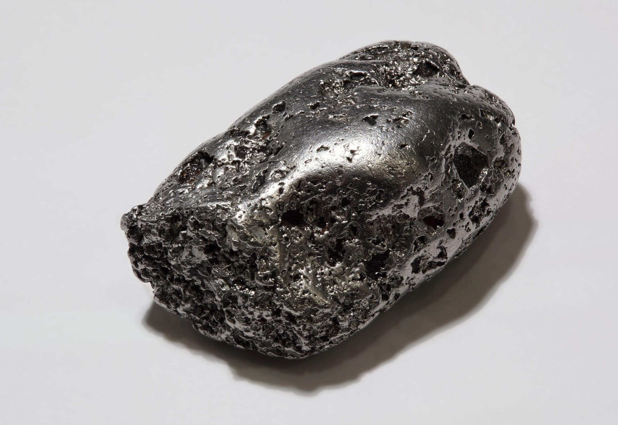

Where was osmium found and whom was it found By?
It was in the 1800’s Smithson Tennant a chemist was studying though another element called Platinum and looking through the element he notice another substance which later in 1804 he finally figure out there was 2 new elements in Platinum called one of them Osmium.
Platinum

Slide 5
~List of uses~
Hard Alloys for fountain pens
Instrument Pivots
Needles
Electrical contacts
In The Chemical World can be use as a catalyst

Slide 6
How is Osmium obtained?
Osmium can be obtained or extracted from Platinum plus can be mined.
Places You Can Find Osmium:
Bulgaria
Canada
Turkey
Russia
South Africa

Slide 7
Sources:
http://www.stickpng.com/es/img/iconos-logotipos-emojis/flechas/flecha-bruta-verde-derecho
https://www.youtube.com/watch?v=D9C_lbivcn4
http://blog.malabargoldanddiamonds.com/early-uses-of-platinum
http://www.chemistryexplained.com/elements/L-P/Osmium.html
http://www.rsc.org/periodic-table/element/76/osmium
http://www.miningoilgasjobs.com.au/mining/rocks,-metals---gems/metals/osmium.aspx
http://www.rtve.es/noticias/20120224/smithson-tennant-estudioso-diamantes/500652.shtml

