Slide 1
Xenon

Slide 2
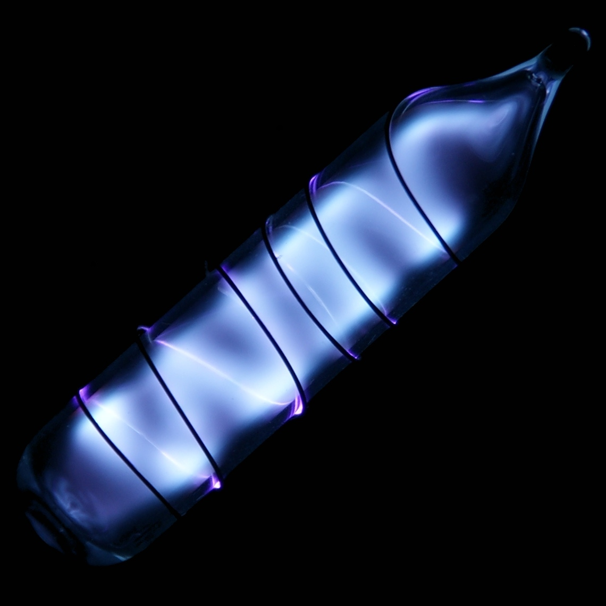
Element name: Xenon
Symbol: Xe
Description: It is a colorless, dense,odorless noble gas found in the Earth’s atmosphere in trace amount.
http://www.rsc.org/periodic-table/element/54/xenon

Slide 3
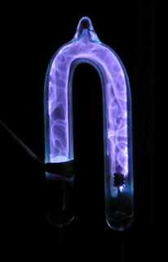
An explanation of why your element has the name assigned to it.
It was named after the Greek word that means “stranger”.
http://www.chemistryexplained.com/elements/T-Z/Xenon.html

Slide 4
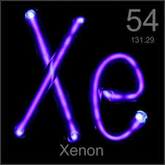
An explanation of how, where, and by whom your element was discovered.
It was found in the Earth’s atmosphere in trace amount by Sir William Ramsay & Morris William Travers
http://www.chemistryexplained.com/elements/T-Z/Xenon.html

Slide 5
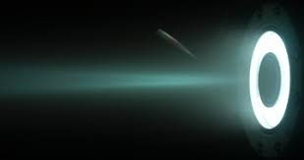
A list of your element uses
Used in certain specialised light sources,high-speed electronic flash bulbs used by photographers, sunbed lamps and bactericidal lamps used in food preparation and processing.
http://www.rsc.org/periodic-table/element/54/xenon

Slide 6
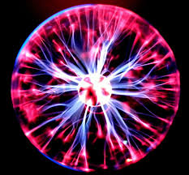
A description of how your element is mined or obtained
Xenon, like other noble gases, is unreactive towards most other substances. It does react naturally with fluorine and can be made to react with other compounds. It is used in strobe lights, lasers and has various applications in nuclear energy research, especially radiation detection equipment.
http://www.chemistryexplained.com/elements/T-Z/Xenon.html

