Slide 1
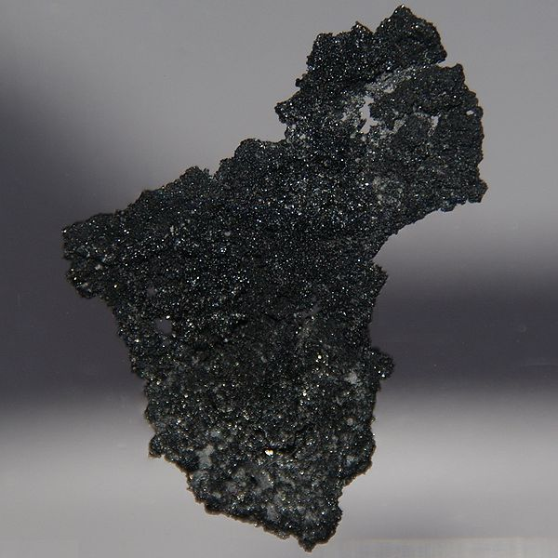
Boron

Slide 2
Elements name, symbol and more
Density: 2.34 g/cm
Group # : 13
Its state at room temperature : solid
element name : boron
Symbol : B
Atomic # : 5
Atomic mass : 10.811
Group name: metalloid

Slide 3
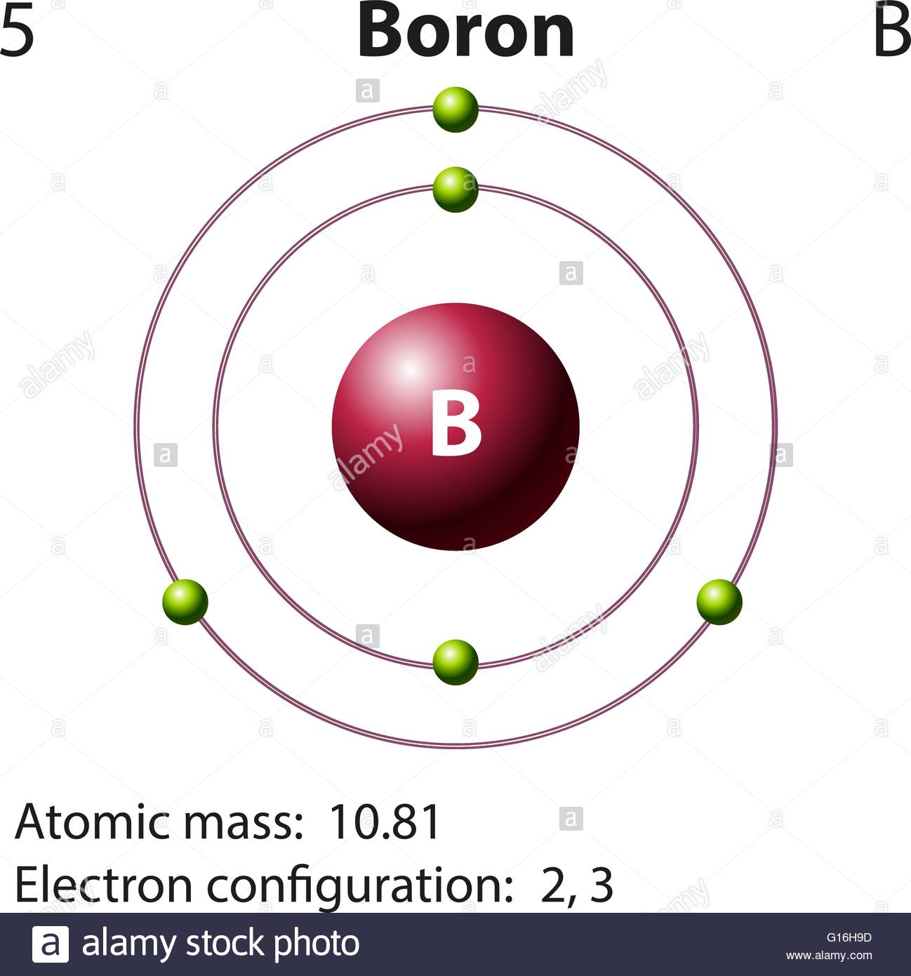
Diagram of boron

Slide 4
Summary of what it is
Atomic #5 , known as the element Boron (B) is a chemical element. It’s made purely from cosmic ray spallation and supernovae but not from stellar nucleosynthesis. It’s located within group 13 in the periodic table, with a melting point of 3771°F and a density point of 2.34g/cm^3. Boron is a Solid/ mineral that can be found in solar system and the earth’s crust and can also be found within our environment and food.

Slide 5
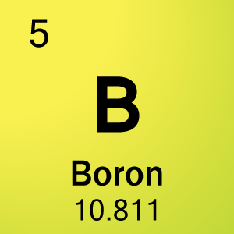
The element boron
( what the element card looks like)

Slide 6
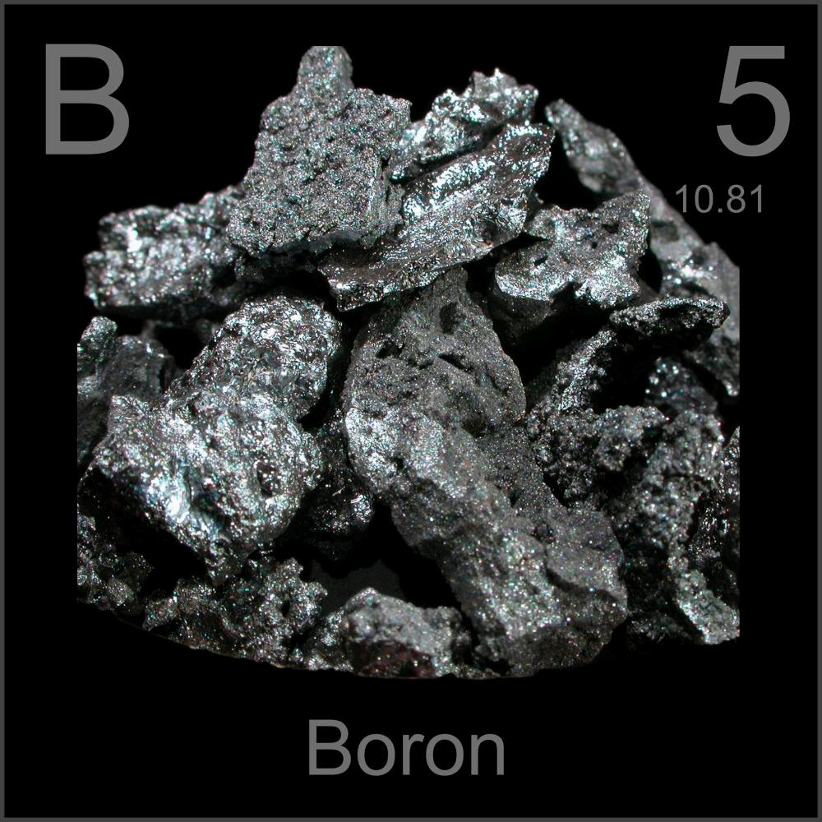
This is what boron looks like →
(looks like some flat rocks)

Slide 7
Why is it named that? + how/where/ by whom was it discovered?
Boron was founded by joseph - Louis Gay - lussac & Louis Jacques Thénard who were french chemists.
a third party named sir Humphry Davy who was an english chemist who discovered it independently.
Boron was found in France, and all 3 discovered this element in 1808.
The word “boron” comes from a mineral box & is derived from the arabic word Buraq and the Persian word Burah

Slide 8
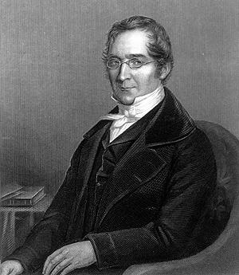
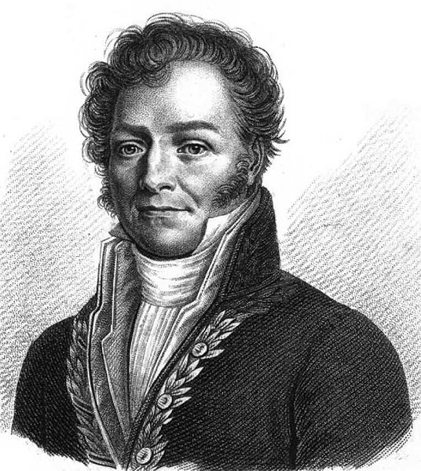
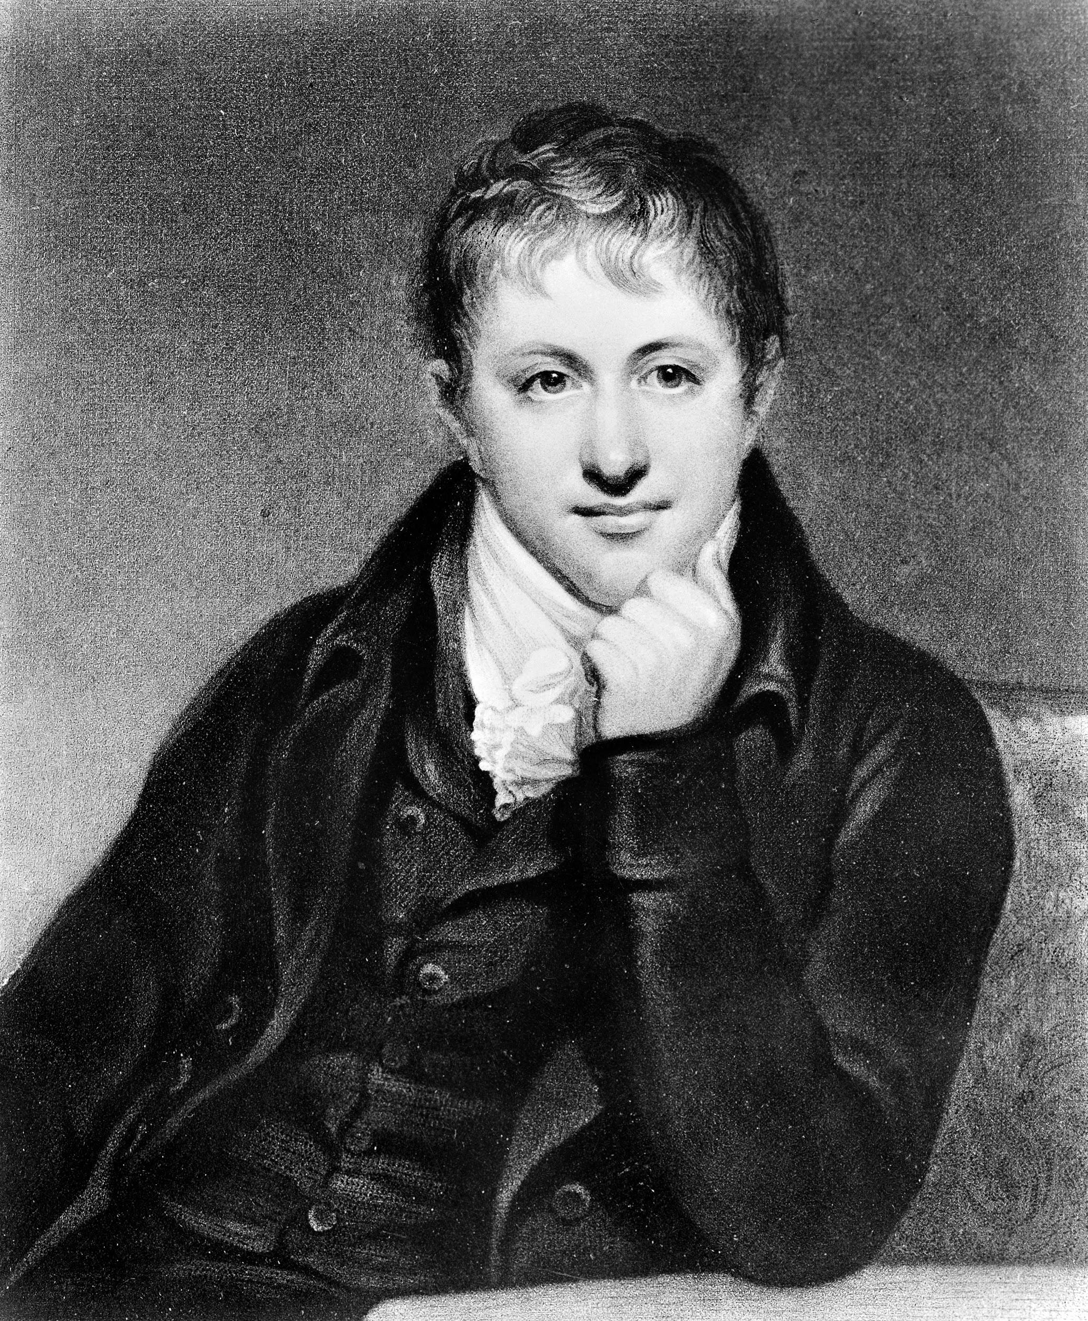
The three chemists
joseph Louis Gay lussac, lussac Louis Jacques Thénard & sir Humphry Davy

Slide 9
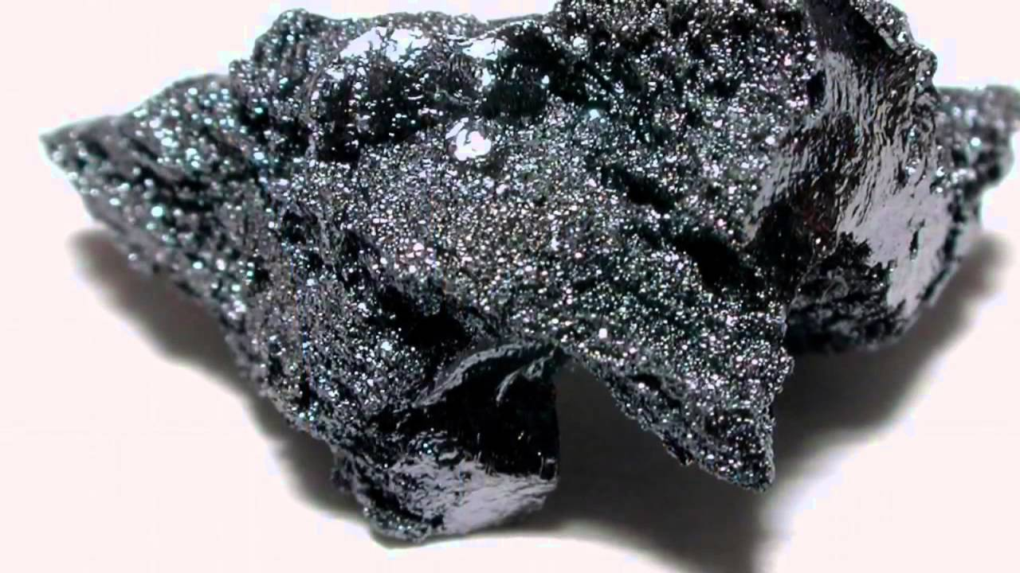
It’s uses
Boron can be used in pyrotechnics + used in flares to turn the colors green
Other uses for this can be fuel source for rockets, ceramics/ glass help control the rods that are in nuclear reactors etc.

Slide 10
How is it contained/ mined?
Since boron is a naturally occurring element, from the environment it’s in, Boron comes from a combination of oxygen and other elements, compounded into what is known as “borates”.
There are a limited number of deposits that can be mined economically. They’re located in regions such as Turkey, USA, Argentina, Chile, Russia, China, and Peru.

Slide 11
The end.
http://www.rsc.org/periodic-table/element/5/boron
https://en.wikipedia.org/wiki/Boron
https://education.jlab.org/itselemental/ele005.html
https://www.greenfacts.org/en/boron/boron-1.htm
https://education.jlab.org/itselemental/ele005.html
https://www.ducksters.com/science/chemistry/boron.php
sources:

