Slide 1
Ag - Silver

Slide 2
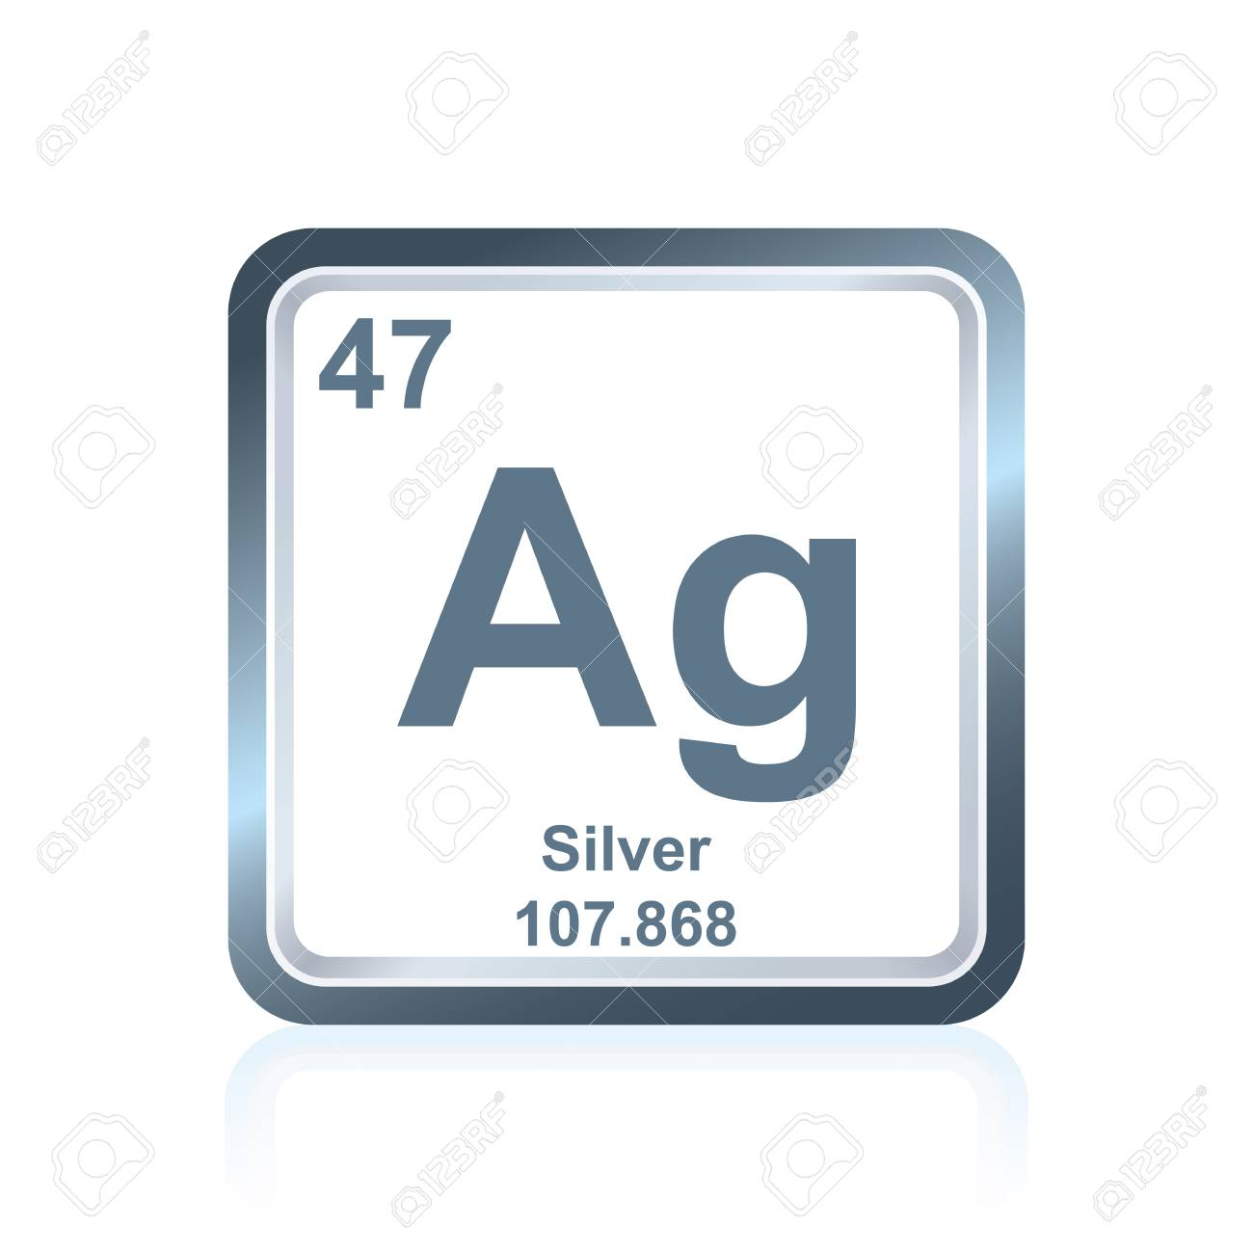
Element Ag
Period 5 - Group 11

Slide 3
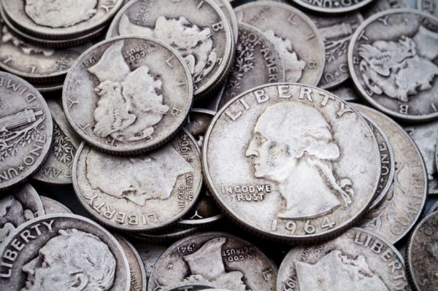
What Is Silver?
Symbol Ag from Argentum in Latin (silver)
Atomic number of 47
Shiny Metal
It has the highest electrical conductivity, thermal conductivity, and reflectivity of any metal
Similar in physical properties with gold and copper
Silver stopped being used for coin production in 1964 and coins from before 1964 and created with 90% silver

Slide 4
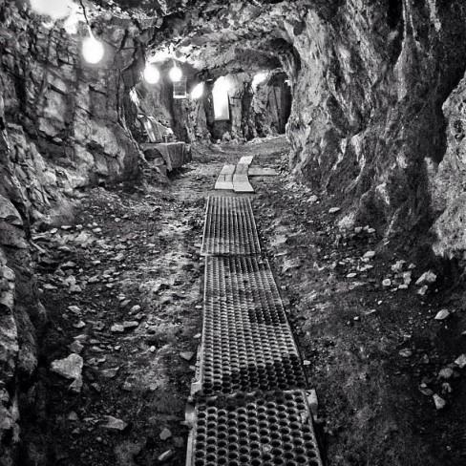
Where is Silver found?
Silver can be found from a natural source in pure form
Silver is mostly mined in the US, Canada, Mexico,Peru, Bolivia, and certain parts of Europe
Silver often occurs as a minor constituent in the ores of copper, lead, and zinc
Earth’s crust has an abundance of silver

Slide 5
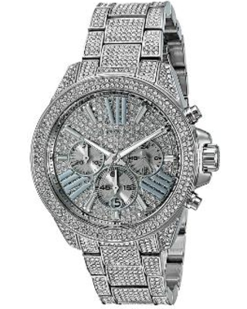
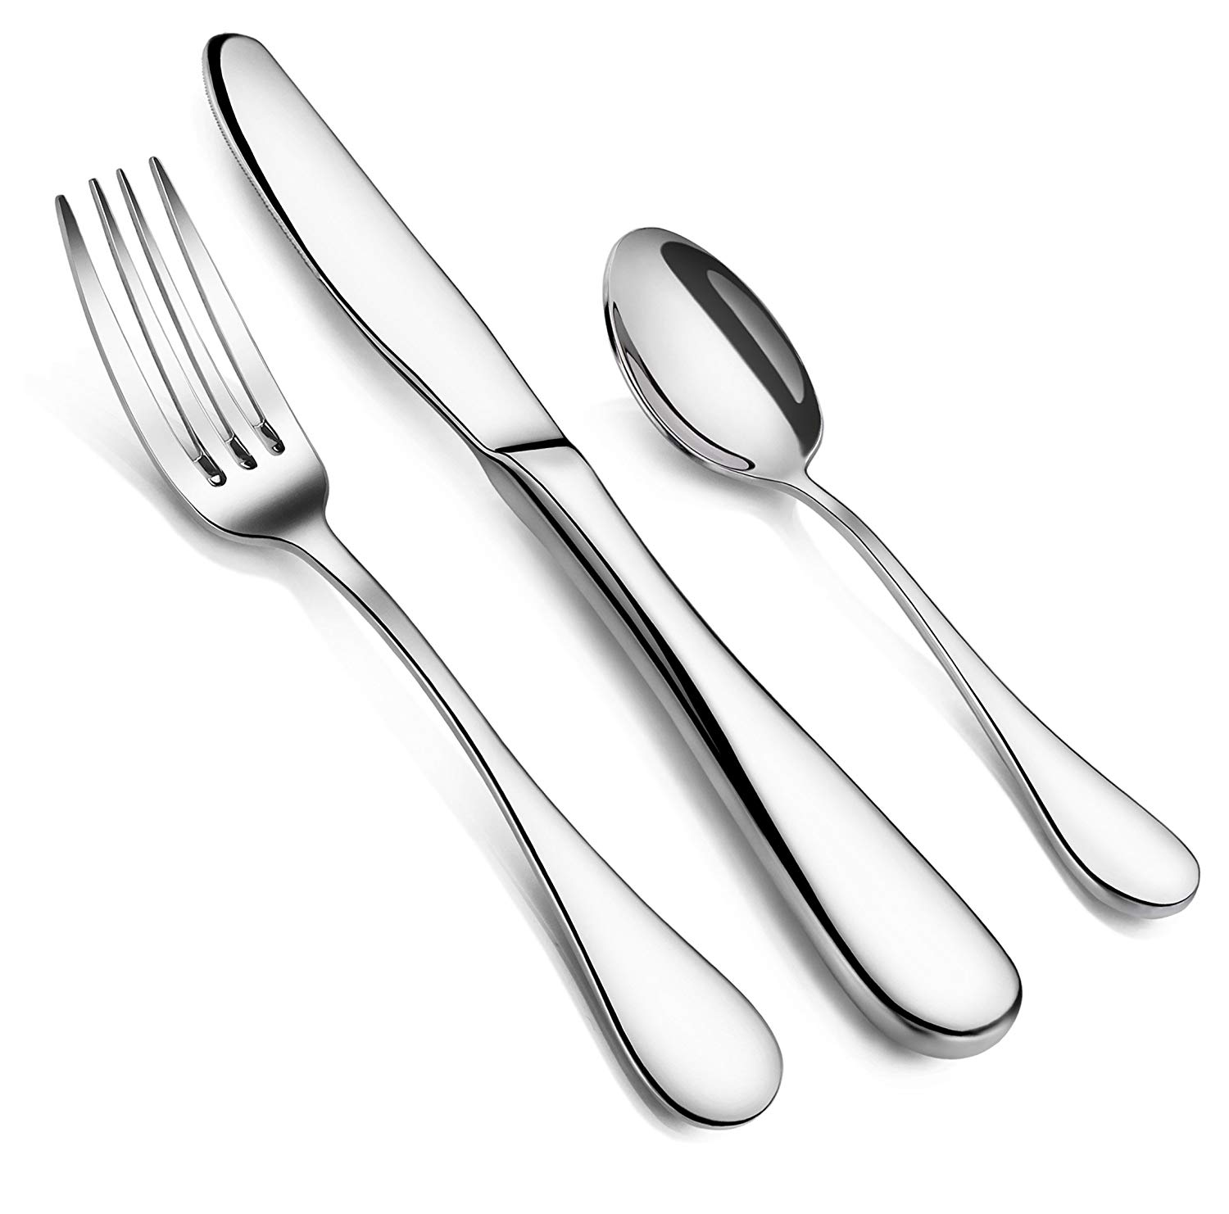
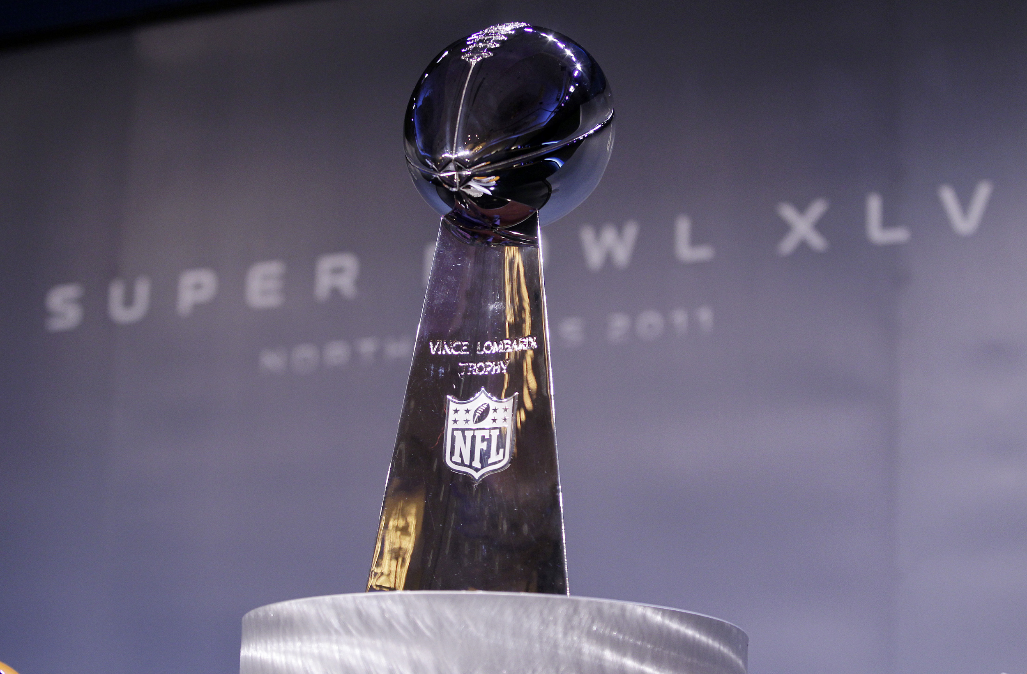
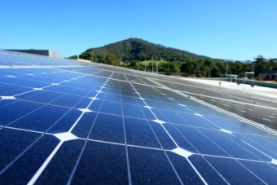

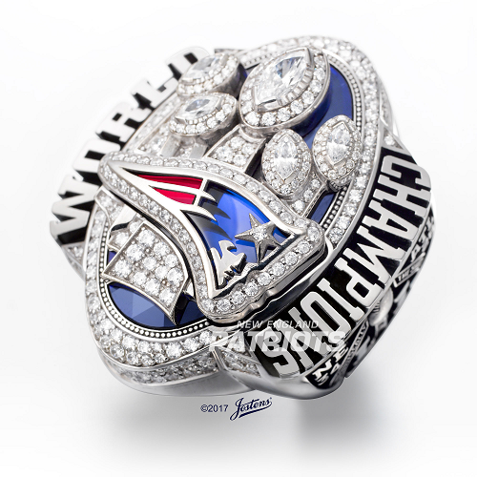
What are the uses of Silver?
Coins until 1964
Mirrors
Lots of jewelry
Electrical Switches
Circuit (On/Off Switch)
Solar Panels - (Silver paste contacts
printed onto photovoltaic cells capture and carry
electrical current. )
Silver was used for the film of cameras back in the day
Silverware (utensils)
(Did you know the Super Bowl trophy is made of sterling silver)

Slide 6
Who found Silver?
Although no one knows who specifically found silver, artifacts date back to 3000 BC in Mesopotamia where is now around Iraq.
Silver is named after the Anglo-Saxon word for silver, “seolfor.”
The chemical symbol “Ag” is from the Latin word Argentum. The word is based of the Sanskrit word meaning “Shining.” Silver is then basically called a shiny metal

Slide 7
Links
https://geology.com/articles/uses-of-silver/
https://www.britannica.com/technology/silver-processing
https://www.chemicool.com/elements/silver.html
https://www.livescience.com/37040-silver.html

