Slide 1
PALLADIUM(46)

Slide 2
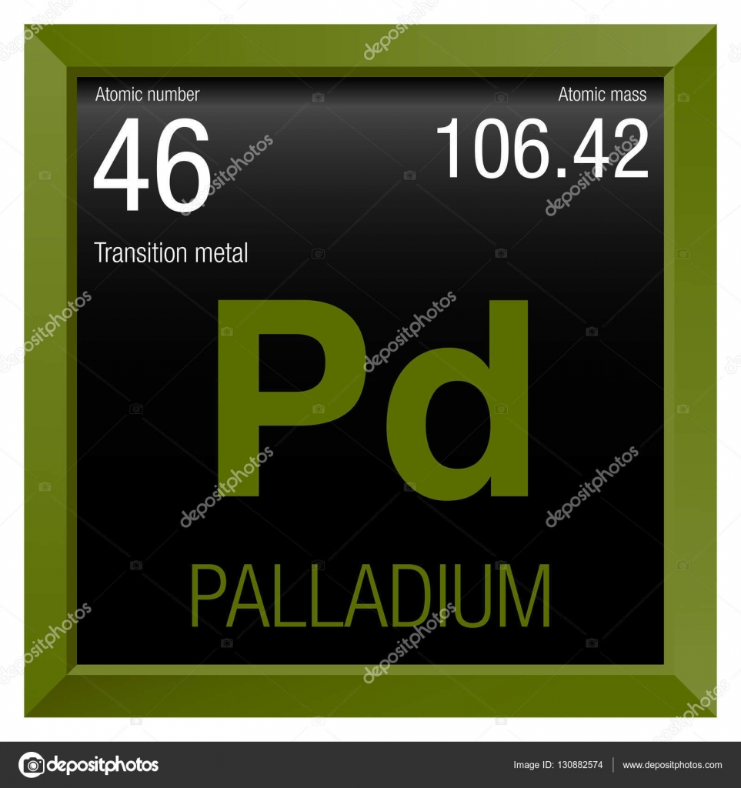
Name , Symbol , Description
Palladium is a chemical element with symbol Pd and atomic number 46. It is a rare and lustrous silvery-white metal discovered in 1803 by William Hyde Wollaston.

Slide 3
Discovered
By Wollaston in 1803. It is found in platinum and other metals its found by Russia, South America, North America,Ethiopia, and Australia. It is also found associated with the nickel-copper deposits of South Africa and Ontario.

Slide 4
Used for
The main use of palladium, along with rhodium and platinum, is in the three-way catalytic converters in car exhaust systems. Found in Laptops and mobile phones.Used in some dental fillings , It is also in some jewelry.

Slide 5
mined /Obtained
It is mined as a by product from other mineral deposits like nickel-copper,cooperate and polarite.

