Slide 1
Zirconium

Slide 2
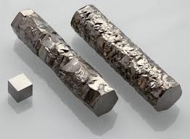
About Zirconium
Name: Zirconium
Symbol: Zr
Description:
Solid at room temperature
A metal
Silver-gray
Atomic number: 40
Strong and malleable

Slide 3
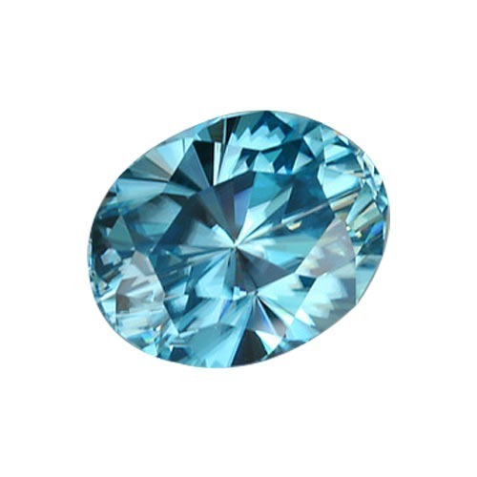
Why It’s Called Zirconium
Found in zircon
Named after zircon
Zircon probably derives from “zargun” which means “golden-colored” (some zircon crystals are a golden color

Slide 4
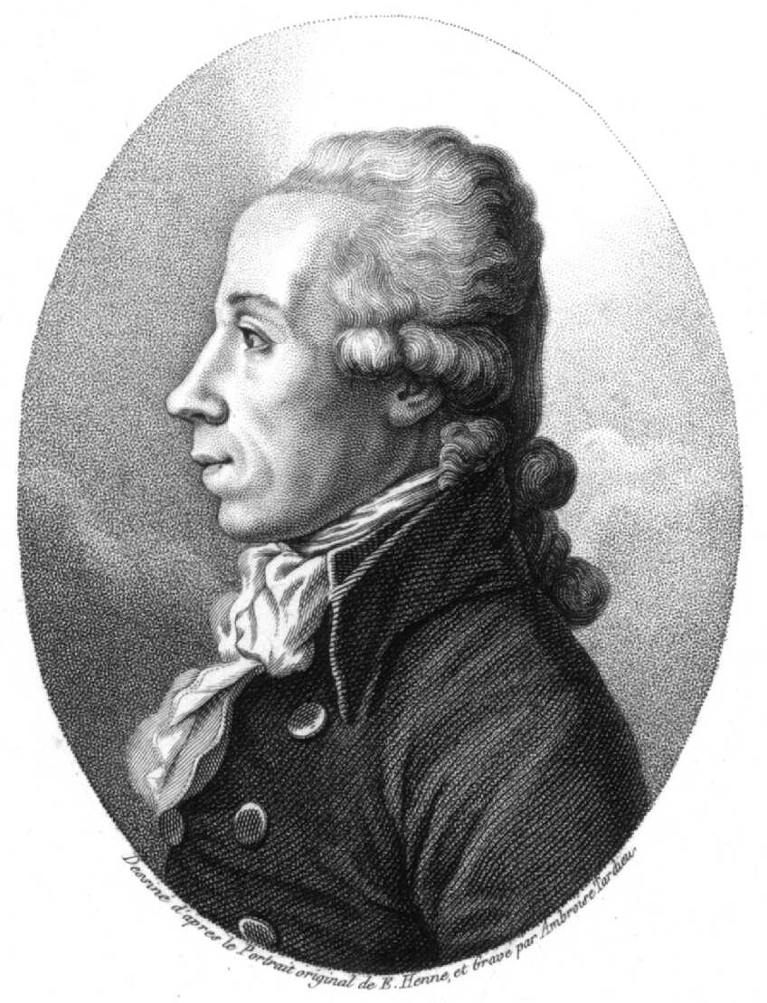
Backstory
Zircon mentioned in the bible
Many chemist thought it was alumina at first
Martin Heinrich Klaproth suspected new element
Klaproth named new element Zirkonerde (zirconia) in 1789
Jöns Jacob Berzelius produced pure zirconium in 1824

Slide 5
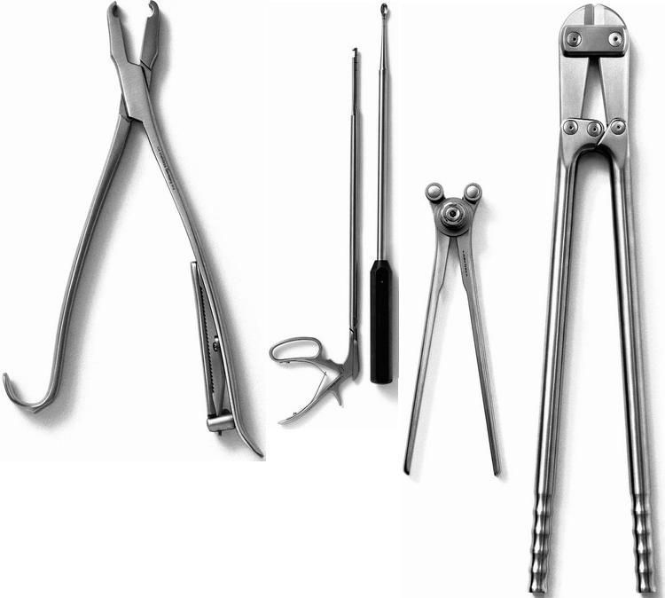
Uses of Zirconium
Used in alloys (ex. zircaloy)
Catalytic converters
Percussion caps
Furnace bricks
Photographic light bulbs
Surgical instruments
Hardening agent in alloys (especially steel)

Slide 6
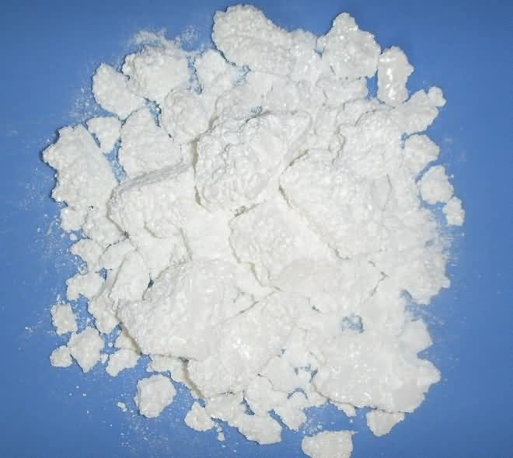
How To Obtain Zirconium
Obtained in zirconium dioxide
Found in zircon
Both mined in Australia, South Africa, USA, Russia, and Brazil
Heat mix of potassium and potassium zirconium fluoride in iron tube (way it was found)

Slide 7
Sources
https://www.lenntech.com/periodic/elements/zr.htm
https://en.wikipedia.org/wiki/Zirconium (Image)
https://en.wikipedia.org/wiki/Martin_Heinrich_Klaproth (Image)
http://metalpedia.asianmetal.com/metal/zirconium/history.shtml
https://www.indiamart.com/proddetail/blue-zircon-gemstone-12921444312.html (image)
https://www.pinterest.co.uk/pin/535224736935284059/ (image)
https://mineralseducationcoalition.org/elements/zirconium/
https://www.alibaba.com/product-detail/Zirconium-Dioxide-Zirconium-Oxide-ZrO2-_50024549593.html (image)

