Slide 1
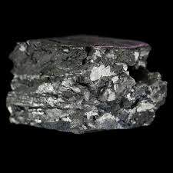
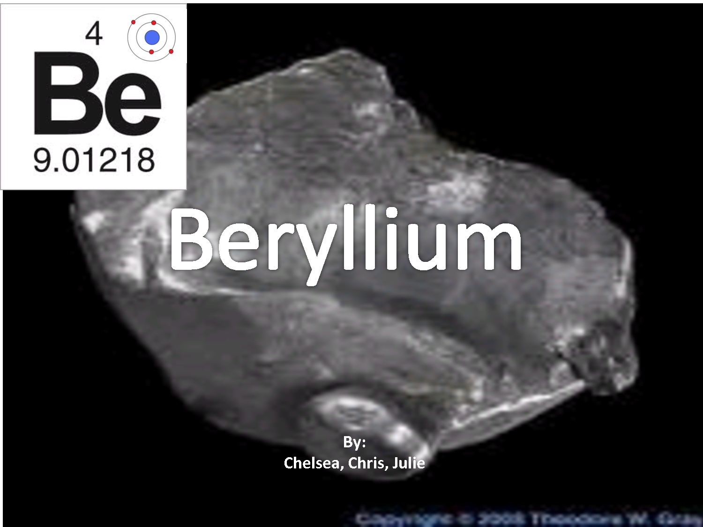
Beryllium

Slide 2
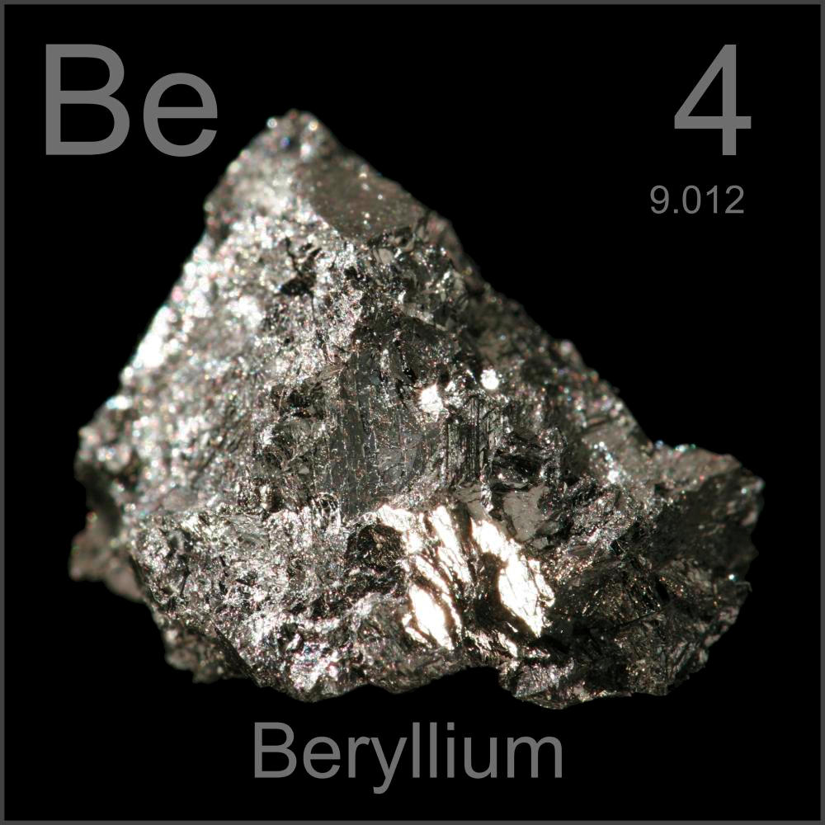
Symbol and Description
Symbol: Be
Description: is the lightest member of the alkaline earth metals family. Its atomic number is 4 and the avg. atomic mass is 9.01218.
It is a silvery metal.

Slide 3
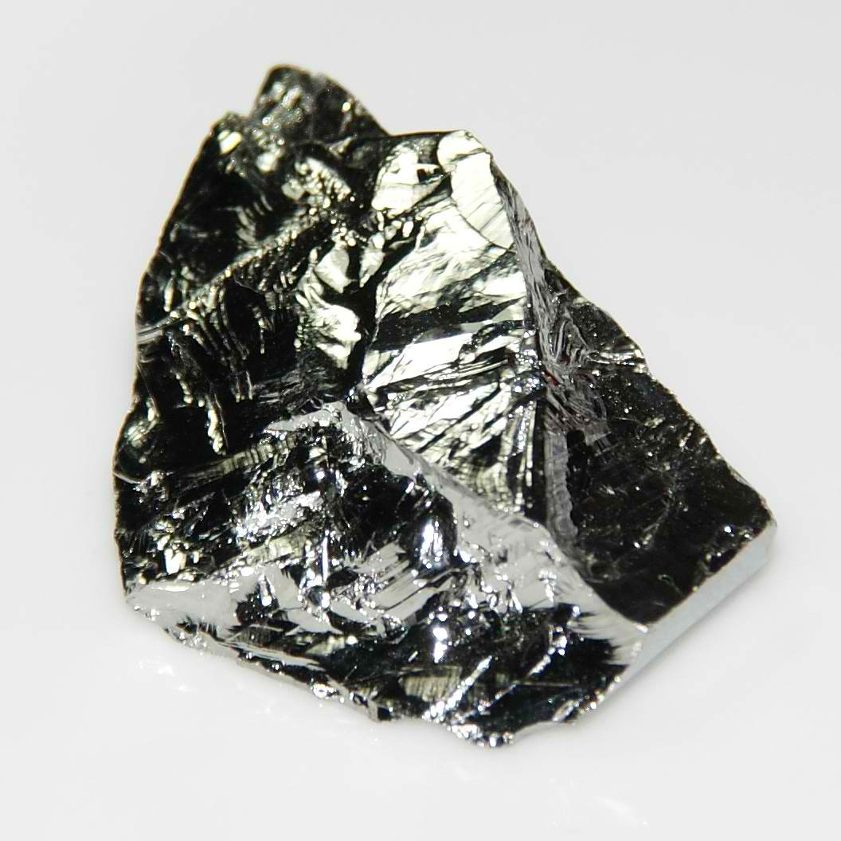
WHY IT’S CALLED BERYLLIUM
It’s named after beryllos, the Greek name for the mineral beryl, the element was originally known as glucinium — from Greek glykys, meaning "sweet" — to reflect its characteristic taste.

Slide 4
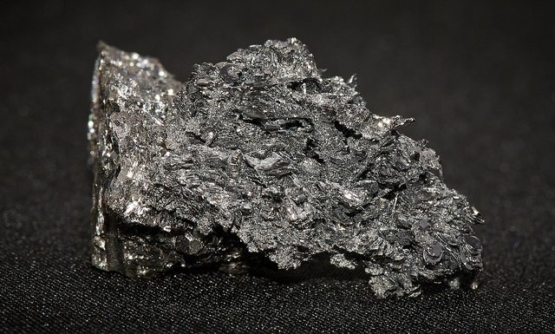
HOW, WHERE, WHO?
HOW: Discovered in the oxide form by Vauquelin in both beryl and emeralds in 1798.
WHERE: In France.
WHO: By the French chemist Louis Nicolas Vauquelin.

Slide 5
USED FOR?
Beryllium is used in alloys with copper or nickel to make gyroscopes, springs, electrical contacts, spot-welding electrodes and non-sparking tools. ... Other beryllium alloys are used as structural materials for high-speed aircraft, missiles, spacecraft and communication satellites. Beryllium is also used as a moderator in nuclear reactors.

Slide 6
OBTAINED?
Today, beryllium is primarily obtained from the minerals beryl (Be₃Al₂(SiO₃)₆) and bertrandite (4BeO. 2SiO. H₂O) through a chemical process or through the electrolysis of a mixture of molten beryllium chloride (BeCl₂) and sodium chloride (NaCl).

Slide 7
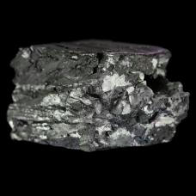
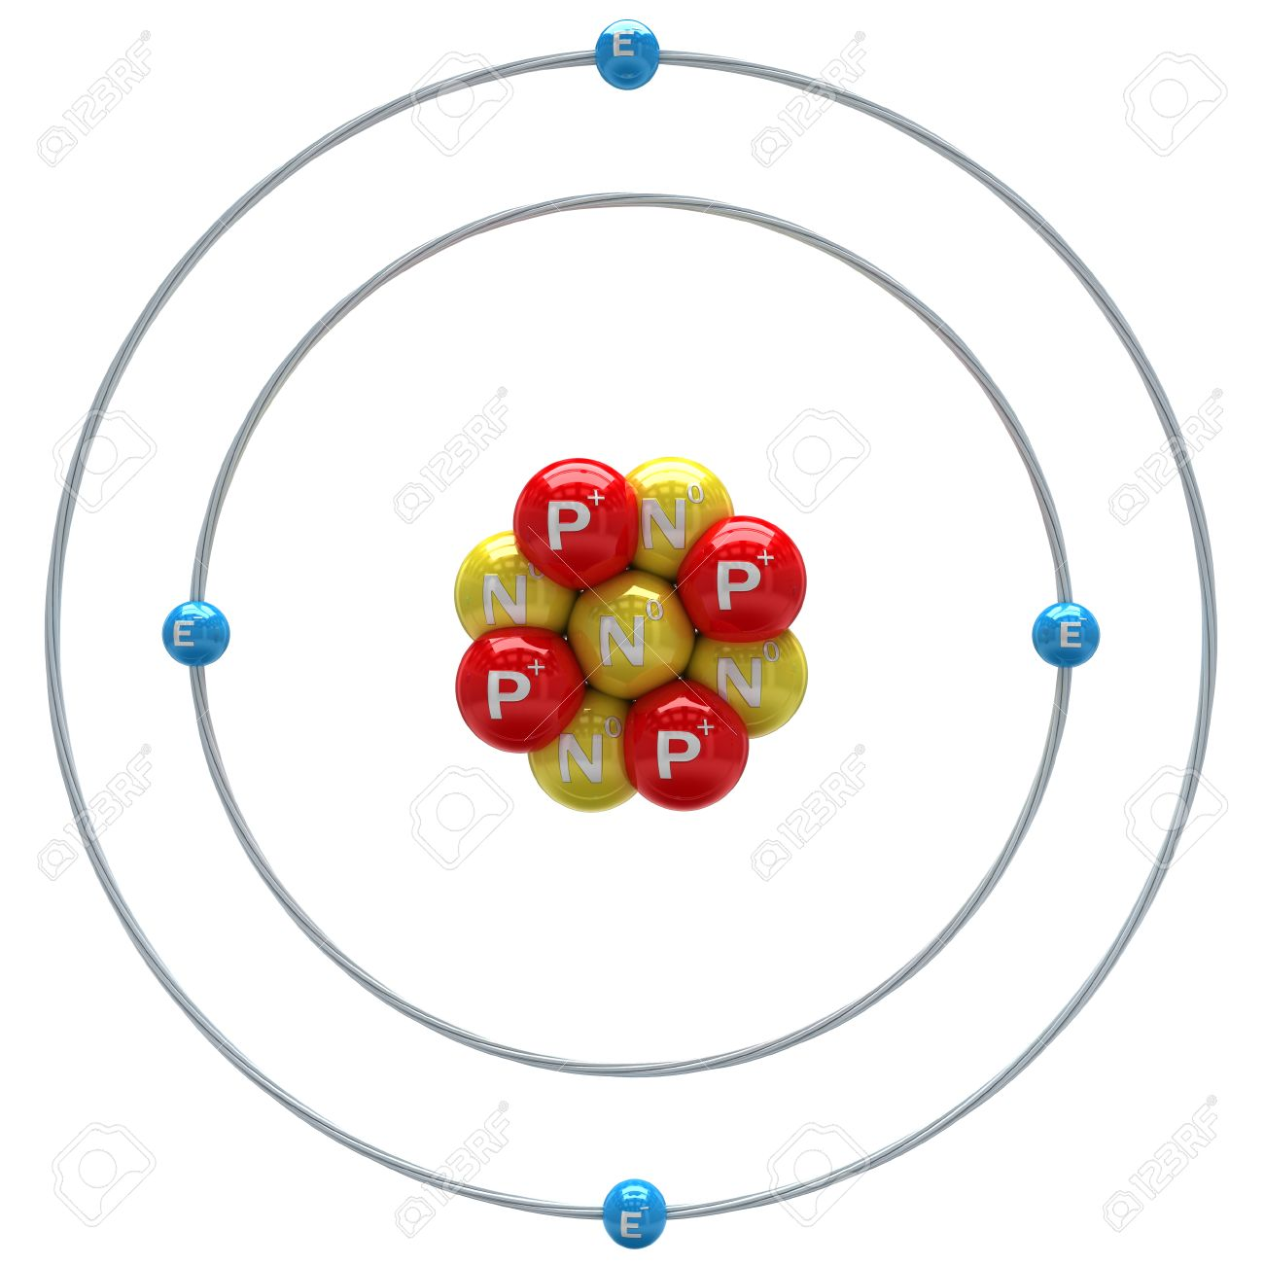
SOURCES
http://www.rsc.org/periodic-table/element/4/beryllium
https://www.ducksters.com/science/chemistry/beryllium.php
https://education.jlab.org/itselemental/ele004.html

