Slide 1

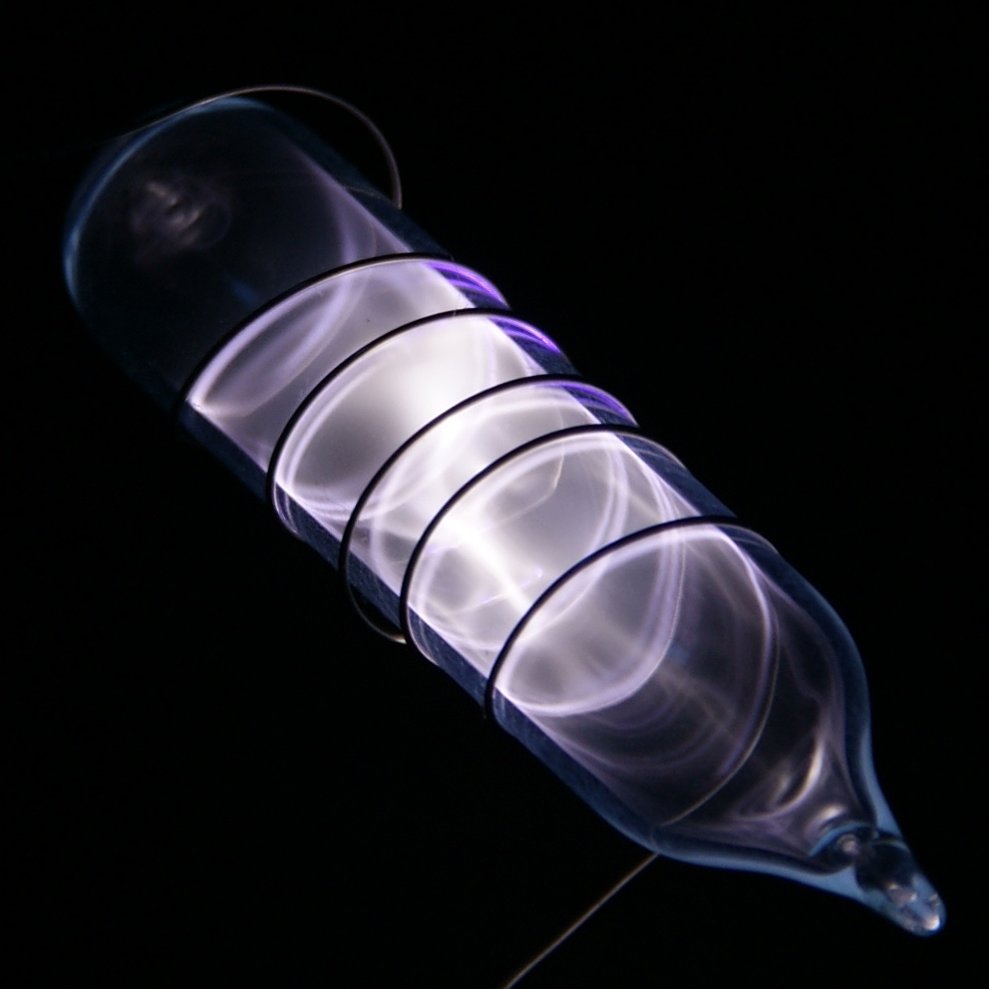

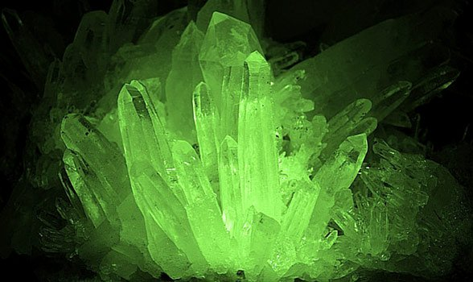
Krypton

Slide 2
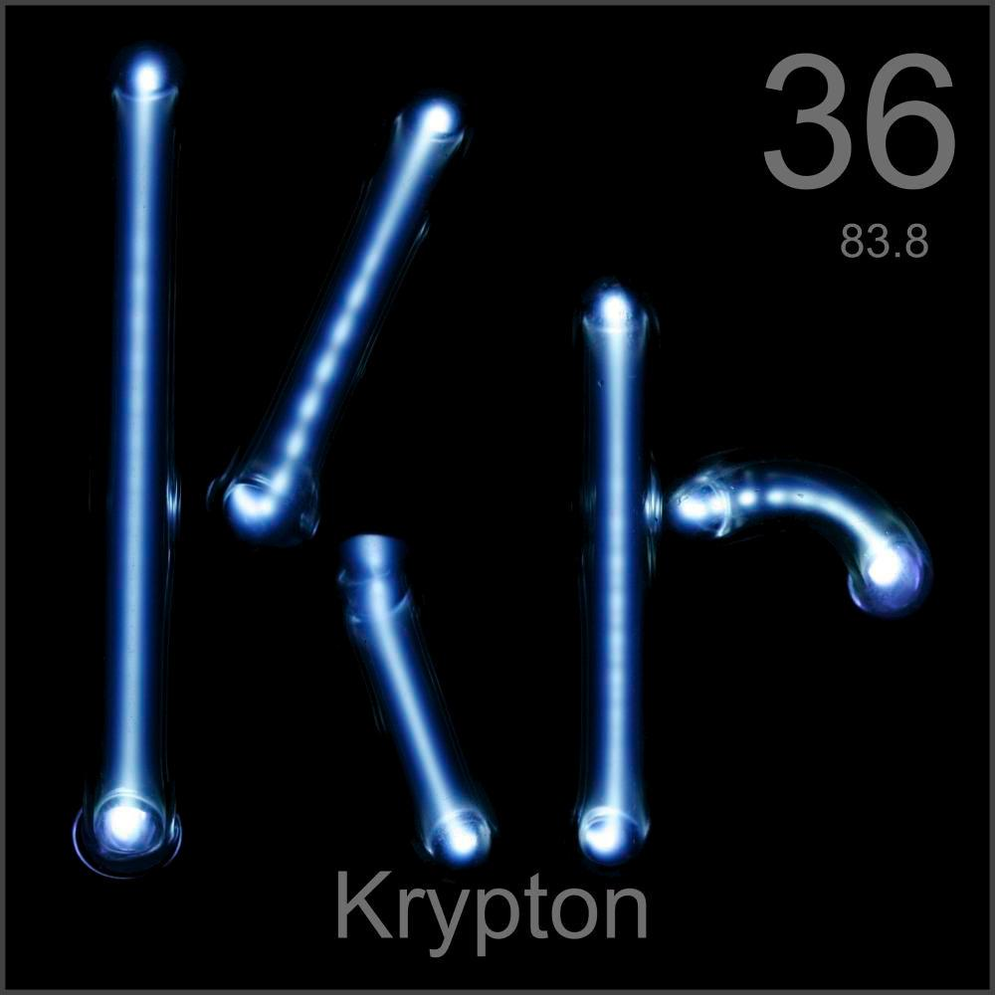




Atomic #: 36
Symbol: Kr
Atomic Mass:83.8
Name: Krypton

Slide 3
Krypton's Origin
With the discovery of the noble gas argon, which was extracted from air. William Ramsay and Morris William believed this must belong to a new group of elements. They decided others were likely to be hidden in the argon and by a process of liquefaction and evaporation they discovered krypton in the afternoon of May 30th 1898 . The name is derived from the Greek 'kryptos', meaning hidden.

Slide 4
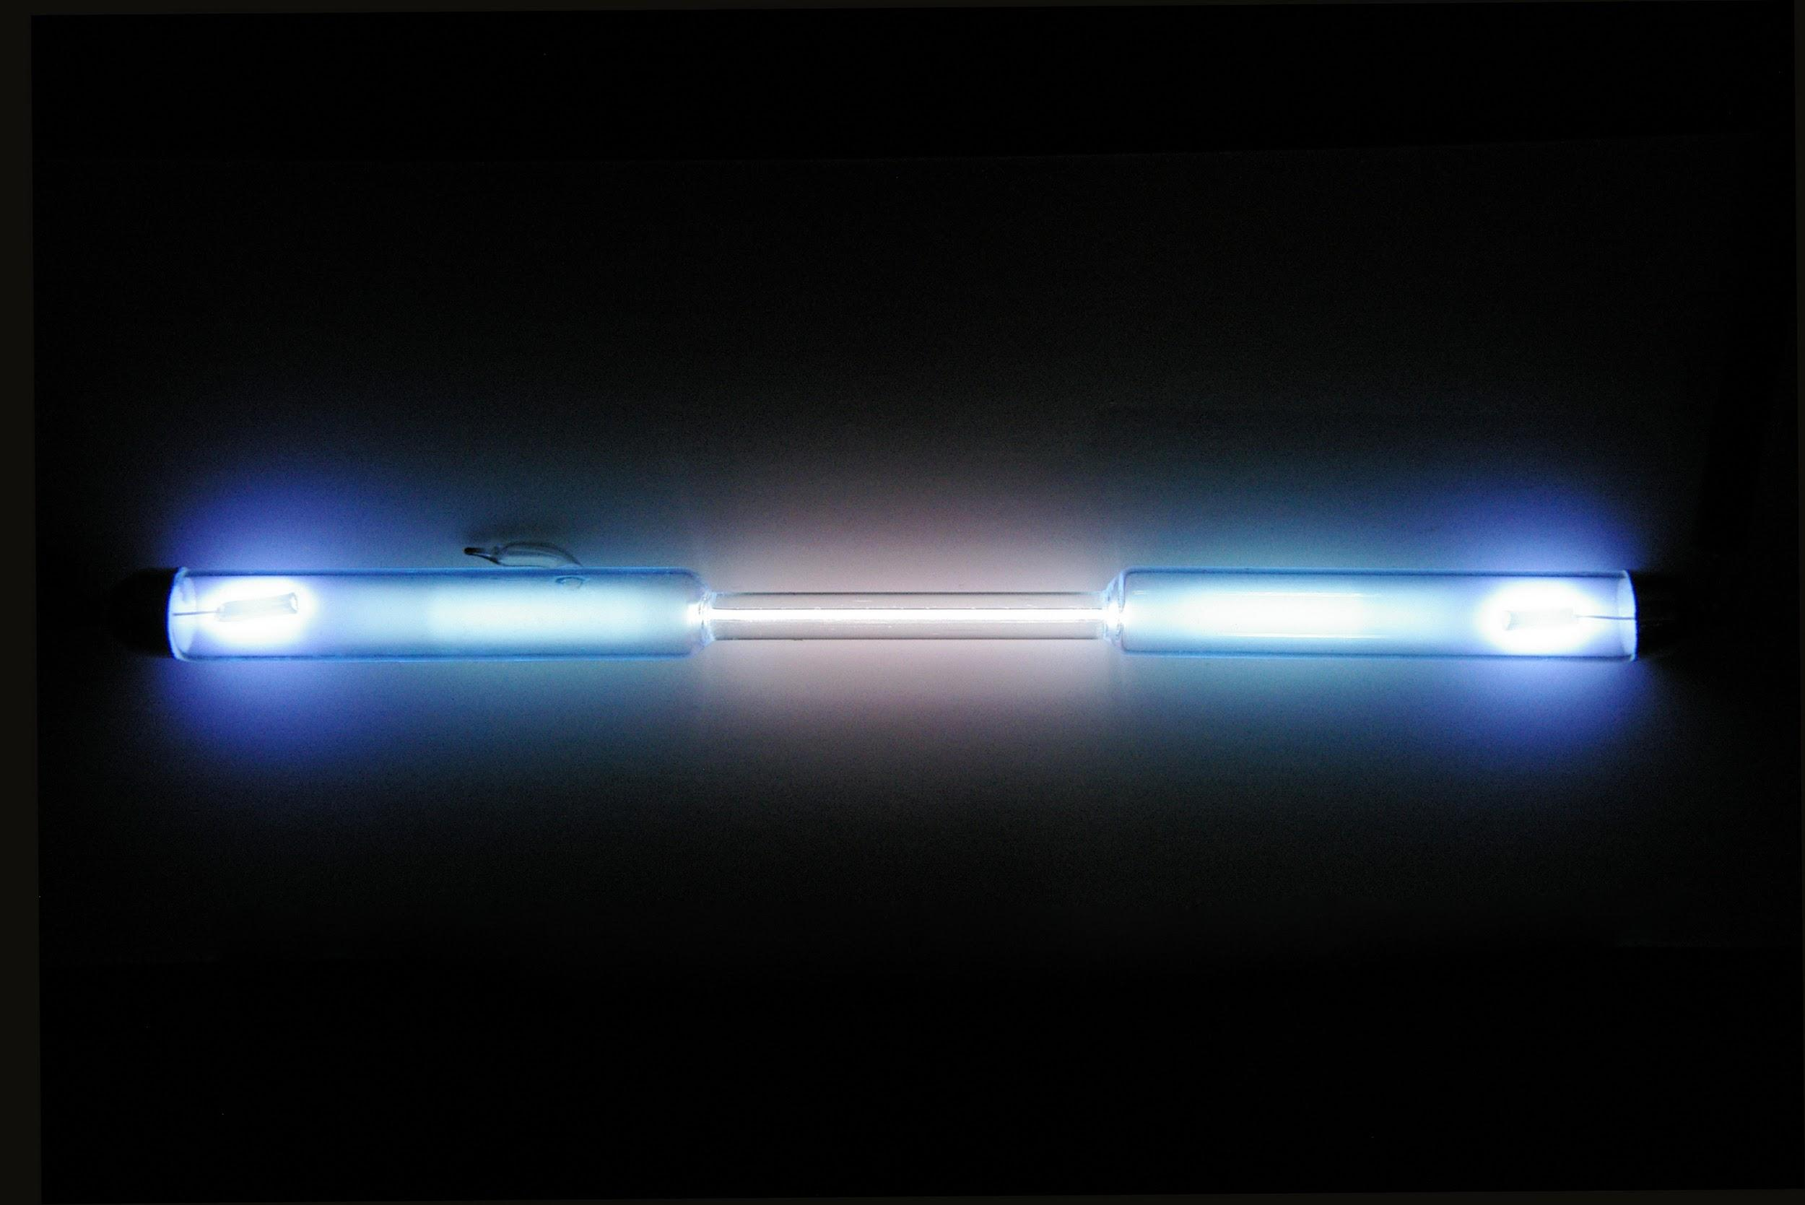
Properties
Appearance:
No Color or smell
Non reactive with everything but fluorine gas.
Uses:
Commercially used as a filling gas for energy-saving fluorescent lights. It is also used in some flash lamps used for high-speed photography.
It’s reactive enough to form some chemical compounds. For example, krypton fluoride which is used in some lasers.
Radioactive krypton was used during the Cold War to estimate Soviet nuclear production.
Obtainability:
It is extracted by distillation of air that has been cooled until it is a liquid

Slide 5

Bibliography
http://www.rsc.org/periodic-table/element/36/krypton

