Slide 1
Germanium
By:Bryan Ramirez

Slide 2
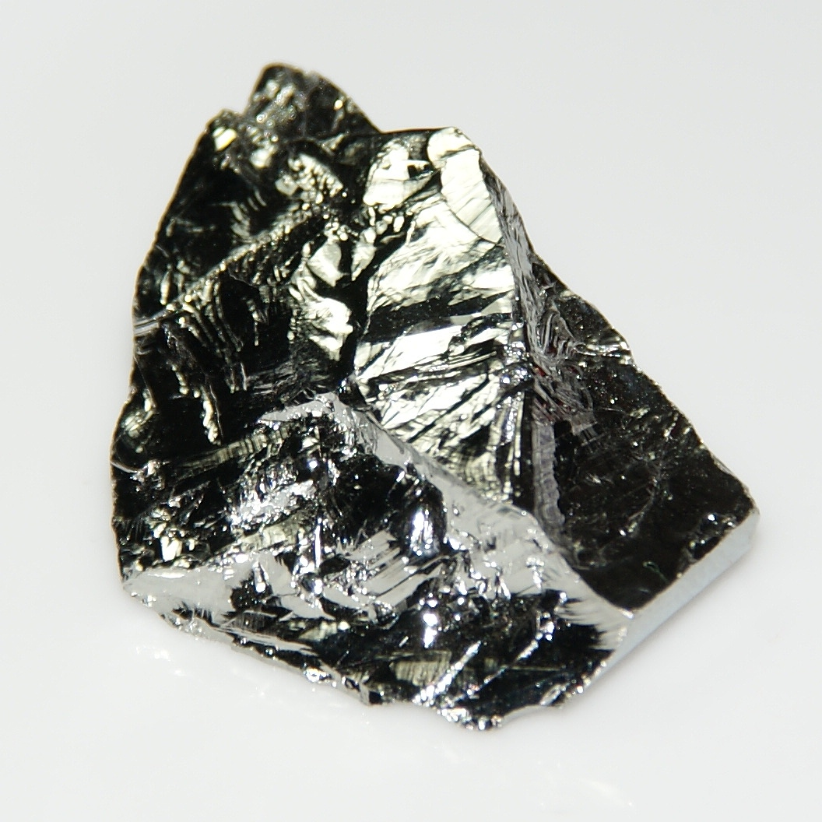
Name,symbol,and description
Germanium
32
It is silverish-white semi-metal brittle

Slide 3
Name
called germanium because the person who discovered it was german and named it after germany

Slide 4
It was discovered in a mineral sample from a silver mine
in germany by german chemist clemens A. Winkler
In 1886

Slide 5
uses
Germanium is used in semiconductors industry
When doped with arsenic,gallium,indium,antimony,or phosphorus is used to mak transistors for use in electronic devices.

Slide 6
Obtained
Germanium is found in germanite argyrodite and some zinc ores.

