Slide 1
The Element Zinc (Zn)

Slide 2
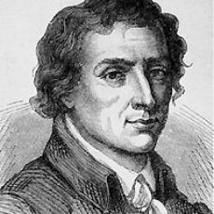
Origin of Zinc
Zinc was identified as an element on 1746.
It was discovered by Andreas Marggraf.
Derived from the german word ‘zinc’, which may derive from the word ‘sing’ in Persian which means stone.
Andreas Marggraf (1709-1782

Slide 3
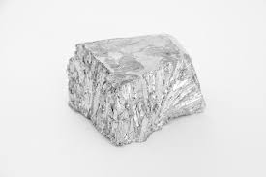
Information about Zinc
Zinc is mainly used to galvanize other elements, such as iron, to prevent rusting.
Zinc looks like a silvery-white metal with a blue tinge
Zinc is a $34 billion per year market, larger than silver, platinum, and molybdenum combined.
Fourth most used metal in the world, behind iron, aluminum, and copper

