Slide 1
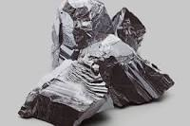
Name: Lithium
Symbol: Li
Description: A metal that is grey and looks sort of like a
clay look but is solid. It is used a lot for people's mental health and also in ceramics, glass, and polymers
Description of name: The origin of the name comes from the Greek word lithos meaning stone
Discovery: Lithium was discovered in 1817 by Johann August Arfvedson in a metal petalite which is a crystallized version of lithium (LiAl(Si2O5)2)
Uses: Lithium is used for mental illnesses, with bipolar disorder, depression, and schizophrenia as well as eating
https://www.medicinenet.com/lithium/article.htm
http://www.rsc.org/periodic-table/element/3/lithium

