Slide 1
Nickel (Ni)

Slide 2
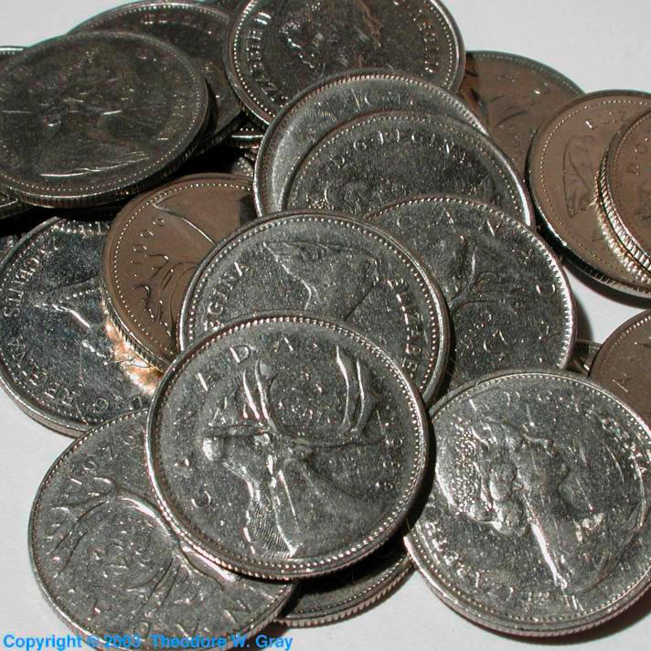
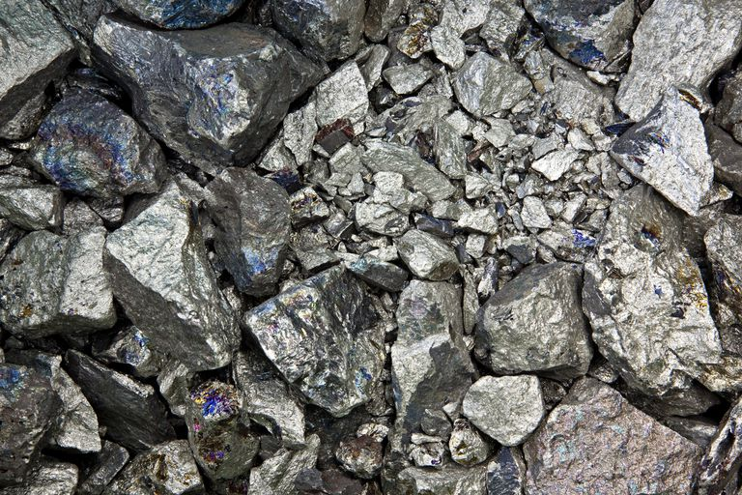
Nickel
Symbol: Ni
Nickel is a a silvery metal that resists corrosion even at high temperatures.

Slide 3
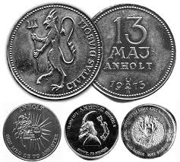
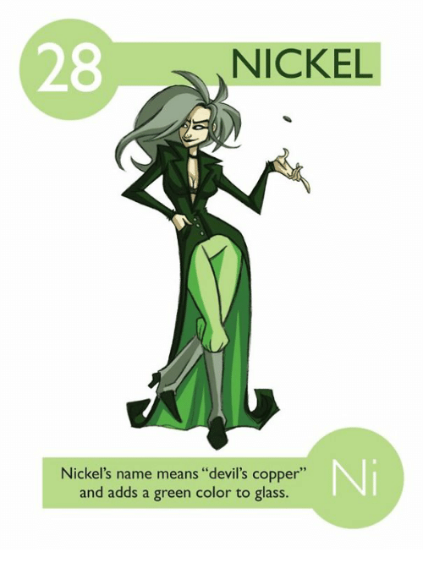
Devil’s Copper
Nickel gets its name from the German word "kupfernickel" which means “old Nick’s copper”. It was also given the nickname "devil's copper” because German miners tried to remove nickel from an ore that they thought was copper, so it was super hard to remove.

Slide 4
Origin of the nickel
Who: Axel Fredrik Cronstedt
Where: When Axel worked at Stockholm he investigated a new metal, which was nickel, it was discovered in a mine at Los, Hälsingland, Sweden.
How: He found it in a mine and thought is might contain copper, but it was actually a new element

Slide 5
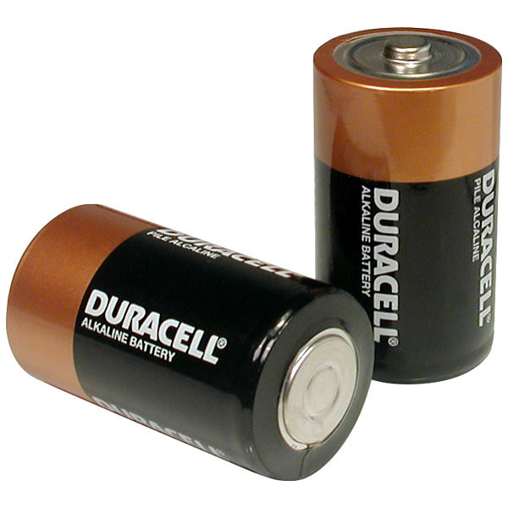
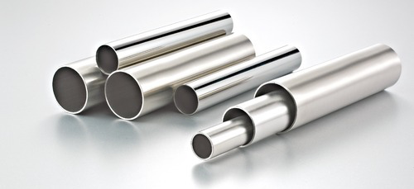
Uses of Nickel
Resists corrosion
Plates other metals to protect them
Mainly used in making alloys such as stainless steel
Used in batteries
The U.S coin “the Nickel” is 25% nickel and 75% copper
When adding nickel to glass, it is used to give in a green color

Slide 6
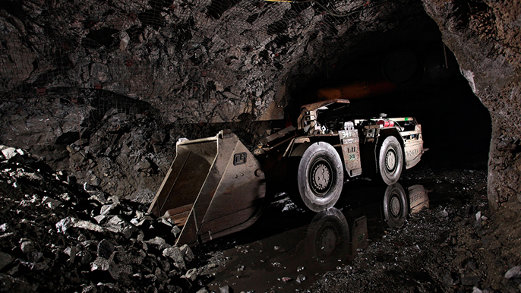
How the Nickel is mined and obtained
Most of the world’s supply of Nickel is mined in the Sudbury region of Ontario, Canada
Primary nickel is produced and used in the form of ferro-nickel, nickel oxides and other chemicals, and as more or less pure nickel metal.

Slide 7
Sources
http://www.rsc.org/periodic-table/element/28/nickel
https://www.ducksters.com/science/chemistry/nickel.php
http://www.chemistryexplained.com/elements/L-P/Nickel.html
https://education.jlab.org/itselemental/ele028.html
https://www.nickelinstitute.org/NickelUseInSociety/AboutNickel/HowNickelIsProduced.aspx

