Slide 1
Iron

Slide 2
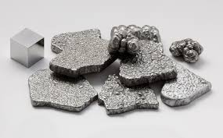
Element name
Element name is “Iron”
Element symbol is “Fe”
Iron is a chemical element with symbol Fe (from Latin: ferrum) and atomic number 26. It is a metal in the first transition series. It is by mass the most common element on Earth, forming much of Earth's outer and inner core. It is the fourth most common element in the Earth's crust.

Slide 3
The reason it's called iron
Origin of name : from the Anglo-Saxon word "iron" or "iren" (the origin of the symbol Fe comes from the Latin word "ferrum" meaning "iron"). Possibly the word iron is derived from earlier words meaning "holy metal" because it was used to make the swords used in the Crusades

Slide 4
how , where and who discovered iron
How: Discovery of Iron. The first iron used by humans is likely to have come from meteorites. ... In Mesopotamia (Iraq) there is evidence people were smelting iron around 5000 BC. Artifacts made of smelted iron have been found dating from about 3000 BC in Egypt and Mesopotamia.
Were: In Mesopotamia (Iraq) there is evidence people were smelting iron around 5000 BC. Artifacts made of smelted iron have been found dating from about 3000 BC in Egypt andMesopotamia. In those times, iron was a ceremonial metal; it was too expensive to be used in everyday life.
Who: Iron has been known since ancient times

Slide 5
How it's obtain
Iron makes up about 80% of the earth's core Things such as vehicles use iron
And buildings Most of our iron comes from china

