Slide 1
Chromium

Slide 2
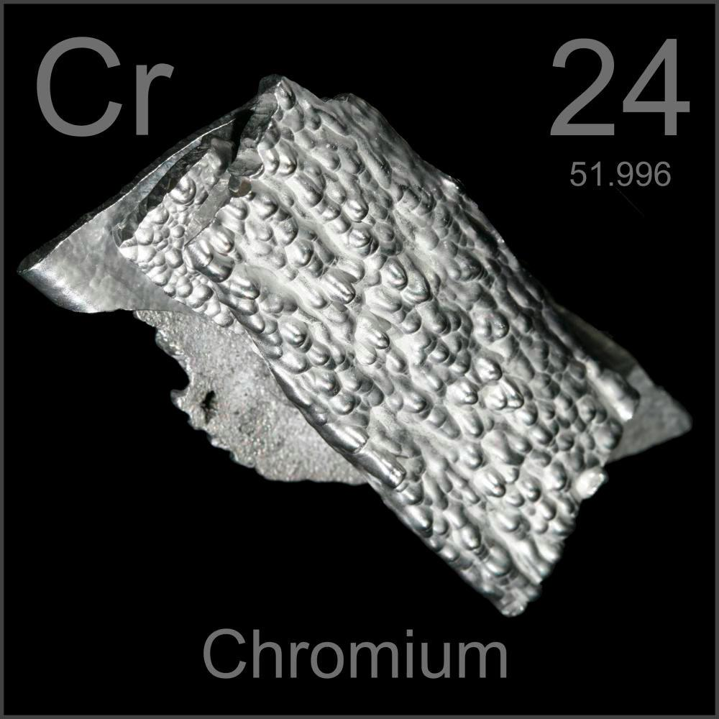
What is Chromium ?
Chromium is element number 24 on the Periodic Table of Elements
Its Symbol is Cr
It is a hard silvery metal with a blue tint

Slide 3
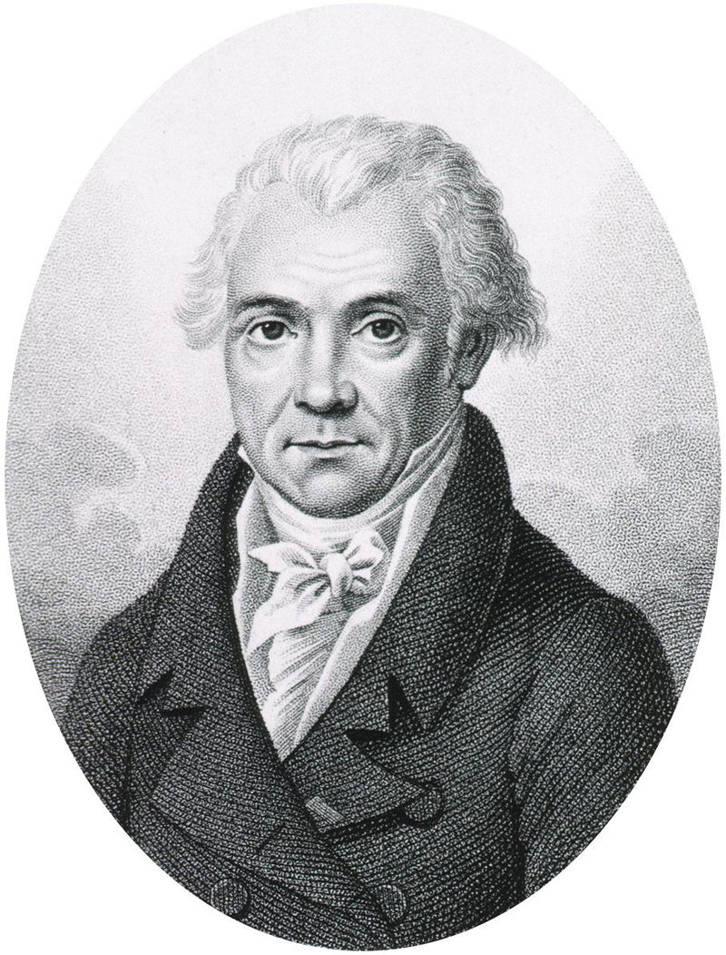
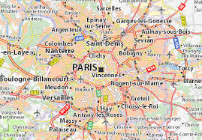
When was Chromium discovered ?
Chromium was discovered in 1797 by Louis-Nicolas Vauquelin in Paris. He discovered it while experimenting with other materials. He obtained chromium by heating the element chormite.

Slide 4

What Chromium is used for:
Chromium is used to harden steel and to make it from not rusting (Stainless steel)

Slide 5
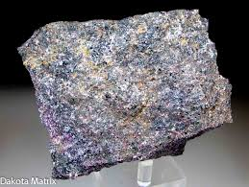
How is chromium mined or obtained?
Chromium is mainly mined as chromite.

Slide 6
Citations
https://education.jlab.org/itselemental/ele024.html (second and forth slide)
https://www.google.com/search?rlz=1CAHPZY_enUS817&biw=1366&bih=677&tbm=isch&sa=1&ei=VTC1W4OuA5S70PEP-_Oy-AU&q=chromium+element+&oq=chromium+element+&gs_l=img.3..0l10.9708.11863..12604...0.0..0.51.350.9......1....1..gws-wiz-img.......0i67.V4Toh-4Yk7g&safe=active&ssui=on (second slide)
http://www.rsc.org/periodic-table/element/24/chromium ( fifth slide and second)
https://www.greatmining.com/chromium.html (sixth slide)

