Slide 1
Titanium

Slide 2
What is Titanium?
Classified as a shiny, silvery-gray dense metal that is apart of the transition metals of the periodic table. At room temperature it is a solid. It is a lustrous, white metal that is corrosion resistant to heat.
The name ‘Titanium’ is derived from from the Titans in Greek Mythology, the sons of the Earth Goddess. 2
Titanium is of Group 4 of the Periodic Table.
Discovered by William Gregor in 1791 in South West England, Cornwall.1
1,2 http://www.rsc.org/periodic-table/element/22/titanium
https://www.merriam-webster.com/dictionary/titanium
https://www.webelements.com/titanium/

Slide 3
Titanium
22
T
i
47.87

Slide 4
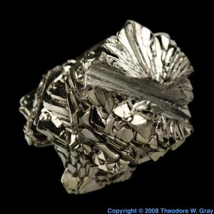
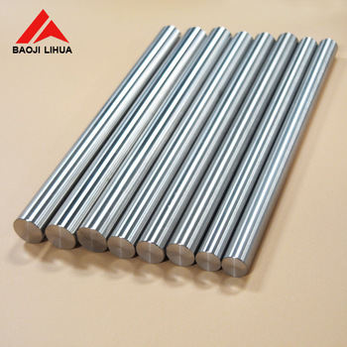
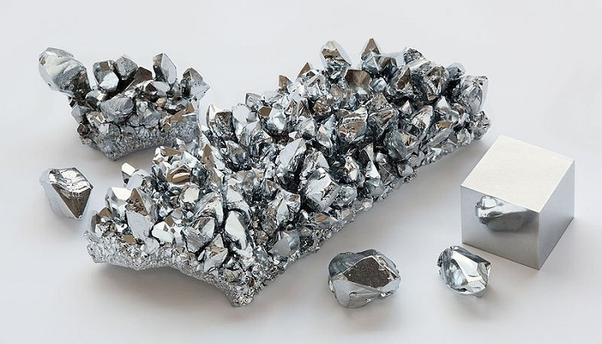
Types of Titanium:
Commercially produced.
Metalloid.
Titanium in other objects.

Slide 5
Uses of Titanium
Used along with other metals such as aluminum or iron in objects.
Titanium has the density of 4.5kg/cm3
Because of the elements low density, it is used in parts of aircraft, missiles or rockets because of its high resistance to high temperature.
Commonly used as an alloy with other metals like iron, aluminum or manganese..
https://education.jlab.org/itselemental/ele022.html

Slide 6
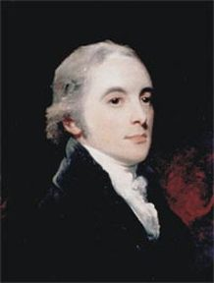
William Gregor
An english chemist and mineralogist who discovered titanium in South West, England. He was also an ordained pastor. He graduated from the University of Cambridge. Because he was very interested in minerals and studying them, he discovered titanium in a mineral called “Menachanite.”
https://www.webelements.com/titanium/history.html
https://www.britannica.com/science/titanium#ref921496

Slide 7
How is titanium mined or obtained?
Titanium is rare to be found in its purest form. It is also found in other minerals, commonly found in rutile and ilmenite.
Commonly mined from other crystalline metals and can be dissolved from sodium and steel to get its purest form.
Titanium can be found in the earth’s crust.
Also present in meteorites
https://mineralseducationcoalition.org/elements/titanium/
https://www.worldofchemicals.com/98/chemistry-articles/william-gregor-discoverer-of-titanium-metal.html

