Slide 1
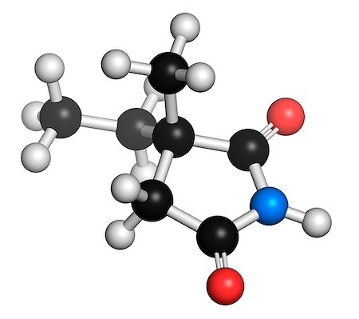
Calcium___
Ca__
-calcium is a reactive metal that forms a dark oxide-nitride layer when exposed to air.

Slide 2
Why, whom, where, how?
Calcium was named after the Latin term calx meaning lime.
Calcium was discovered by Sir Humphry Davy in England (1808).
After learning that Berzelius and Pontin prepared calcium amalgam by electrolysing lime in mercury, Sir Humphry Davy was able to isolate the impure metal. He did this by the electrolysis of a mixture of lime and mercuric oxide (HgO).

Slide 3
calcium’s uses:
A reduce agent in the process of metal extraction.
As an alloying agent in the production of some metals.
An essential element of the earth.
It is classified as a metallic element and its oxides alkaline in nature.
It combines with other elements to form various compound.
An vital substances used by man in life.

Slide 4
How to obtain calcium?
From food; dairy products, seafood,..

