Slide 1
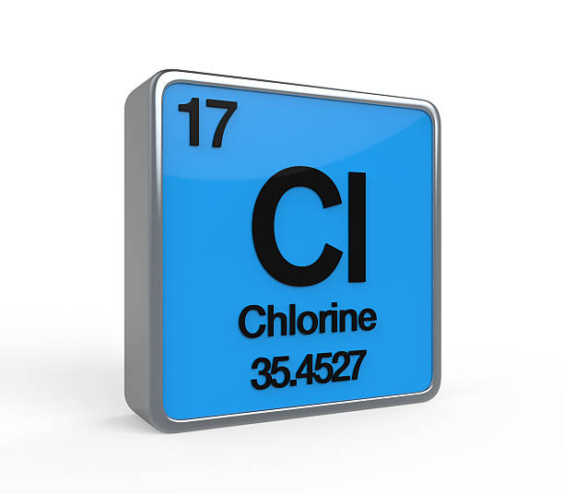
Chlorine

Slide 2
Description about
chlorine

Slide 3
Chlorine is a chemical element with symbol Cl and atomic number 17. The second-lightest of the halogens, it appears between fluorine and bromine in the periodic table and its properties are mostly intermediate between them. Chlorine is a yellow-green gas at room temperature.

Slide 4
Discovered in 1774 at Sweden by Carl Wilhelm Scheele, who mistakenly thought it contained oxygen. Chlorine was given its name in 1810 by Humphry Davy, who insisted that it was in fact an element.
The pure chemical element has the physical form of a diatomic green gas. The name chlorine is derived from chloros, meaning green, referring to the color of the gas.

Slide 5

Chlorine is commonly used as an antiseptic and is used to make drinking water safe and to treat swimming pools. Large amounts of chlorine are used in many industrial processes, such as in the production of paper products, plastics, dyes, textiles, medicines, antiseptics, insecticides, solvents and paints.

Slide 6

Chlorine is obtained by the electrolysis of sodium chloride solutions. Along with sodium, chlorine is abundant in the oceans. The most common chlorine-bearing mineral is, of course, halite (sodium chloride).

