Slide 1
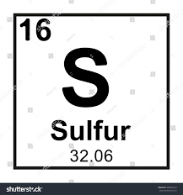
S-SULFUR

Slide 2
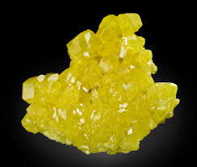
Sulfur
Technical data
Density-1.96g/cm^3
Melting point-115.21 c
Boiling point-444.72 c
Electron properties-[Ne]3s^23p^4

Slide 3
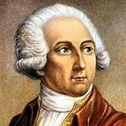
WHO Discovered Sulfur
Antoine Lavoisier
Sulfur, the tenth most abundant element in the universe, has been known since ancient times. Sometime around 1777,Antoine Lavoisier convinced the rest of the scientific community that sulfur was an element.

Slide 4
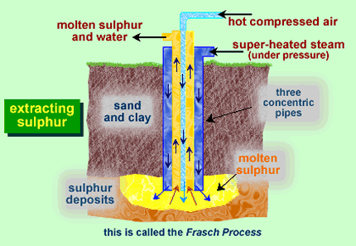
How sulfur is obtained
The majority of the sulfur produced today is obtained from underground deposits, usually found in conjunction with salt deposits, with a process known as the Frasch process. Sulfur is a pale yellow, odorless and brittle material. ... Most of the sulfurthat is produced is used in the manufacture of sulfuric acid (H₂SO₄).

Slide 5
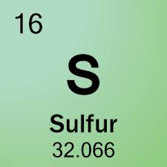
Origin of Sulfur
Sulfur was discovered by known since ancient times in unknown at not known. Origin of name: from the Sanskrit word "sulvere" meaning "sulphur"; also from the Latin word "sulphurium" meaning "sulphur".

Slide 6
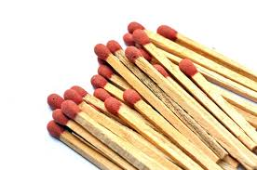
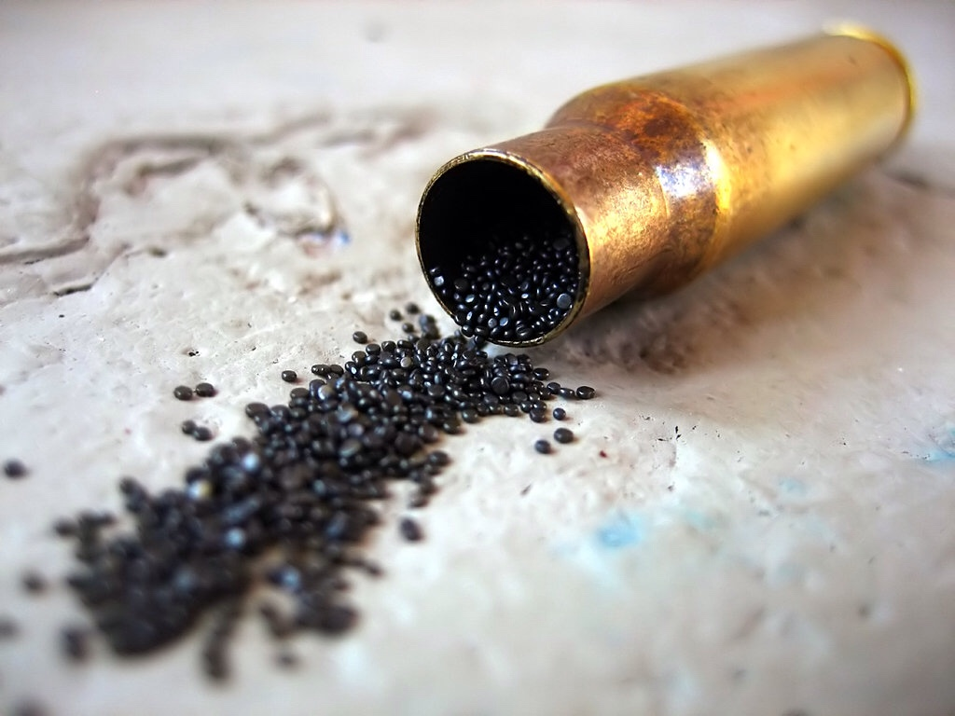
Used in
Elemental sulfur is used in black gunpowder, matches, and fireworks; in the vulcanization of rubber; as a fungicide, insecticide, and fumigant; in the manufacture of phosphate fertilizers; and in the treatment of certain skin diseases. The principal use of sulfur, however, is in the preparation of its compounds.

