Slide 1
Silicon - Si - #14

Slide 2
Silicon?
Silicon is a metalloid found in the crust of the Earth.
It is the second most common element on Earth
It is the 8th most common element in the Universe
Silicon is a semiconductor
Blue-tinted at it’s faces
Atomic Number: 14
Period 14 and Group 3, under Carbon

Slide 3
Who named it Silicon?
Jöns Jacob Berzelius discovered the element in 1823, citing it as “Silicium” but it was named after the Latin word, “Silex” in 1817 by Thomas Thomson. (Cool name, I know)

Slide 4
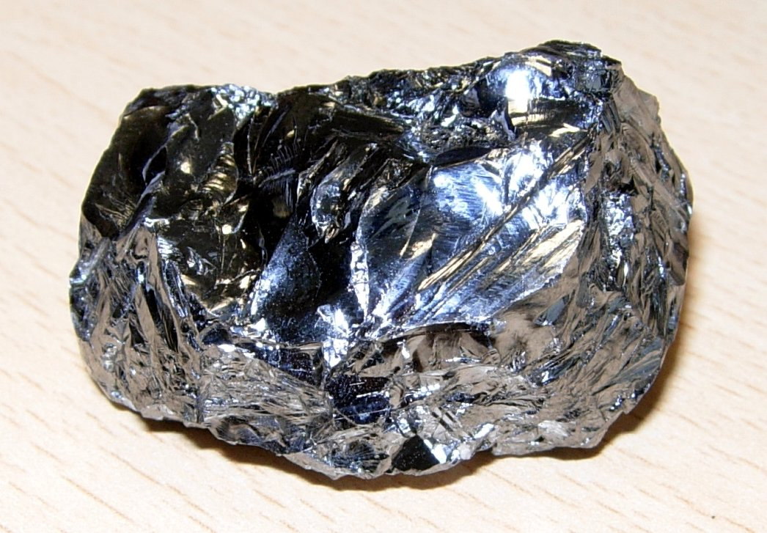
Uses
Portland Cement and Concrete
Porcelain and ceramics
Used in semiconductors, essential to all modern day technology

Slide 5
Where can you find “Silicon”?
Silicon is vastly abundant on Earth, making up most the crust.
There are a ton of compounds on Earth that include Silicon.
It makes up ~28% of the Earth’s crust by mass
You can also find it as a “Silica” or Silicon Oxide
Silicon is also found in flints, one of the earliest tools used by humans, as well as what makes glass, glass.

