Slide 1
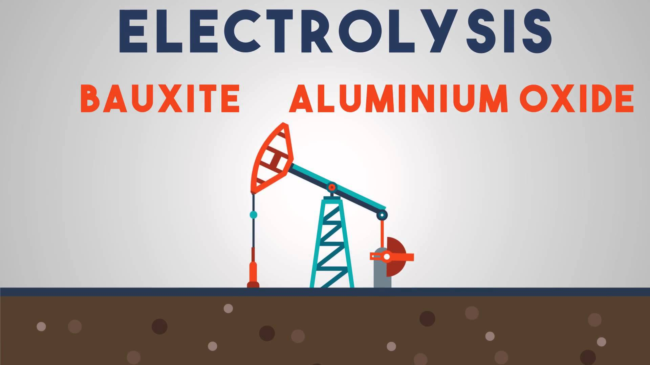
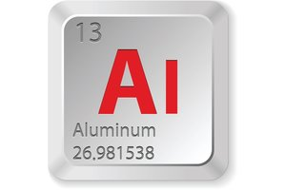
Aluminum (Al)
The name is derived from the Latin name for alum, 'alumen' meaning bitter salt.Aluminum was discovered in 1825 by Hans Oersted

Slide 2
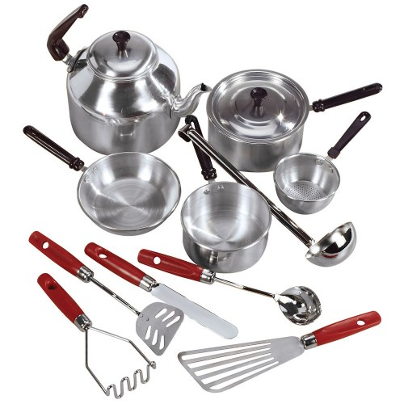
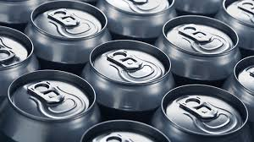
Scientist suspected that an unknown metal existed in alum as early as 1787, but they did not have a way to extract it until 1825.Hans Christian Oersted,a Danish chemist, was the first to produce tiny amounts of aluminum.
Aluminum is used in a huge variety of products such as cans,foils,kitchen utensils,window frames,beer kegs and aeroplane parts.
Aluminum(Al) comprises about 8.2% of earth’s crust.It is the third most abundant element in the crust and the most plentiful metallic element,but is never found on its own in nature.Bauxite is the ore most commonly mined for aluminum in which aluminum occurs as hydroxide minerals

