Slide 1
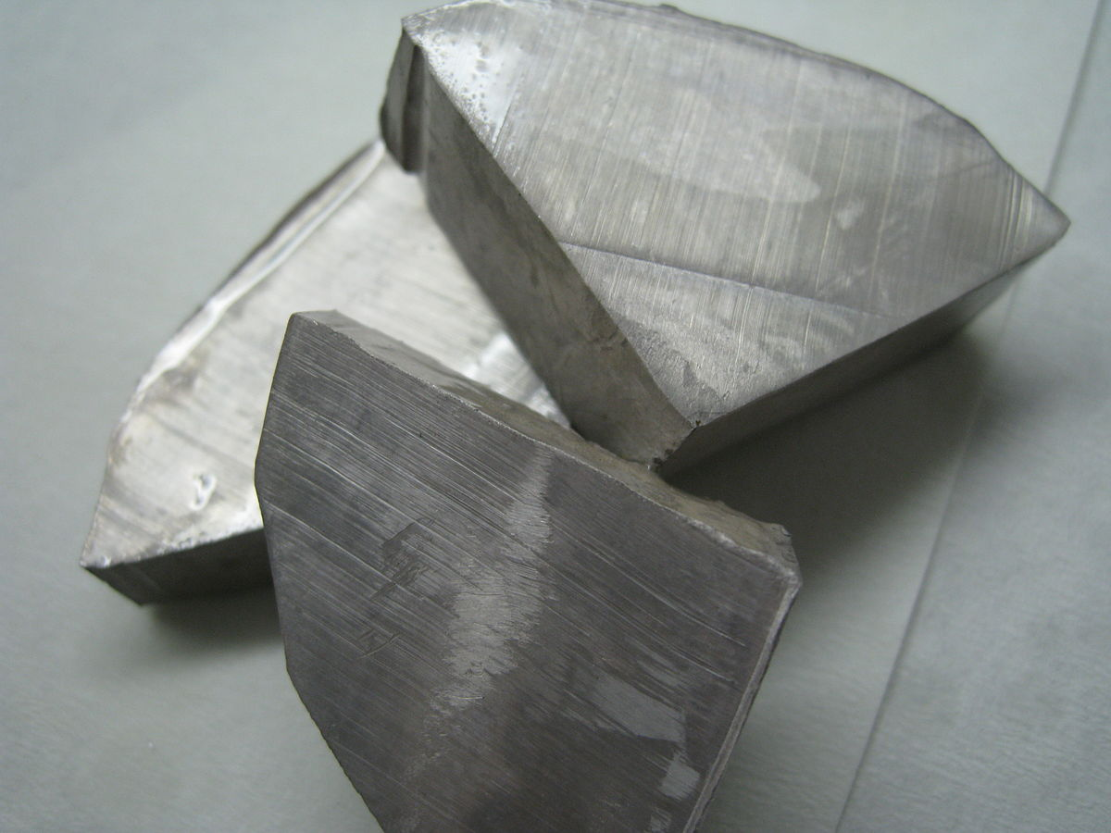
Name,Symbol,Description.
My chemical element is, Sodium (Na) it is a soft silvery-white highly reactive metal. Sodium is also and alkali metal, being in group 1A on the periodic table because it has one single electron in the outer shell. It readily donates, creating a postively charged ion the Na.

Slide 2
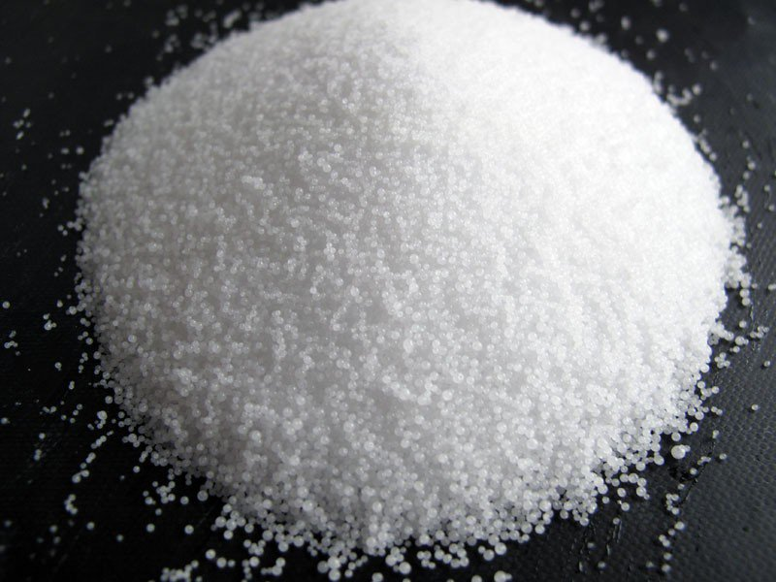
Why sodium was named sodium.
Sodium got its name from, the english word soda. Because the guy who founded the element, used caustic soda when isolating the element. The chemical name (Na) is from the latin word natrium.
Notes:
This is a pic of caustic soda.

Slide 3
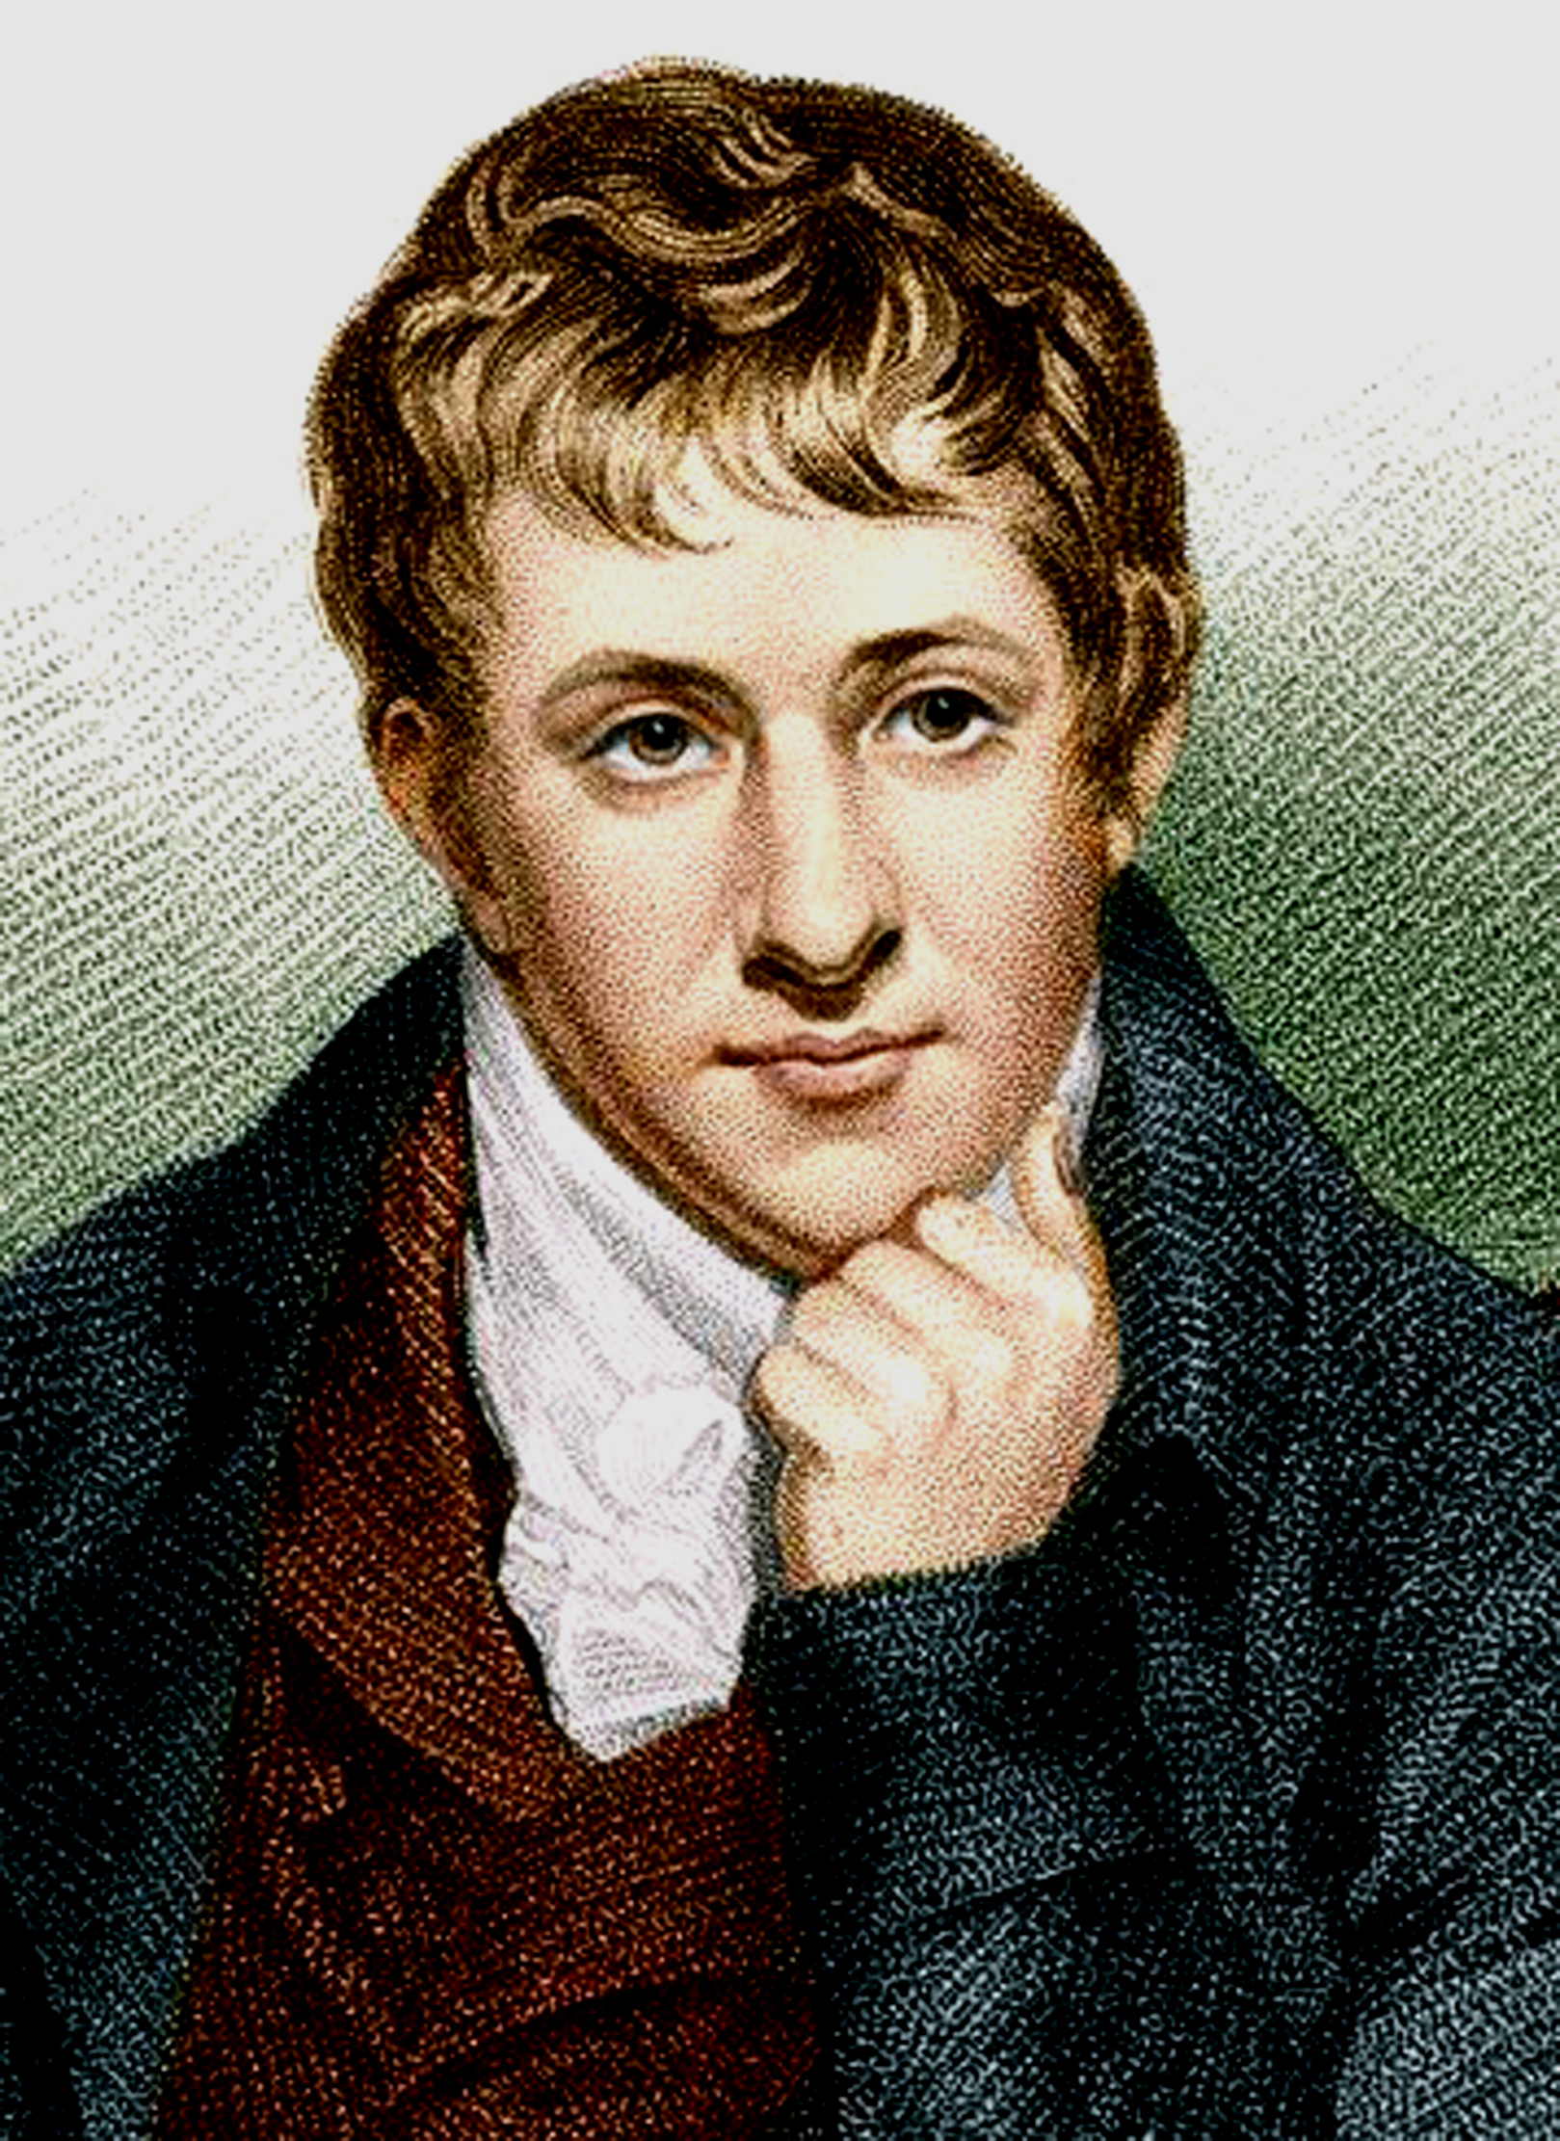
How,Where,When it was founded.
It was founded in 1807 by sir Humphry Davy though it doesn't say where he founded it i'm guessing it was in a lab. He found it by applying electrolysis to caustic soda.

Slide 4
Sodium uses.
Sodium vapor is used for streetlights to create a yellow color.
It is also used for food when it is in a compound known as sodium chloride (NaOH)
It is also baking soda
Its also used to de-ice roads in winter.

Slide 5
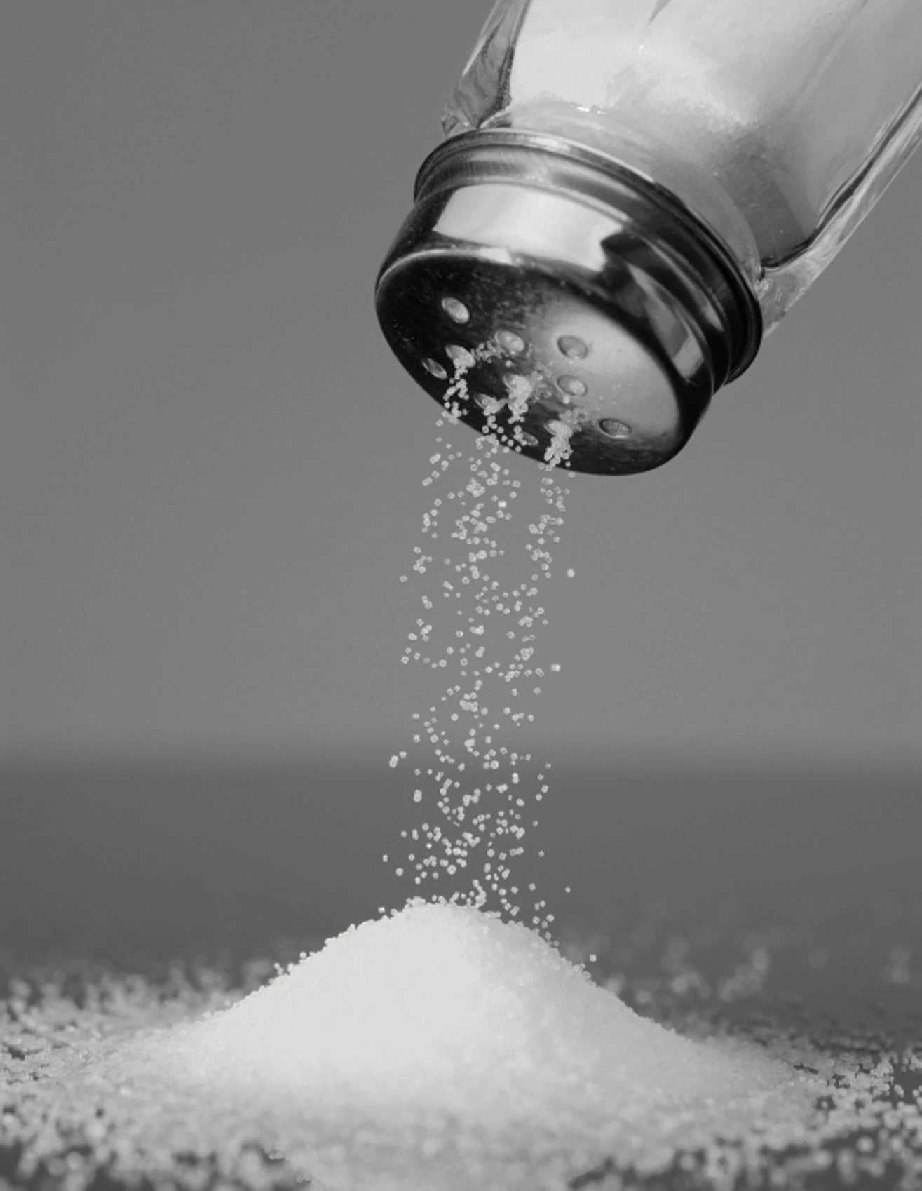
How its mined and obtained.
Sodium cannot be mined it is found and, it cannot be found in nature. You can obtain it through salt or baking soda. Its most commonly found in rock salt or just salt.

