Slide 1
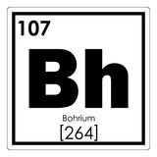
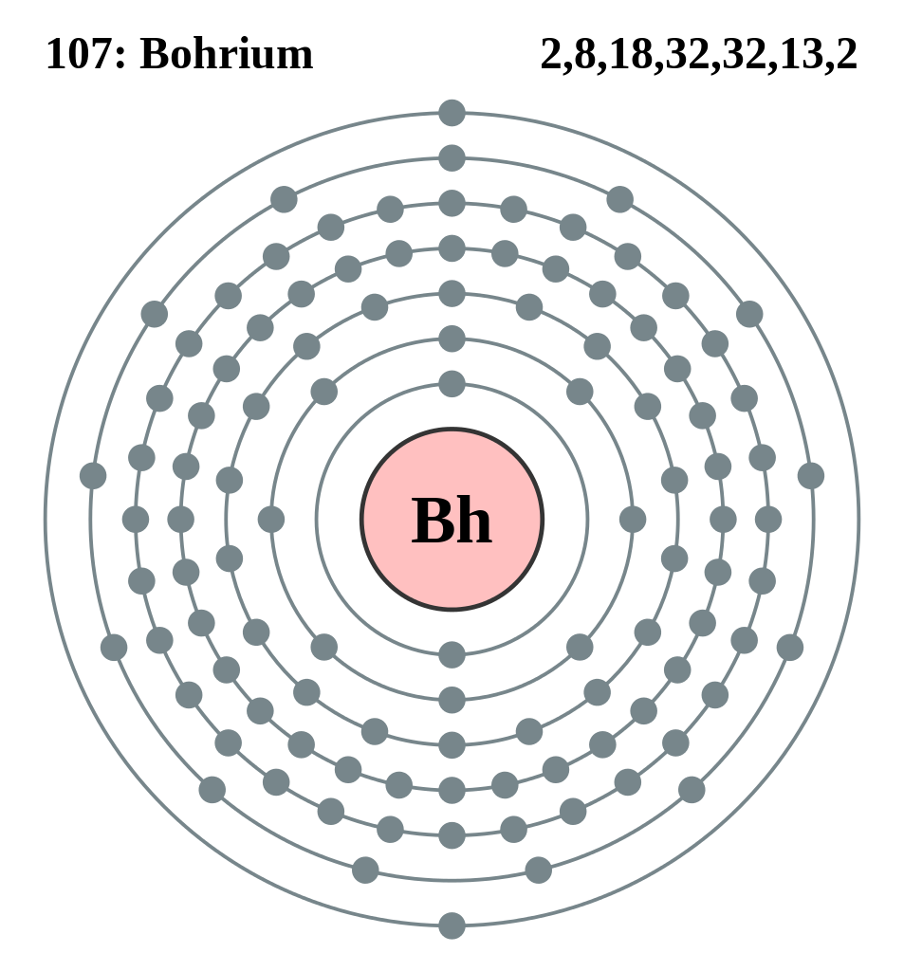
Bohrium (Bh)
https://mineralseducationcoalition.org/elements/bohrium/
http://www.rsc.org/periodic-table/element/107/bohrium
Not found in nature,but is created in a lab. Bohrium is one of the few atoms that has been
produced in a laboratory.
Bohrium is named after Danish physicist Niels Bohr.
Nuclear researchers found that Bohrium was made bombarded bismuth with chromium. Made in Dubna, the German Nuclear Research Institute was the first research team to discover Element 107.
Element 107 is of research purposes/interests only.
Obtained by bombarding bismuth with chromium^^

