Slide 1
Neon

Slide 2
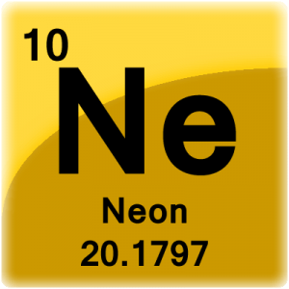
Neon Facts
Atomic number
    10
Noble gas
10 protons, neutrons, electrons
Group 18
Density
    0.901 grams cm^3

Slide 3
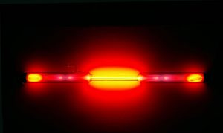

More Neon Facts
Rare on earth
Does not bond with other elements (noble gas)
Monatomic
  Made of one atom

Slide 4
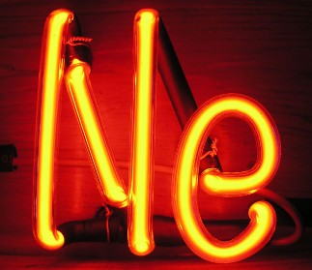
Name Origin
The name neon was inspired by the Greek word, neos, which means new. Which makes sense, because during that time (1898) it was a new discovery.

Slide 5
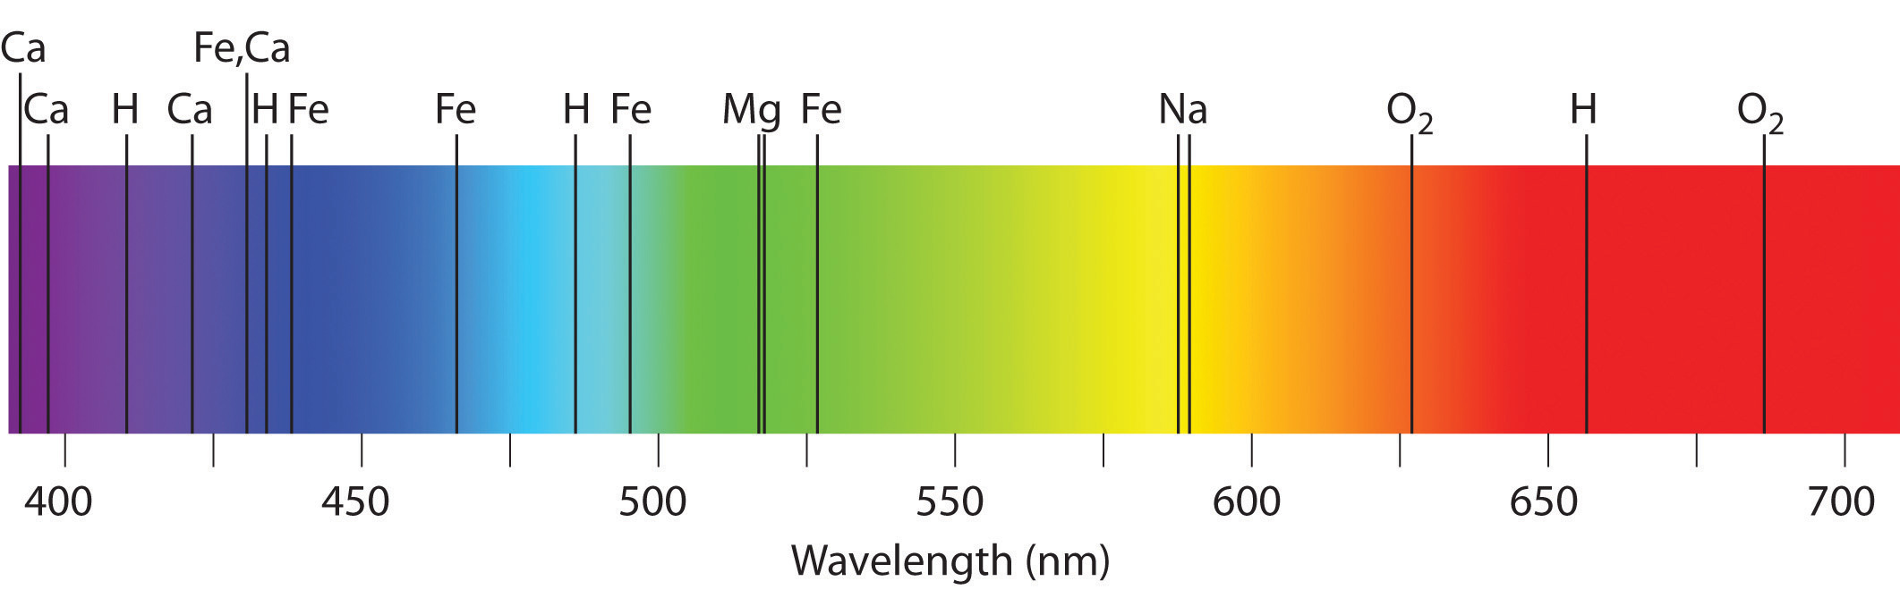
Discovery
The discovery of the noble gas in 1898 by William Ramsay and Morris W. Travers, added another element to the periodic table. Ramsay also found argon and helium, trying to find an element between the two. Both (Ramsay and Morris) separated gases under pressure and iodized the samples to keep the spectra (wavelengths: electromagnetic) and one sample glowed bright red.

Slide 6
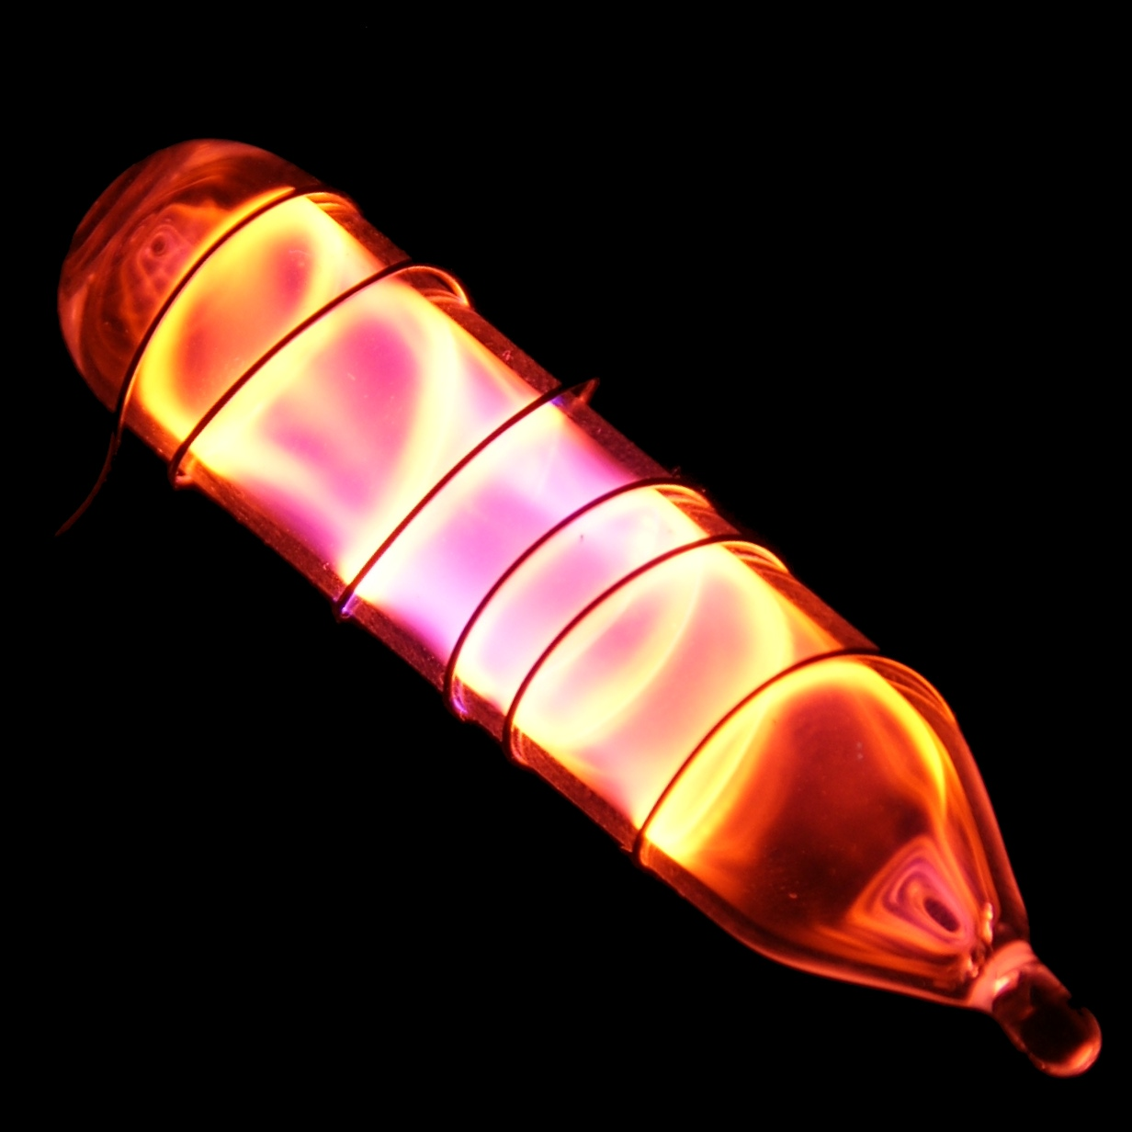
Where to find it
Air
Earth crust
Universe
Produced by humans
    Fractional distillation

Slide 7

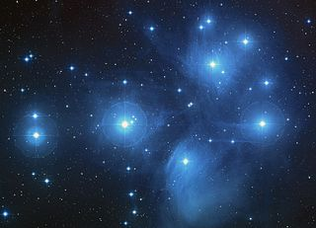
Uses/Found In
Neon lights
Lasers
    Helium and neon lasers
Tv tubes
Stars (Helium and Oxygen fuse)

Slide 8
Sources
https://www.livescience.com/28811-neon.html
https://hobart.k12.in.us/ksms/PeriodicTable/neon.htm
https://sciencenotes.org/neon-facts/
https://www.webelements.com/neon/history.html
https://www.ducksters.com/science/star.php
https://www.ducksters.com/science/chemistry/neon.php

