Slide 1
Hydrogen.
1
1.0079

Slide 2
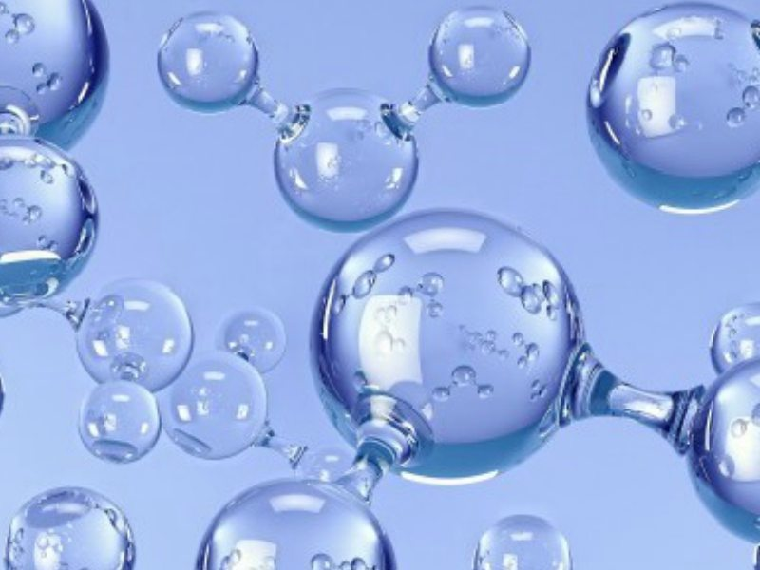
About Hydrogen.
Hydrogen is a gas. It is non-flammable.
It’s used for rocket fuel, welding & harber ammonia process.
Discovered In 1766 By Henry Cavendish. As a non-flammable gas in air.

