Slide 1
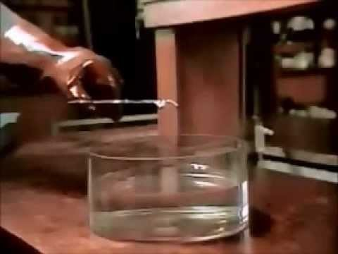
Lesson 9: Create A Table
Properties of the Elements

Slide 2
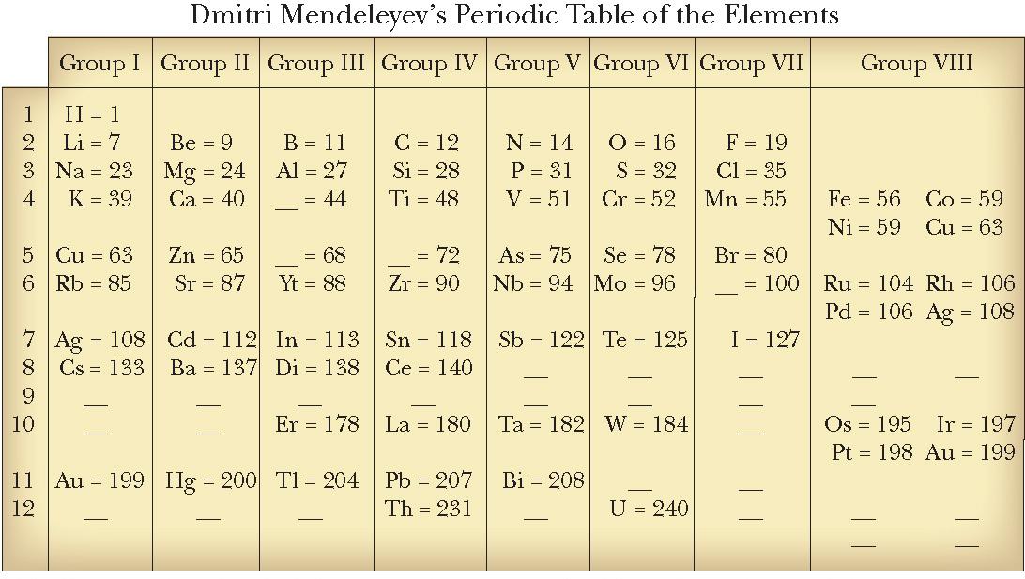
ChemCatalyst
1. How do you think the elements are organized in this table?
2. What do you think Mendelev was trying to do?

Slide 3
Key Question
How is the periodic table organized?

Slide 4
You will be able to:
  describe how the organization of the periodic table is based on reactivity and atomic mass
  predict the characteristics of a missing element on the periodic table based on its position in the table

Slide 5
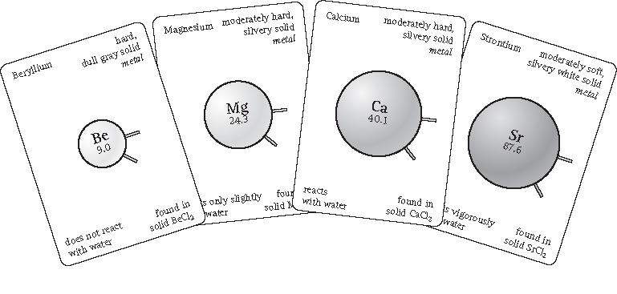
Prepare for the Activity
Work in groups of four with one set of Create a Table cards for each group.

Slide 6
Prepare for the Activity (cont.)
Atomic Mass: The mass of a single atom (or isotope) of an element.
Each element has an average atomic mass that is expressed as a decimal number. These are the numbers that appear in the ChemCataylst and also on the Create a Table cards.

Slide 7
Prepare for the Activity (cont.)
What is reactivity?
Reactivity: A property that describes whether an element or compound will chemically combine with other substances to form compounds and also describes the speed of a reaction.
Reactivity information is included on the Create a Table cards.

Slide 8
Discussion Notes
Mendeleyev organized his periodic table based on the properties of the elements, such as reactivity and atomic mass.
Mendeleyev’s arrangement of the elements helped predict the existence and properties of as-yet-undiscovered elements.

Slide 9
Wrap Up
How is the periodic table organized?
  Mendeleyev organized his periodic table based on the properties of the elements, specifically, reactivity and atomic mass.
  Elements in each column of the periodic table have similar properties.
  Reactivity describes whether an element will chemically combine with other common substances and also describes the speed of the reaction.
  Mendeleyev’s arrangement of the elements helped predict the existence of undiscovered elements.

Slide 10
Check-In
Which of these elements would be grouped together on the periodic table? Explain your thinking.
cadmium Cd | moderately soft, silvery, solid, metal | reacts very slowly with water | found in CdCl₂(s)
zinc Zn | moderately hard, silvery, solid, metal | reacts very slowly with water | found in ZnCl₂(s)
iodine I | purple, solid, nonmetal | reacts slowly with metals | found in ICl(s)
mercury Hg | silvery, liquid, metal | does not react with water | found in HgCl₂(s)

