Slide 1
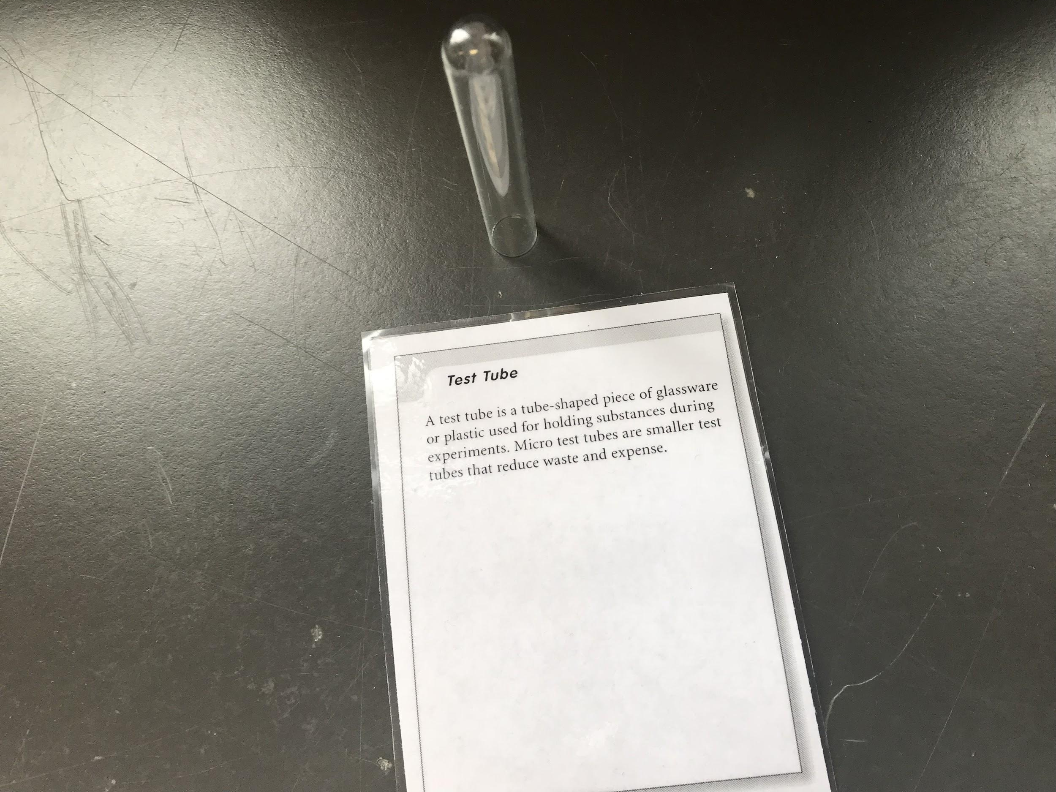
Test Tube
A tube-shaped plastic or glassware responsibly for holding substances during experiments.
Micro/Smaller Test tubes are that reduce waste and expense.

Slide 2
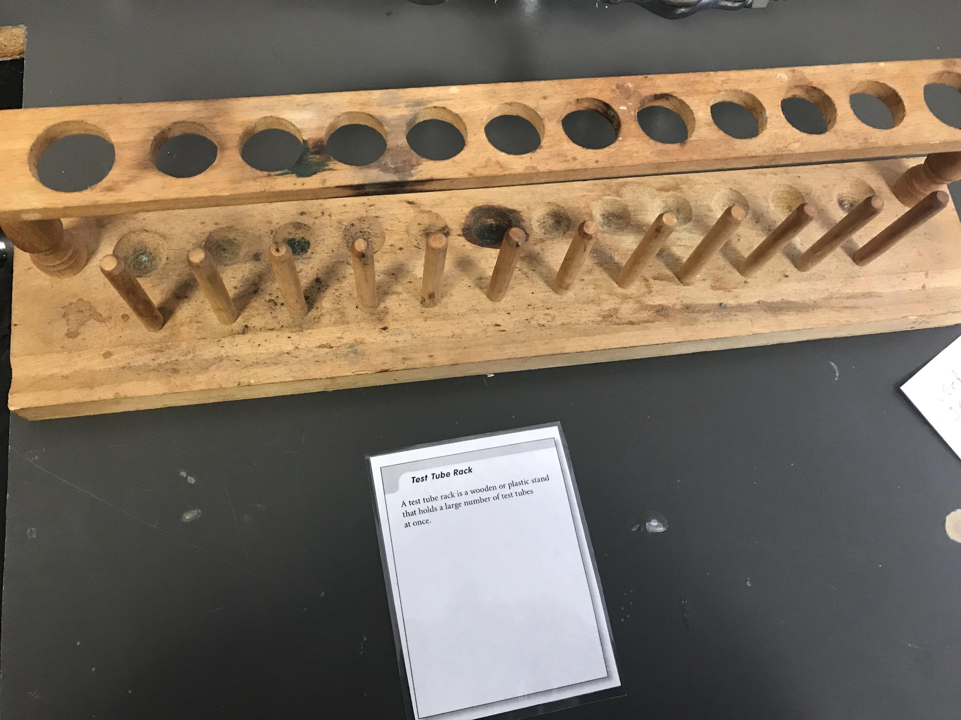
Test Tube Racket
A test tube rack is wooden or plastic stand that can hold a lot of test tubes at once.

Slide 3
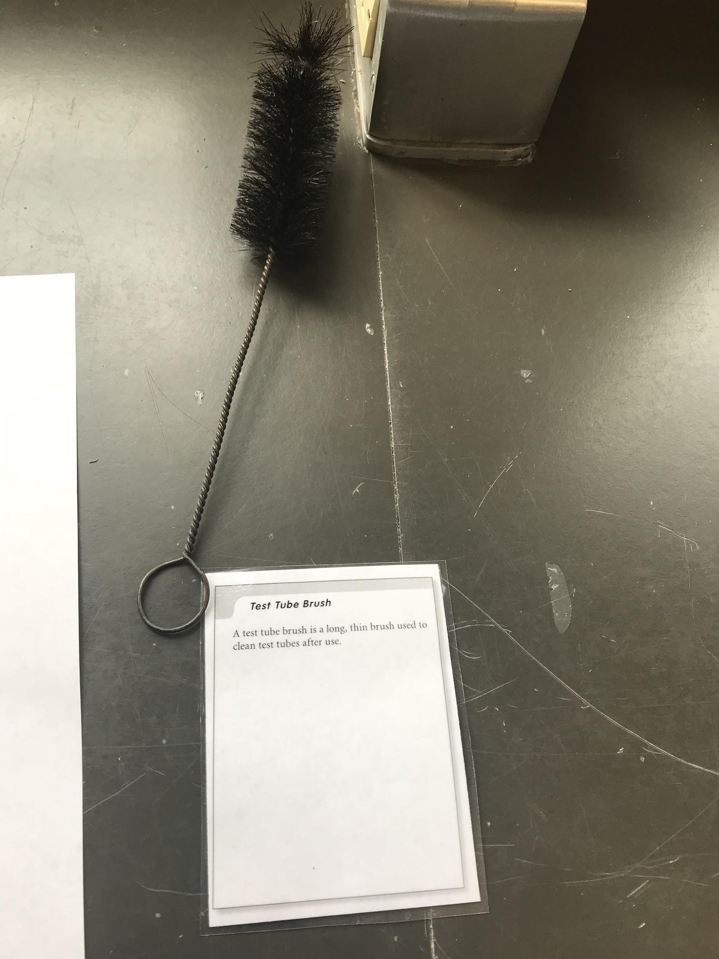
Test Tube Brush
A long, thin brush used to clean tubes after use.

Slide 4
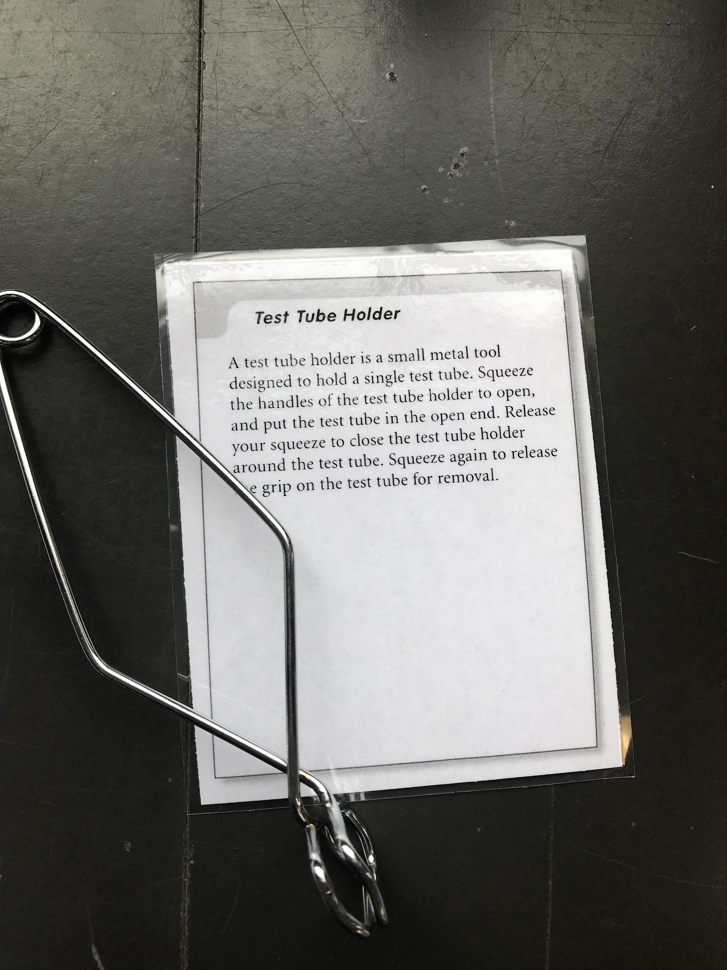
Test Tube Holder
A small metal tool used to hold a singular test tube.
To use :
Squeeze the handle to open, and put the test tube in the open end
Release the squeeze to close the test tube holder around the test tube
Squeeze again to release the test tube from the grip

Slide 5
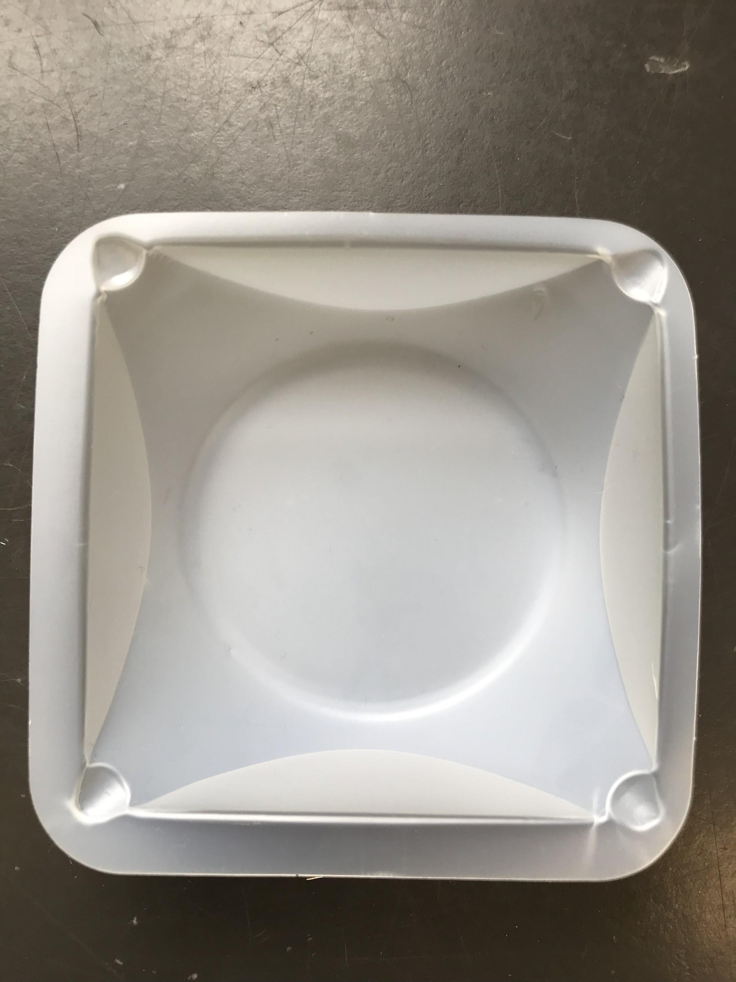
Weighing paper
Weighing paper is used as a container for weighing
powered solids.

Slide 6
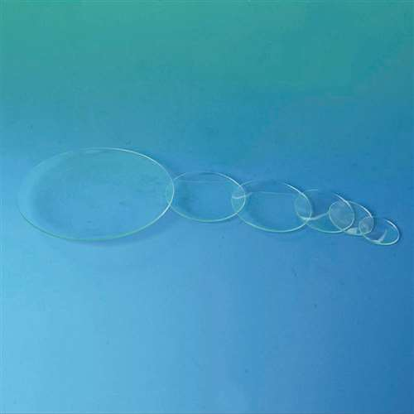
Watch glass
A round piece of glass used for evaporating small amounts of liquid.

Slide 7
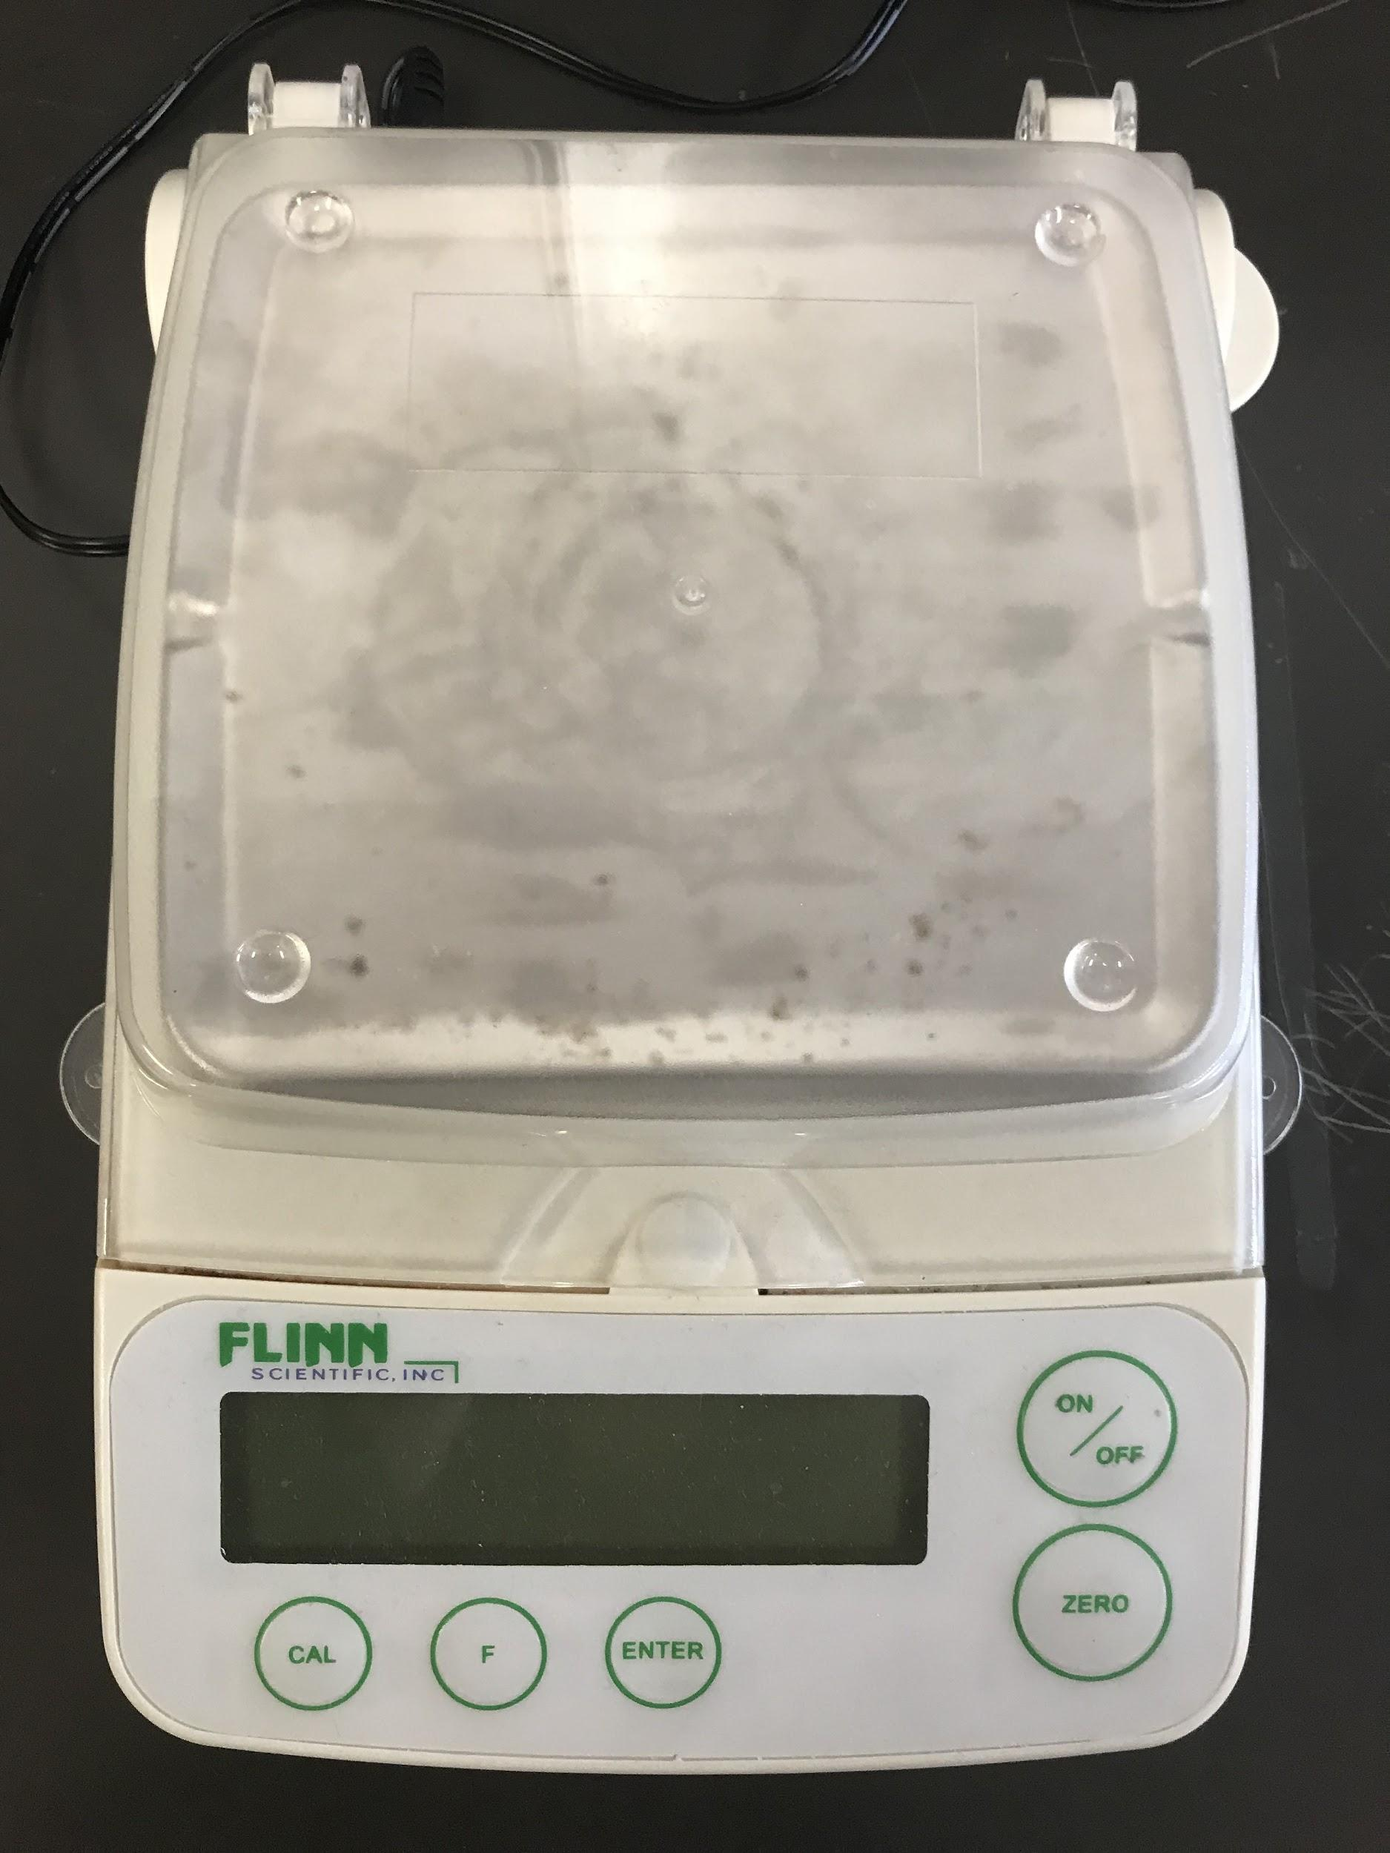
Balance aka Scale
A balance is used to measure the mass of a substance.

Slide 8
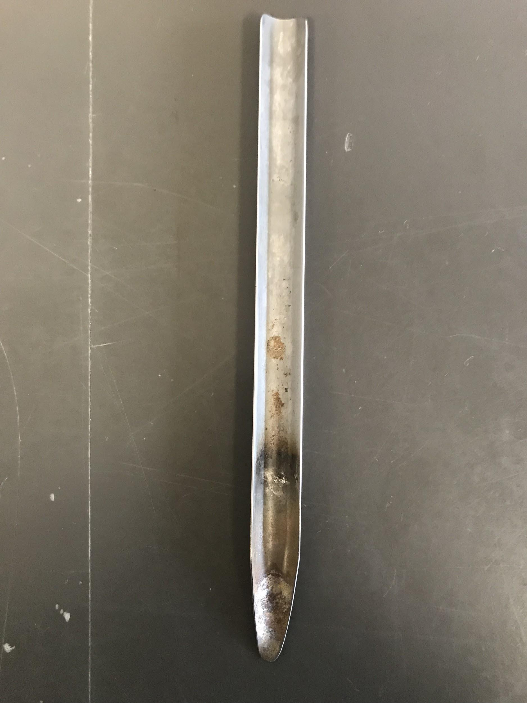
Spatula
A spatula is a slim metal scoop used to transfer solids\
Solids from one container to another

Slide 9
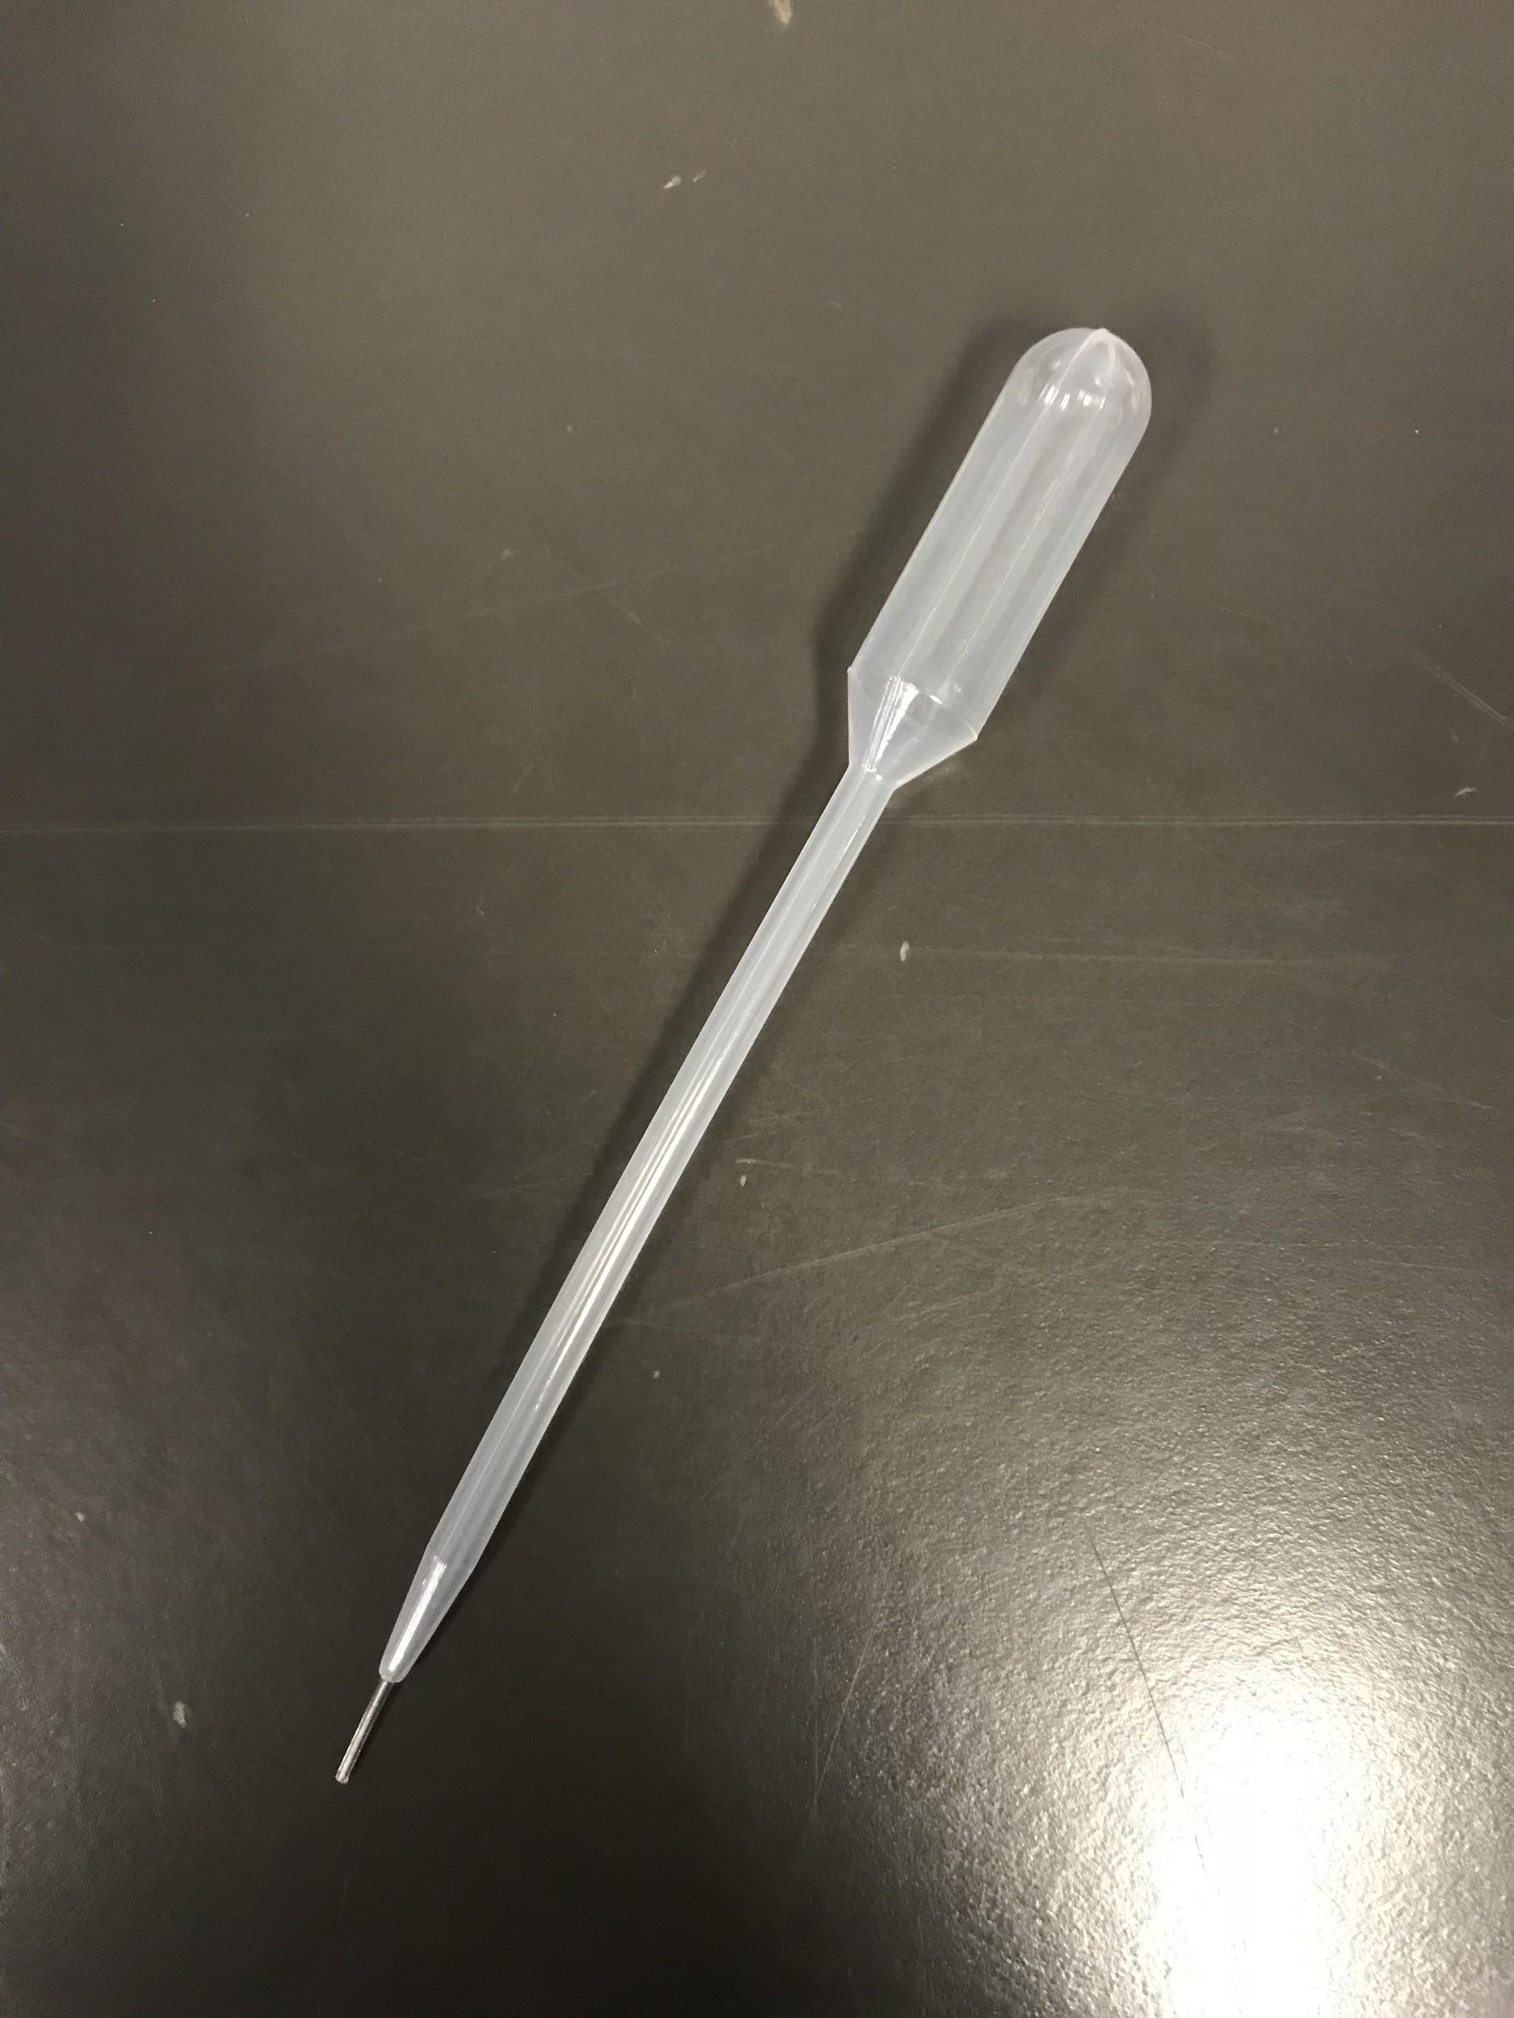
Pipette and Bulb
A pipette is used to measure exact volumes of liquids. First pour the liquid into the beaker. Squeeze the pipette bulb, then place the tip of the pipette below surface liquid. Gradually release your squeeze on the bulb to draw the liquid into the pipette.

Slide 10
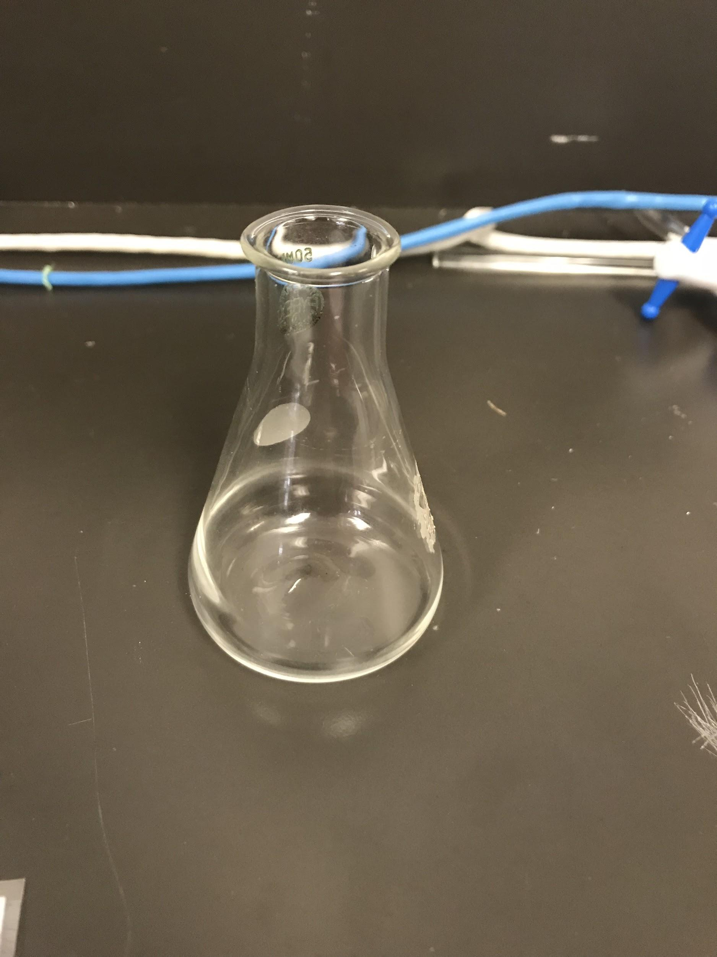
Erlenmeyer Flask
The Erlenmeyer flask is a piece of glassware with a wide circular base and a narrow neck. It is used as a container for liquids.

Slide 11
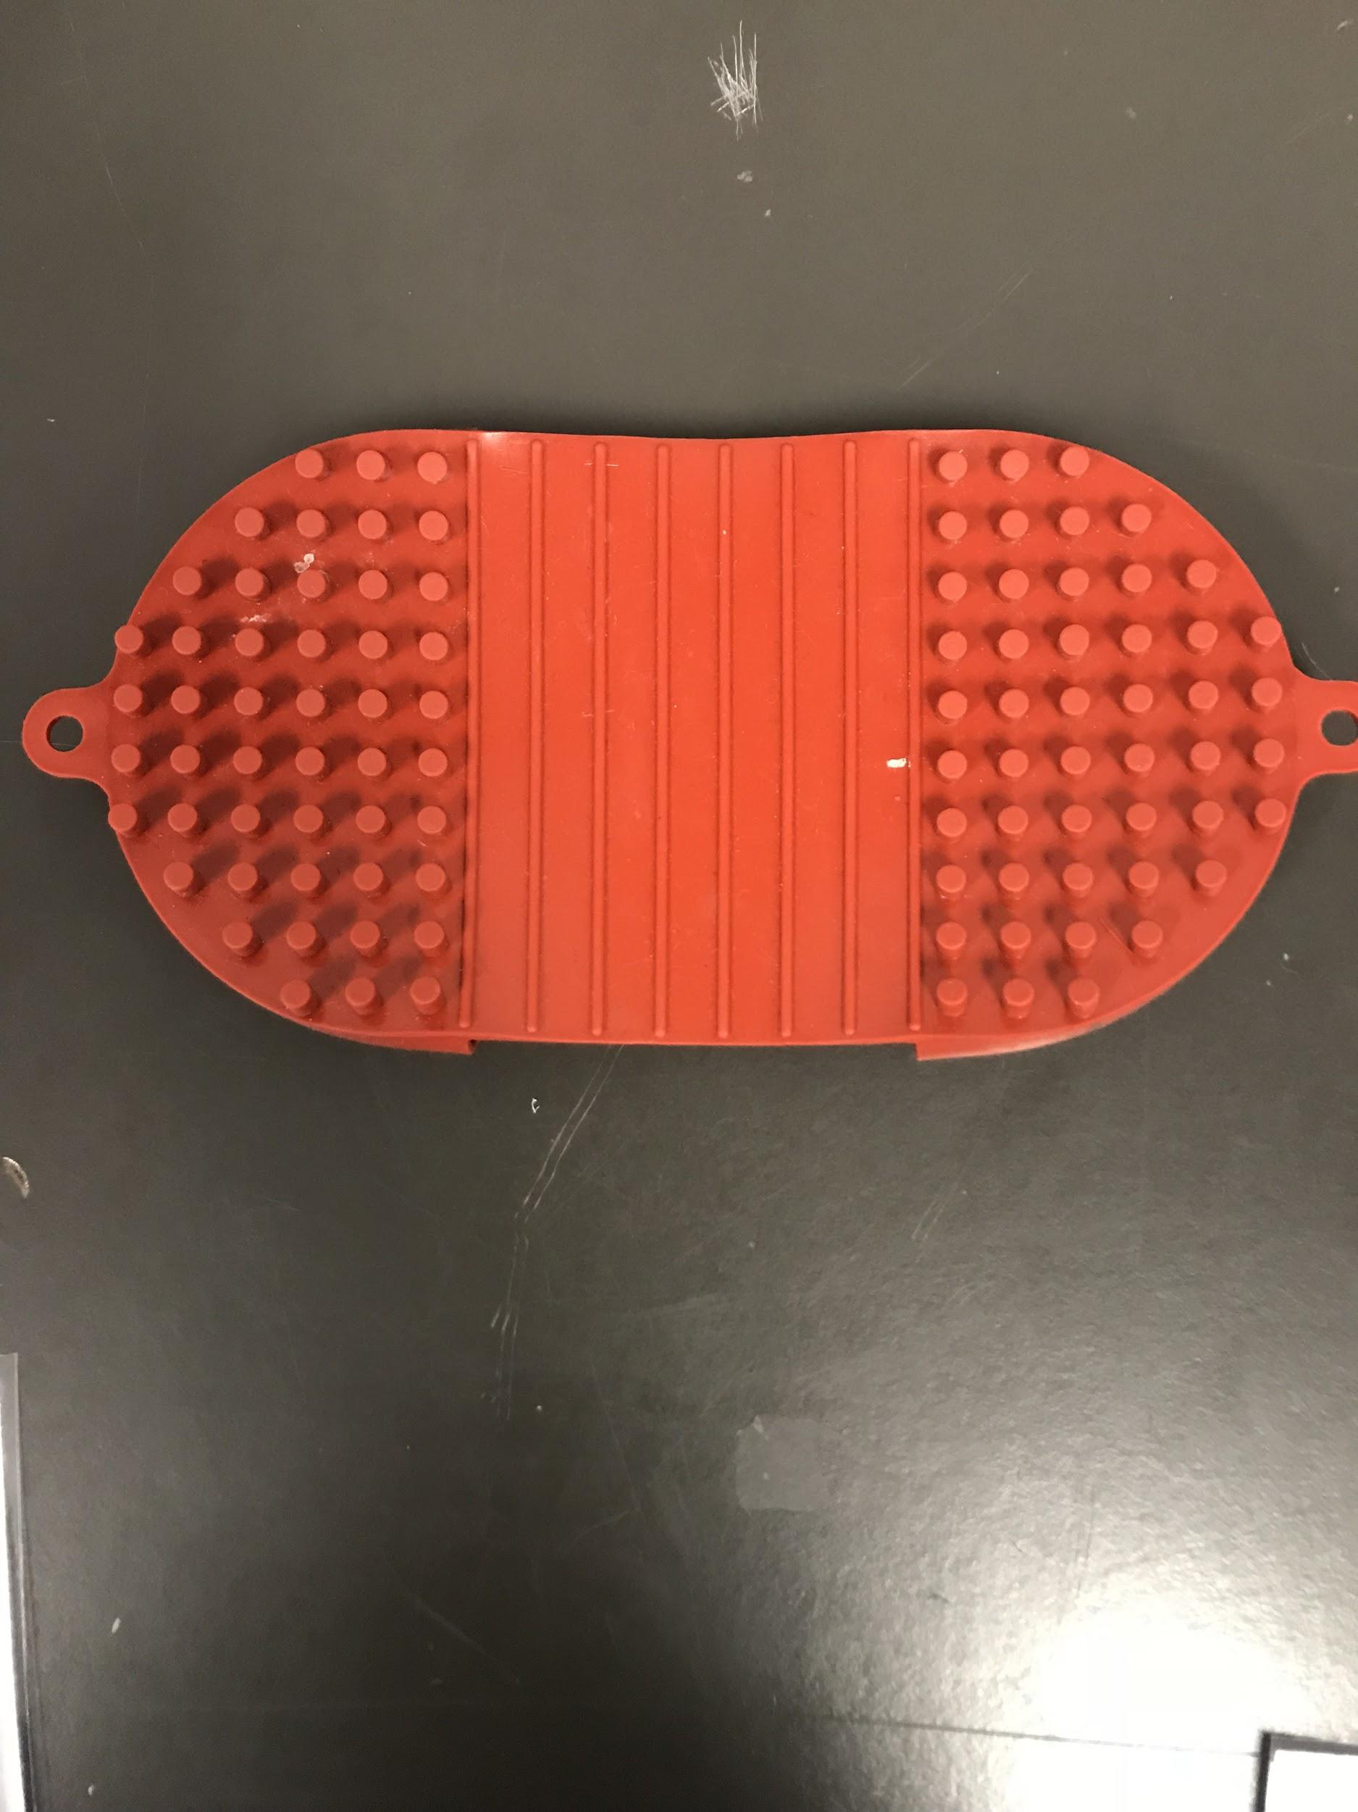
Hot Hands
Glove like sleeve used to handle hot glassware.

Slide 12
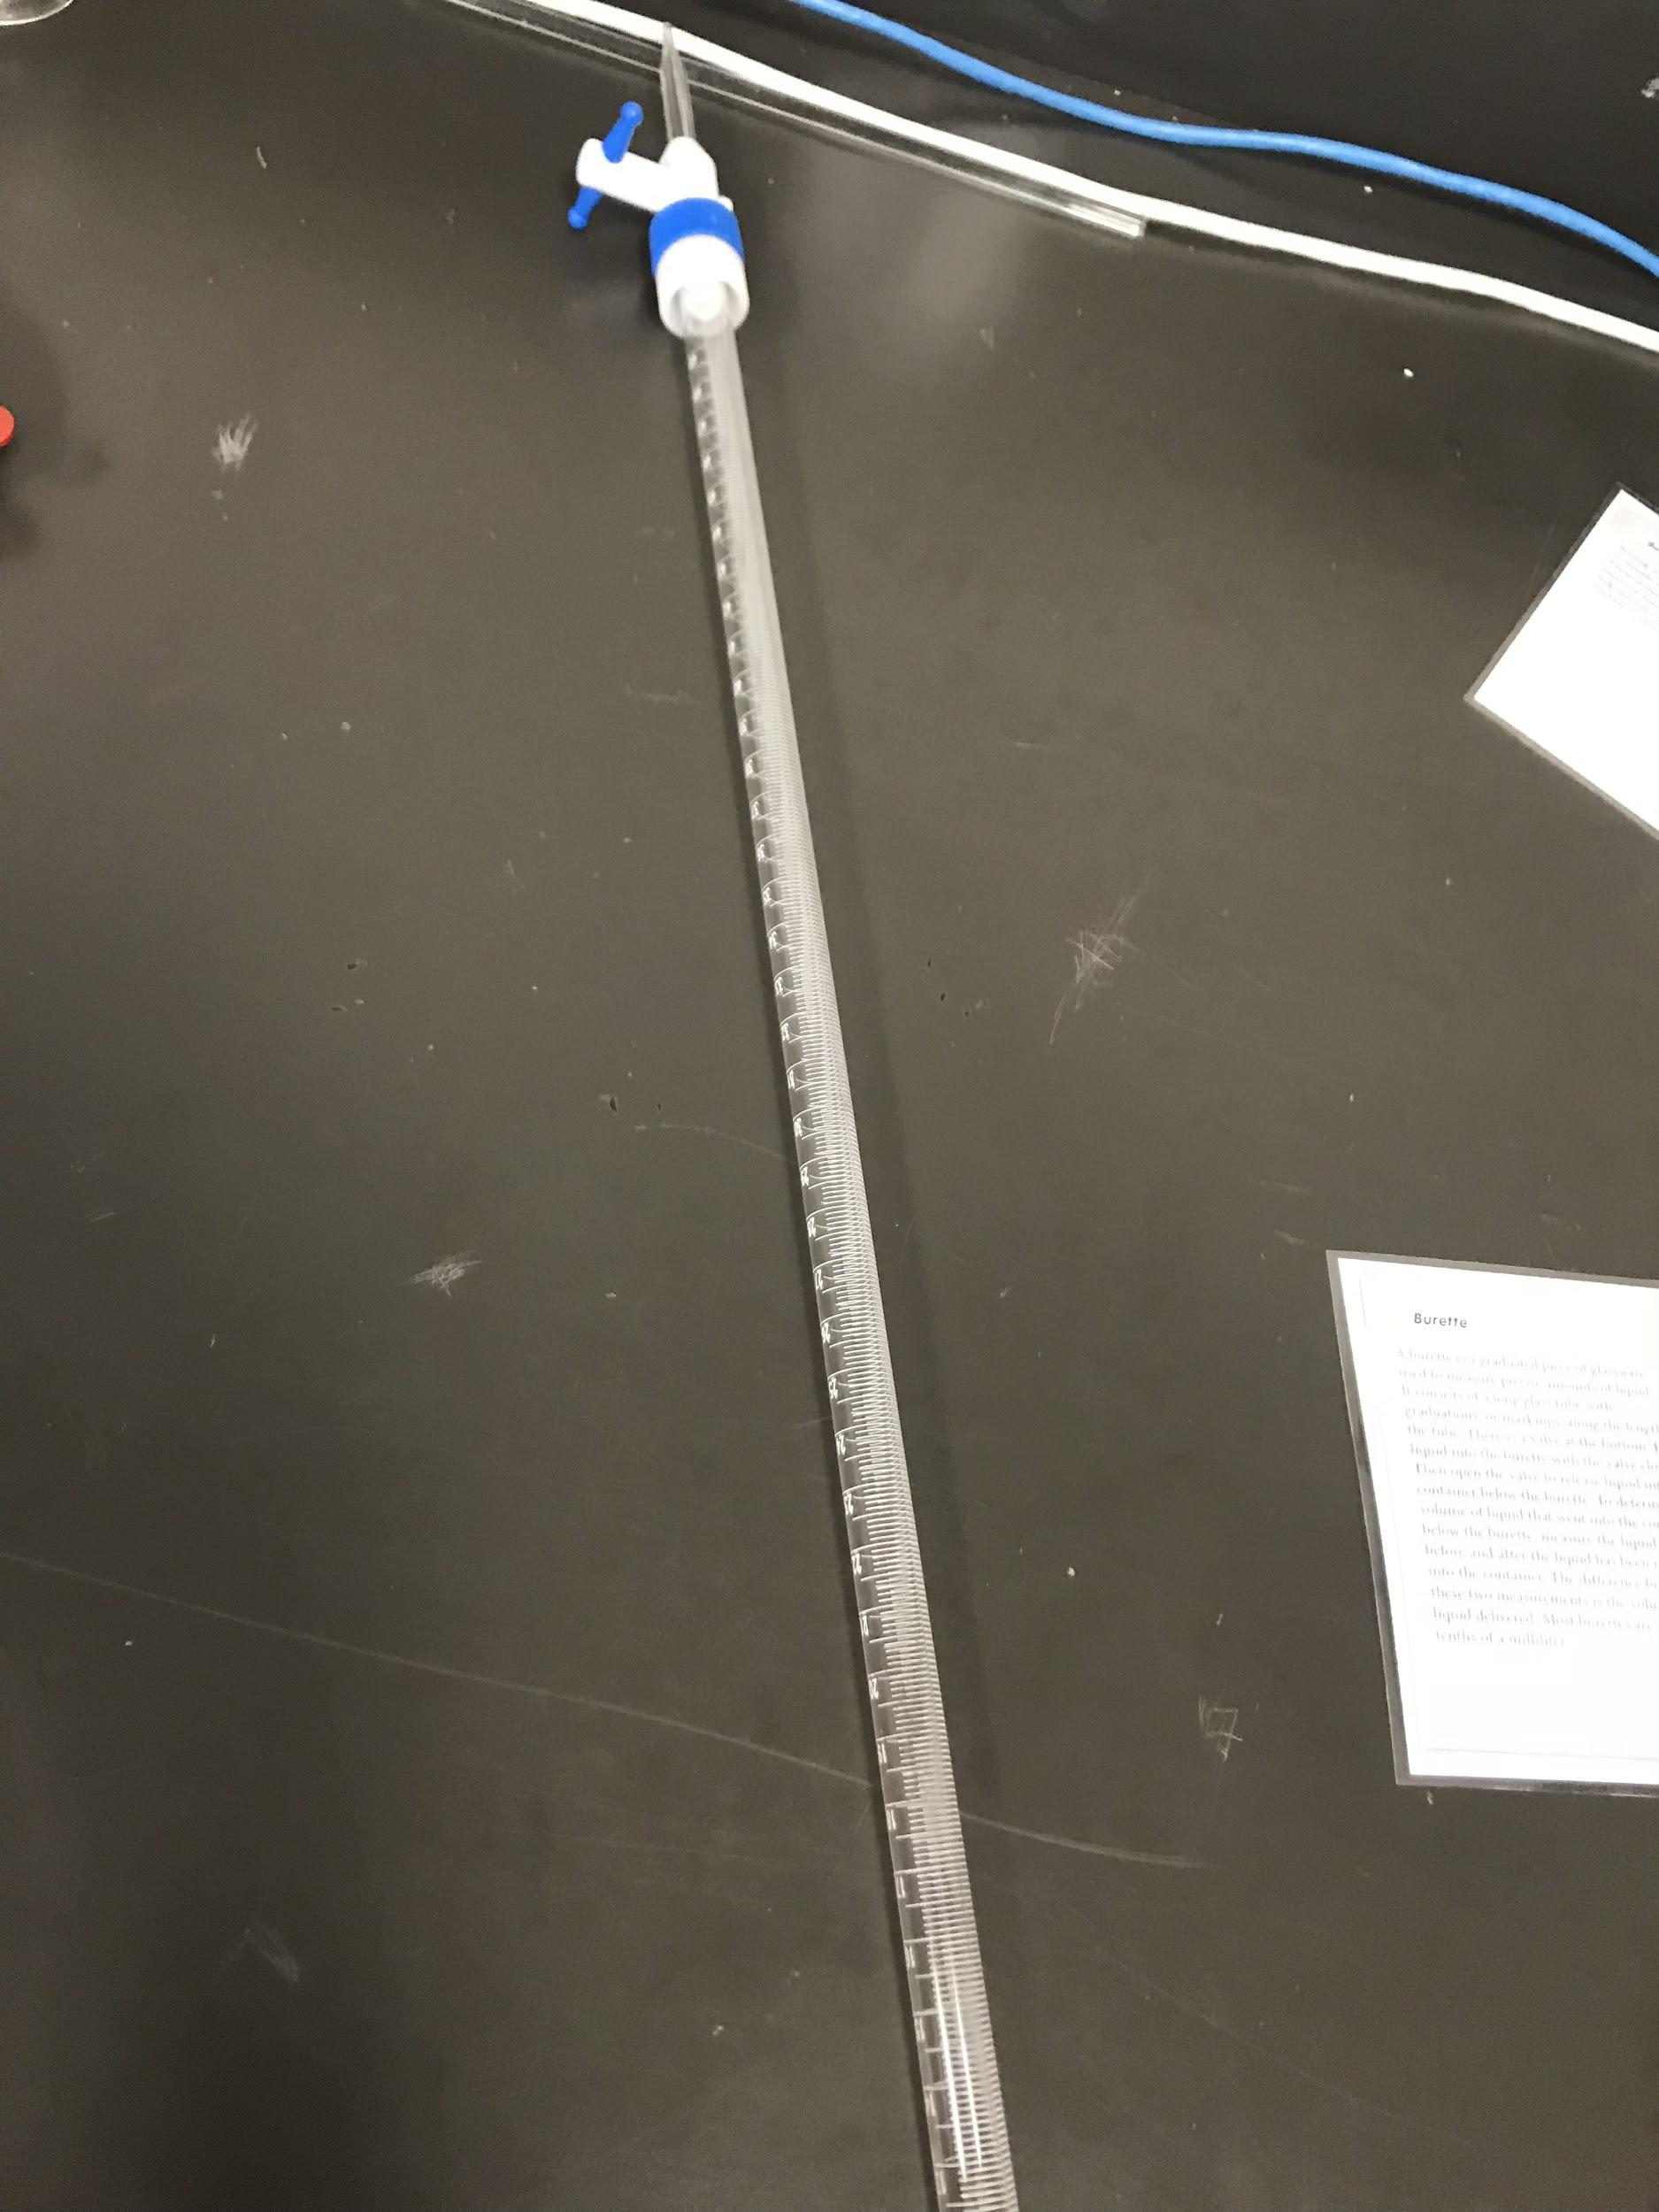
Burette
A burette is a long piece of glass, that is used to measure precise amounts of liquid and it has measurements on the side of the tube.

Slide 13
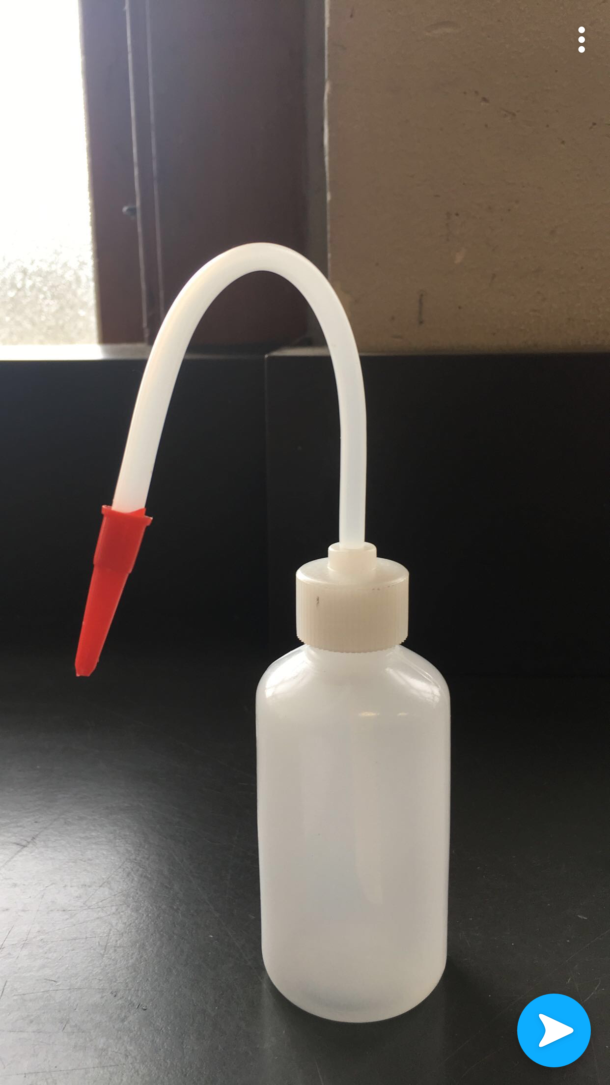
Wash bottle
A wash bottle is a plastic squeeze bottle with a narrow spout on one side. It has distilled water to rinse solids out of containers when filtering. You can also use it to add water into test tubes, graduated cylinders, or other containers

Slide 14
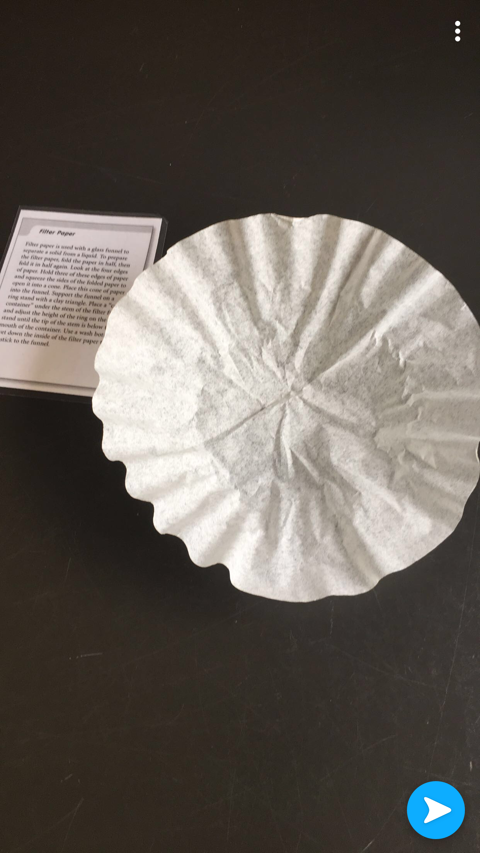
Filter paper
It's used to separate solids from liquids. To use it fold the paper in half, then fold it again.look at the four edges of paper. Hold three of these edges of paper and squeeze the sides of the folded paper to make it into a cone. Put the paper into the funnel

Slide 15
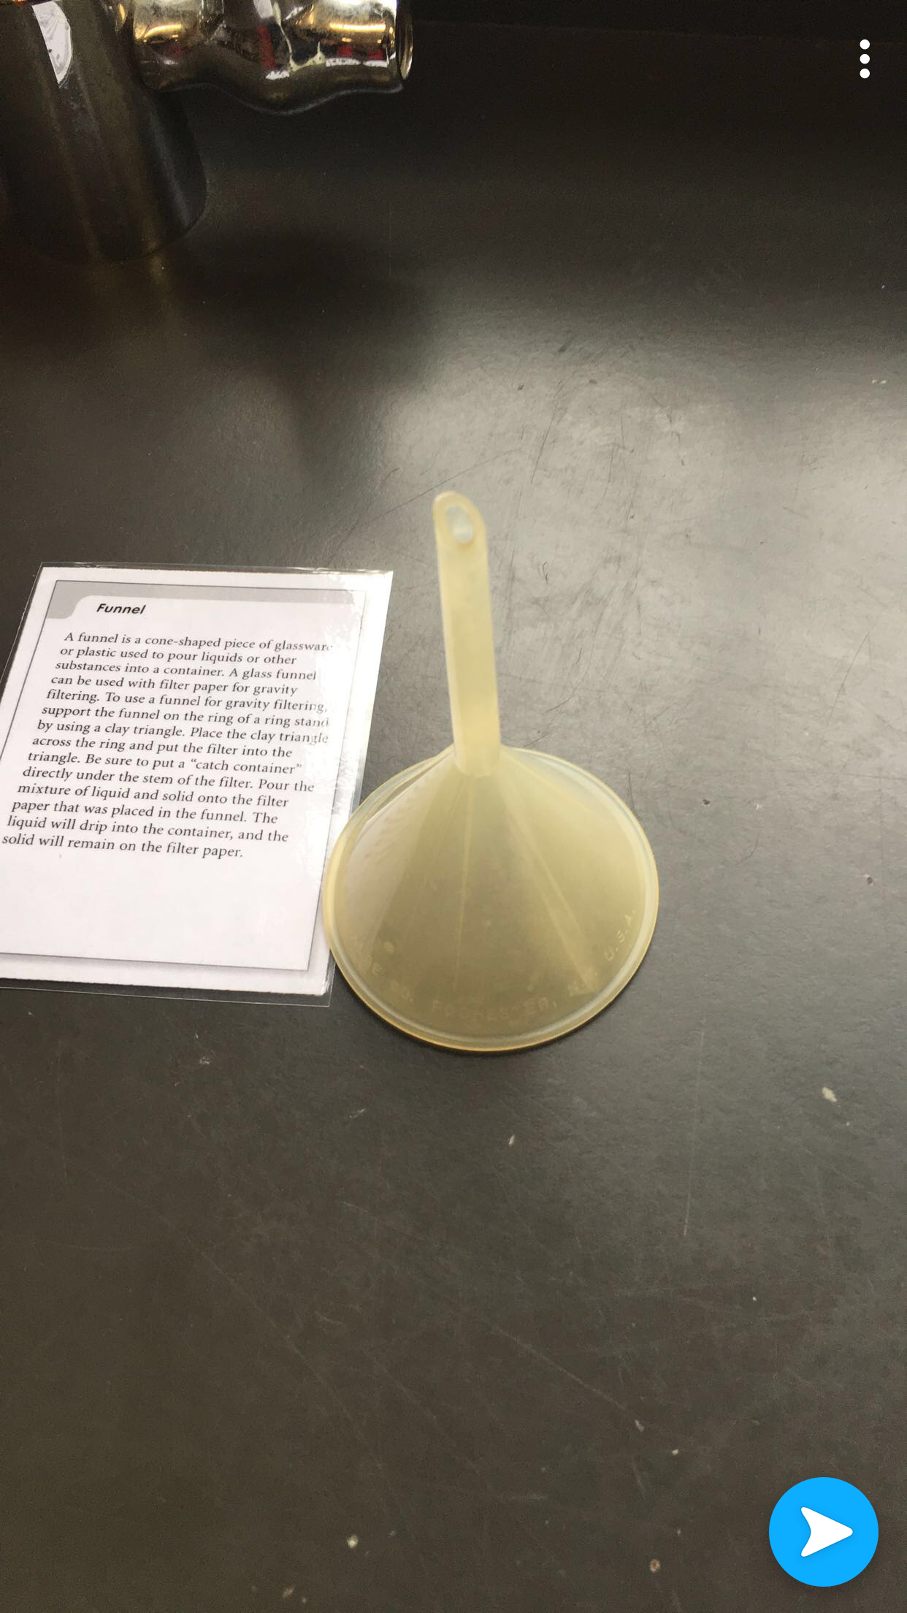
Funnel
Its a cone shaped piece of glassware or plastic used to pour liquids or other substances into a container. Glass funnels could be used with filter paper.

Slide 16
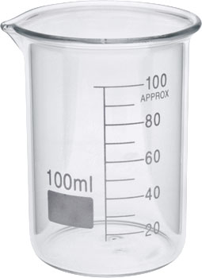
Beaker
A beaker is a cylindrical glass container. Beakers are the most versatile glassware in the lab. Use beakers as container for holding liquids and for mixing substances. The markings on a beaker are only estimates, not accurate volume measurements.

Slide 17
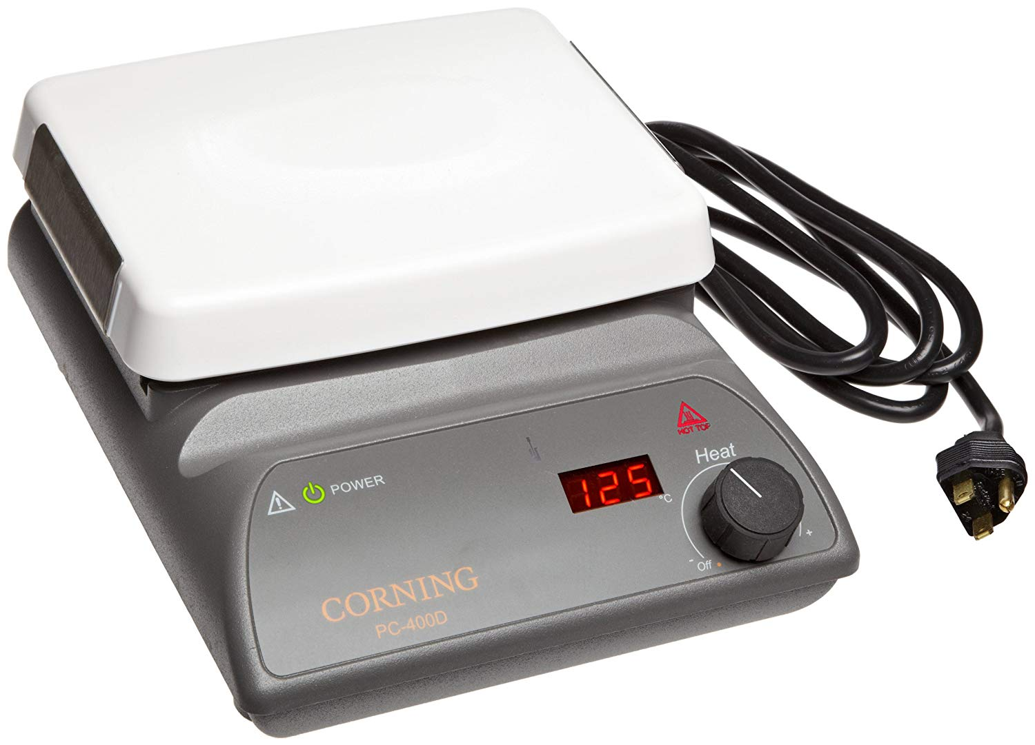
Hot Plates
Is a electrical device used for heating solutions. Place beakers directly on the hot plate, which is plugged into an ordinary electrical outlet. Use the dial on the hot plates when not in use. Do not get the plug wet.

Slide 18
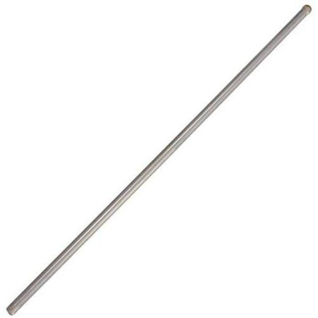
Stirring Rod
Is a piece of glass about 8 to 2 inches in length and typically less that ½ inch in diameter used for stirring solutions. While pouring a liquid from one container to another, use the stirring rod to prevent splashing by allowing the liquid to flow down the rod.

Slide 19
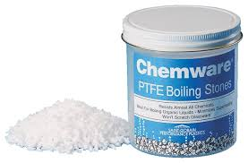
Boiling Stones
Are small stones that are added to liquids to make them boil more smoothly. These stones are commonly known as boil easers or anti bumping agents. Boiling stones help prevent bumping, which can cause hot solution to splash out of the beaker.

Slide 20
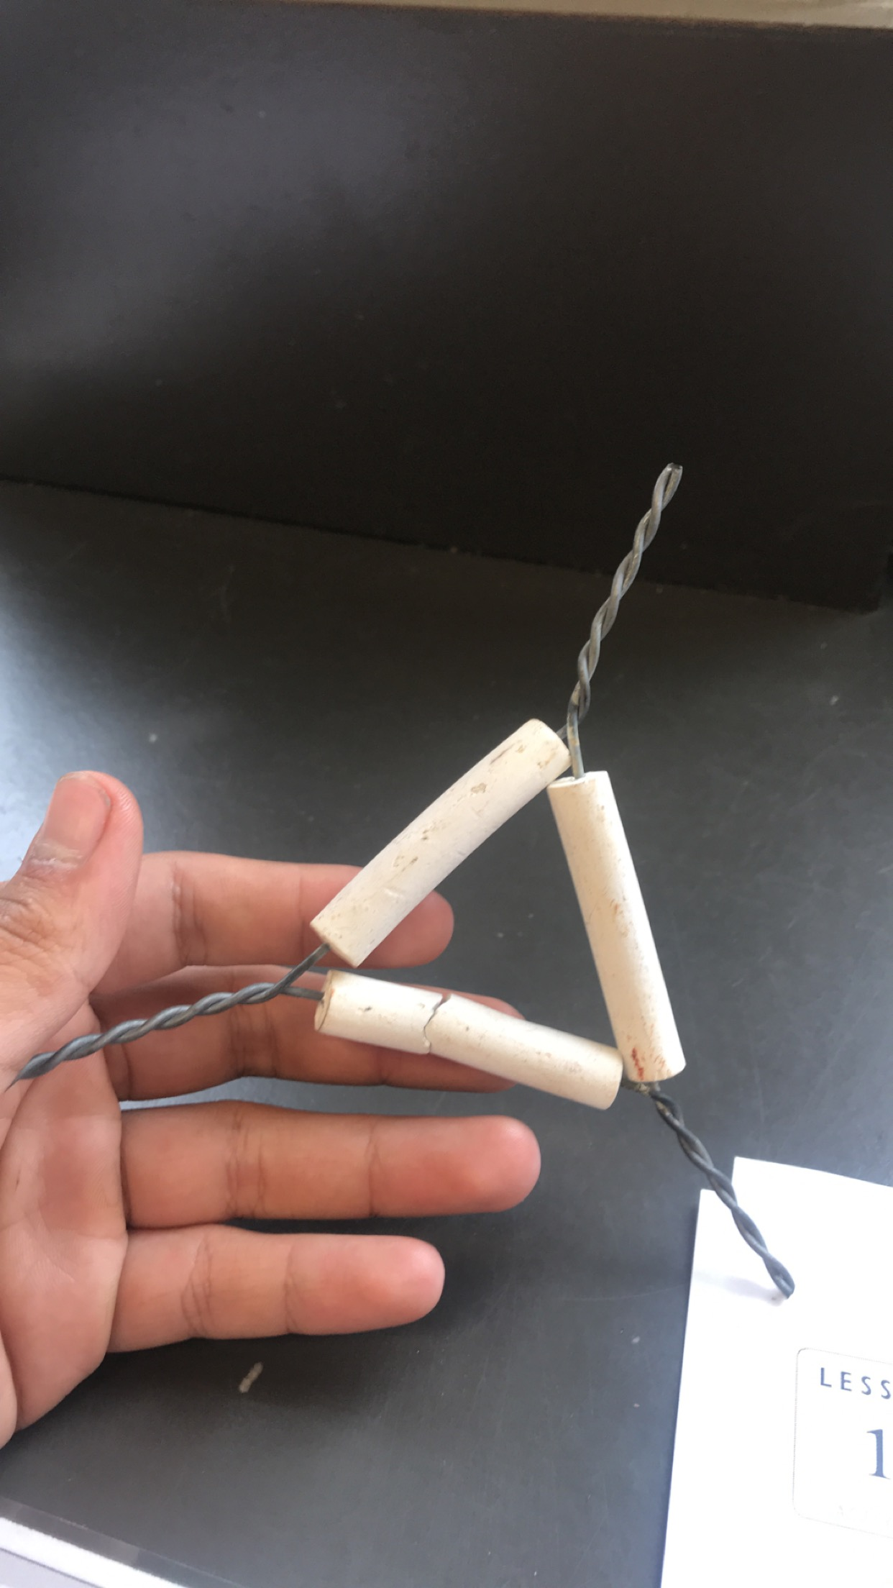
Clay Triangle
A clay triangle is used to support a crucible on a ring stand for heating with a Bunsen burner. A clay triangle can also be used to support a glass funnel on the ring of a ring stand during filtering

Slide 21
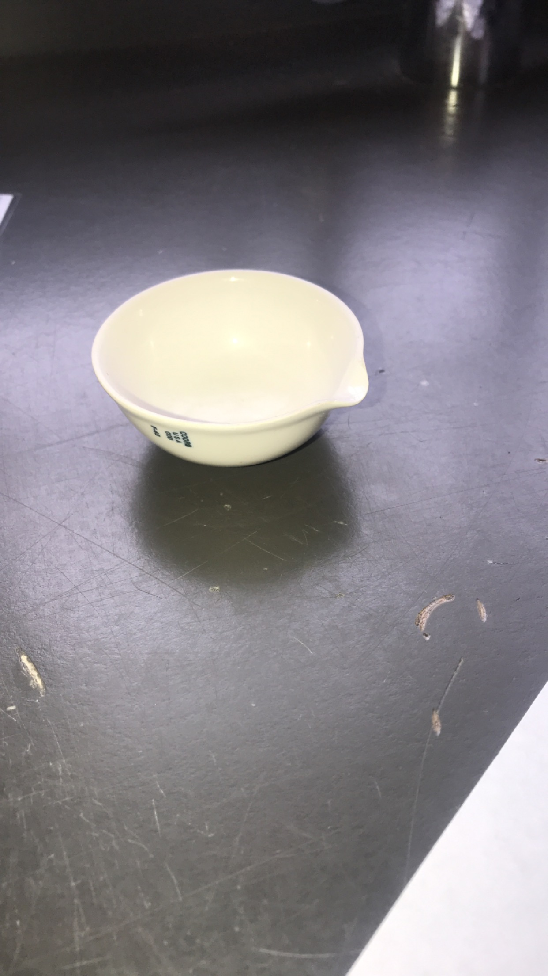
Crucible
A crucible is a dish used in performing chemical reactions and chemical analysis. Crucibles are usually made of porcelain and can stand very high temperatures in a Bunsen burner flame or an oven. But crucible can break if dropped or if set down on cool countertops while still hot. Use a Clay triangle to support a crucible when the crucible is heated over a Bunsen burner. Heat a crucible slowly by keeping the bunsen burner farther away at first and then bringing it closer as the crucible gets warmer. To cool a hot crucible, always place it on a wire gauze.

Slide 22
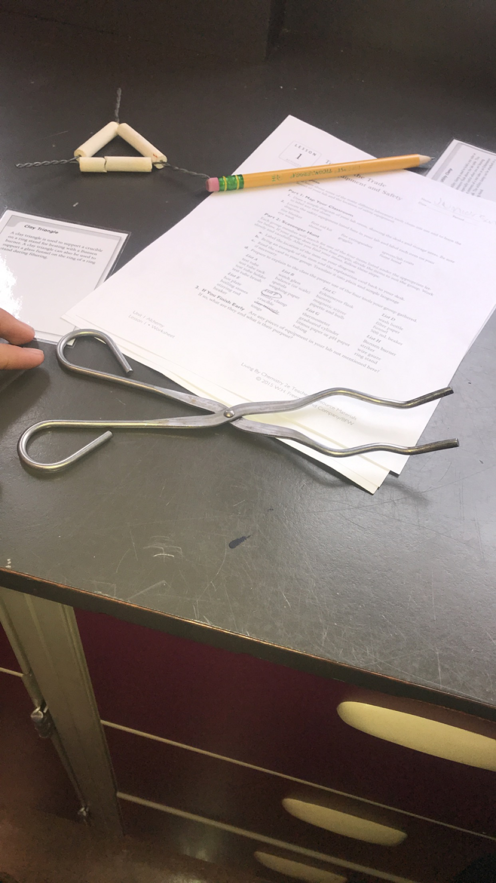
Tongs
Tongs are used for picking up items that are dangerous to pick up by hand. Pick up hot items such as crucibles and crucible covers with tongs

Slide 23
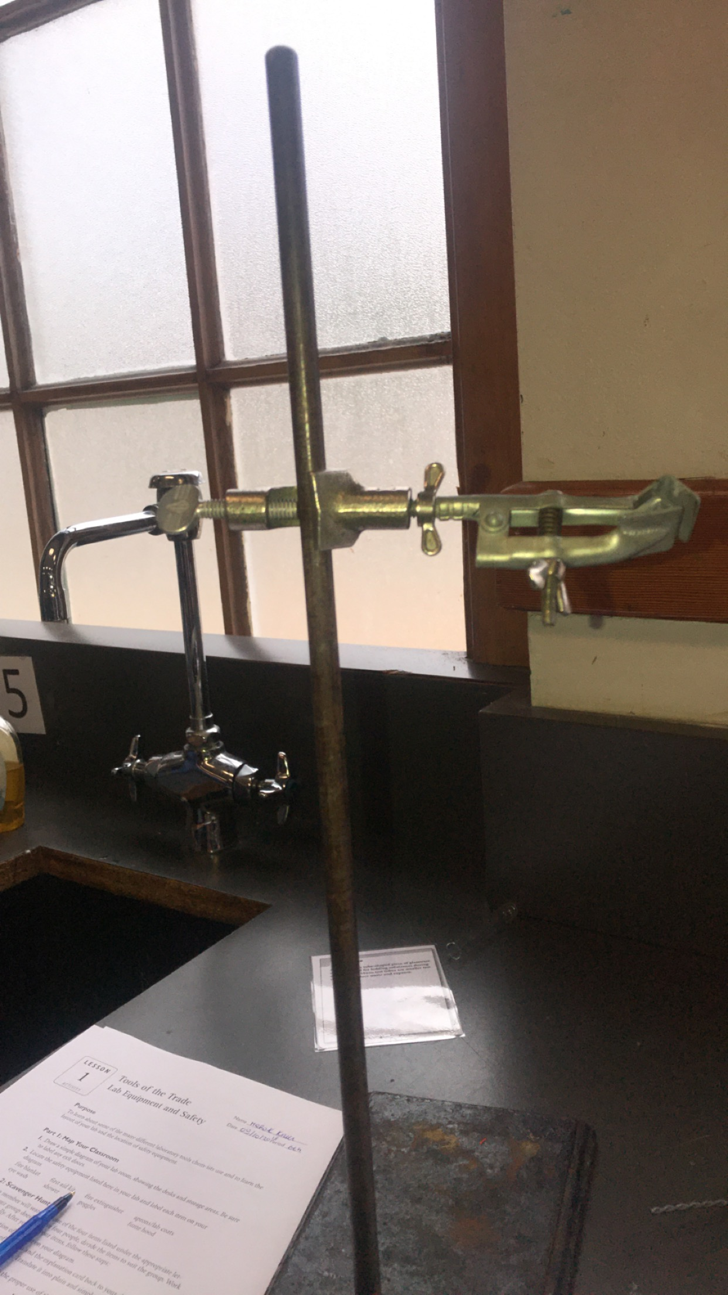
Utility Clamp
A utility clamp is used to hold a test tube or Erlenmeyer flask above the lab table. This is especially useful when you are heating the contents of a test tube or an Erlenmeyer flask. The utility clamp can be attached to a ring stand

Slide 24
Graduated Cylinder
A graduated cylinder is a cylindrical piece of glassware or plastic marked with graduations along its side. Use a graduated cylinder to make accurate measurements of liquid volumes, in milliliters, by comparing the level if the liquid with the marked graduations on the side. The top surface of the liquid is usually curved. This curve is called a meniscus. Record the volume at the bottom of the meniscus. The bumper ring on larger cylinders prevents breakage if the graduated cylinder is tipped over. Keep the bumper ring near the top of the cylinder.

Slide 25
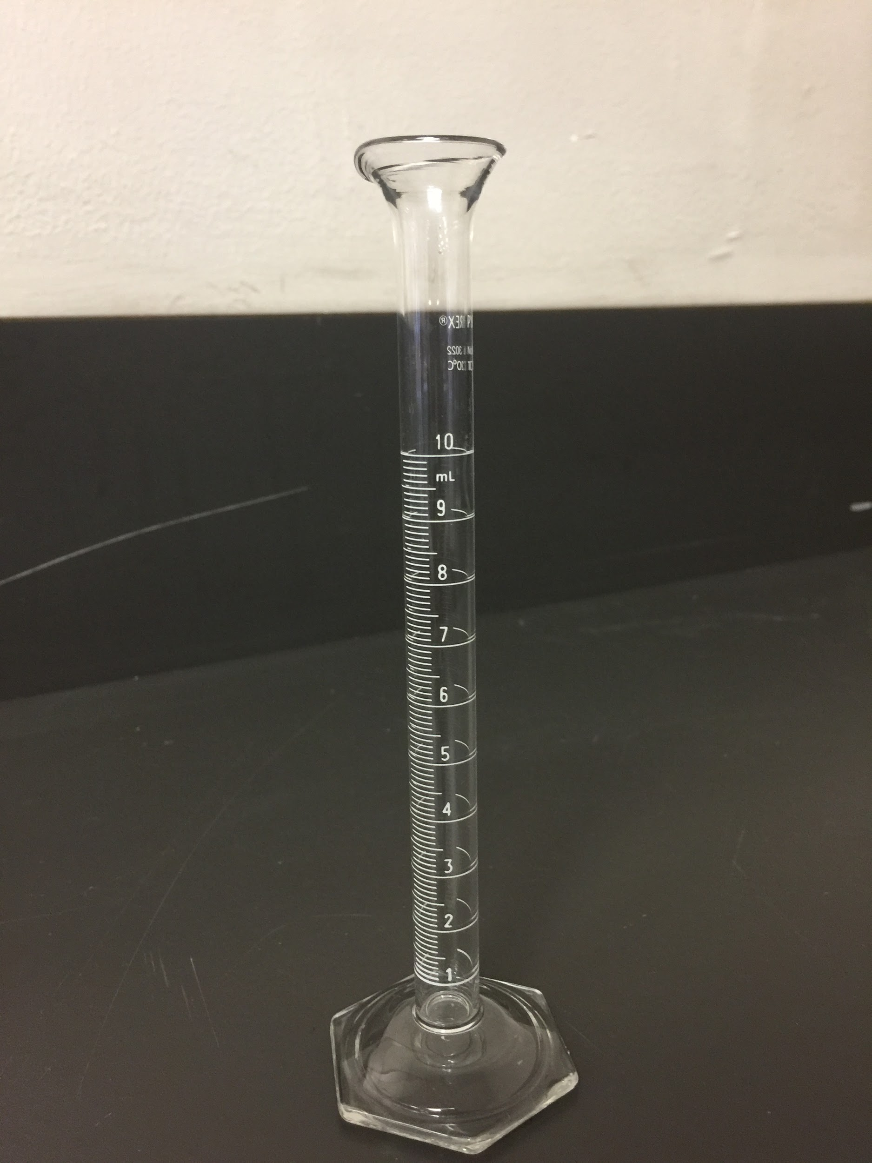
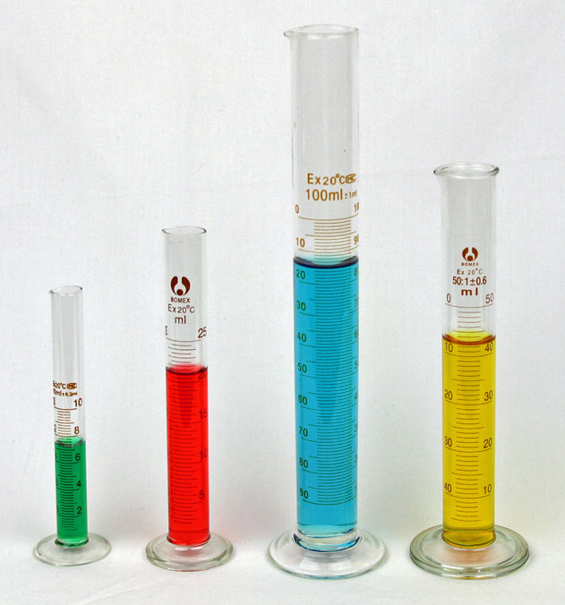
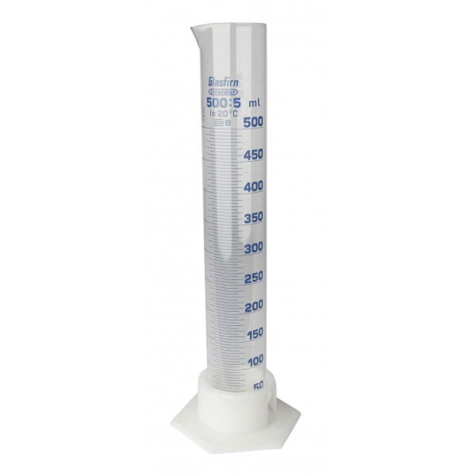
Graduated Cylinder Photo

Slide 26
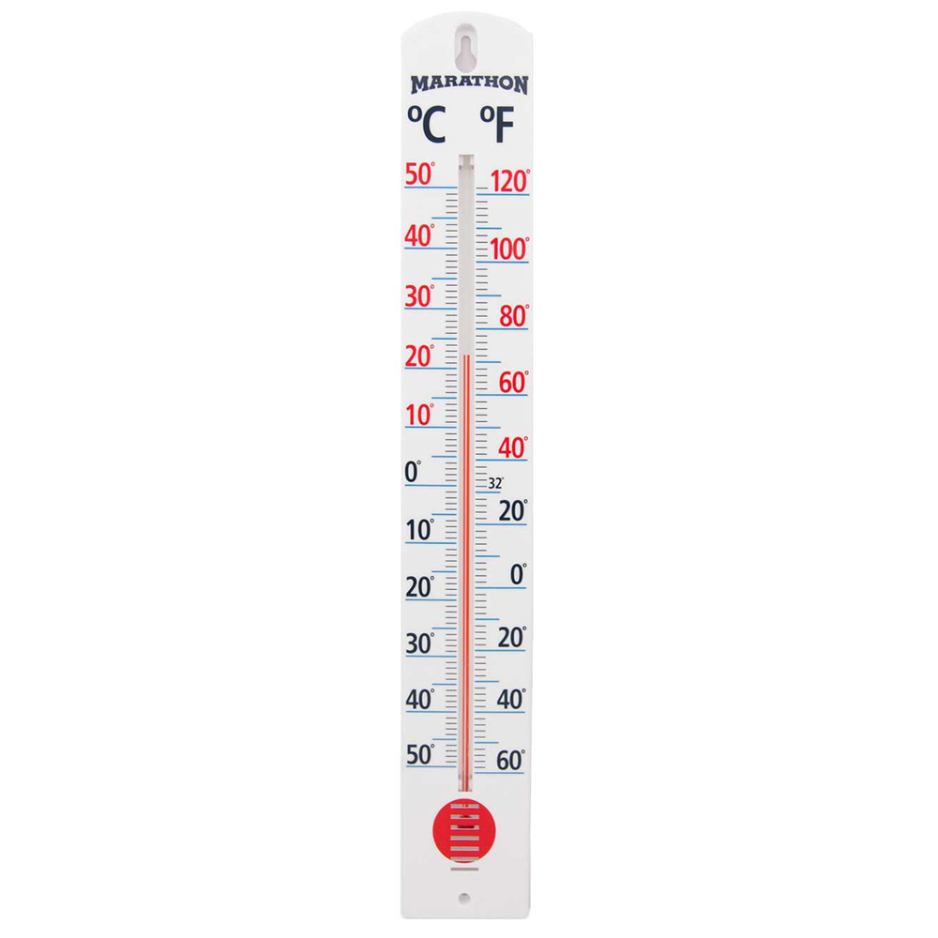
Thermometer
A thermometer is used to measure the temperature of solids, liquids, or gases.
A thermometer contains a substance that change to respond temperature.
Bulb thermometer contain a liquid ( such as mercury or alcohol) in a reservoir.
When the liquid is heated, it expand into a narrow tube that has been marked to show the temperature.
Temperature can be recorded in degree of Celsius, Fahrenheit, or Kelvin.

Slide 27
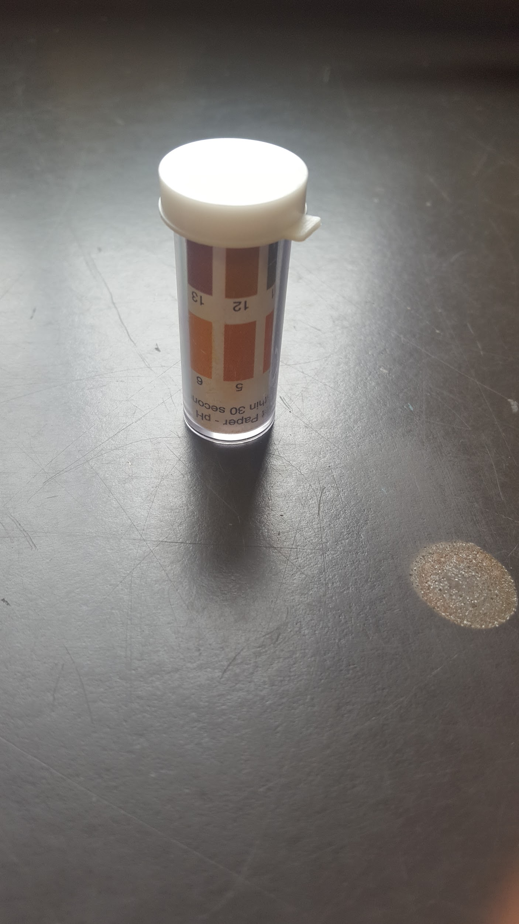
Litmus paper or pH paper
Is used to measure the acidity or basicity of a substance.
An acid turns blue pH paper into red and a base turns red pH paper into blueb.

Slide 28
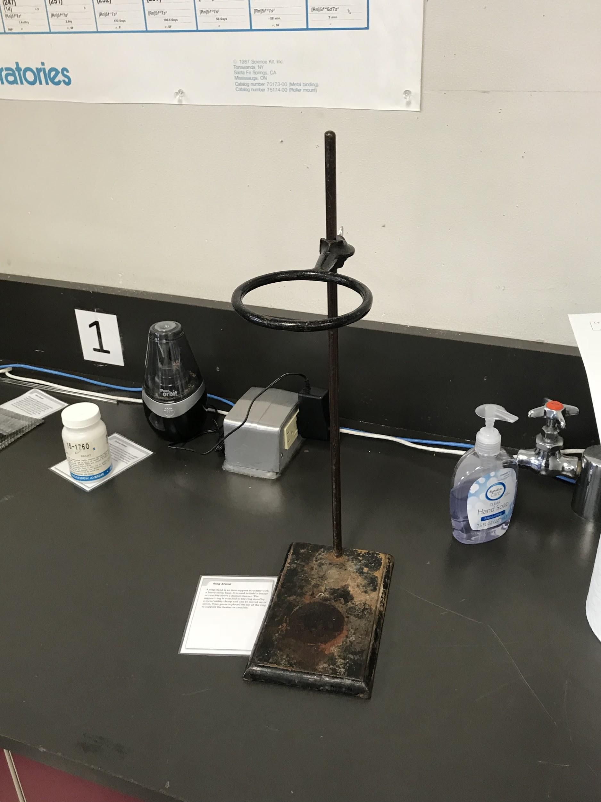
Ring Stand
A ring stand is an iron support structure with a heavy metal base. It is used to hold a beaker or crucible above a Bunsen burner (next slide). The support ring is attached to the ring stand by a metal utility clamp and can be moved up or down. Wire gauze (in 2 slides) is placed on top of the ring to support the beaker or crucible.

Slide 29
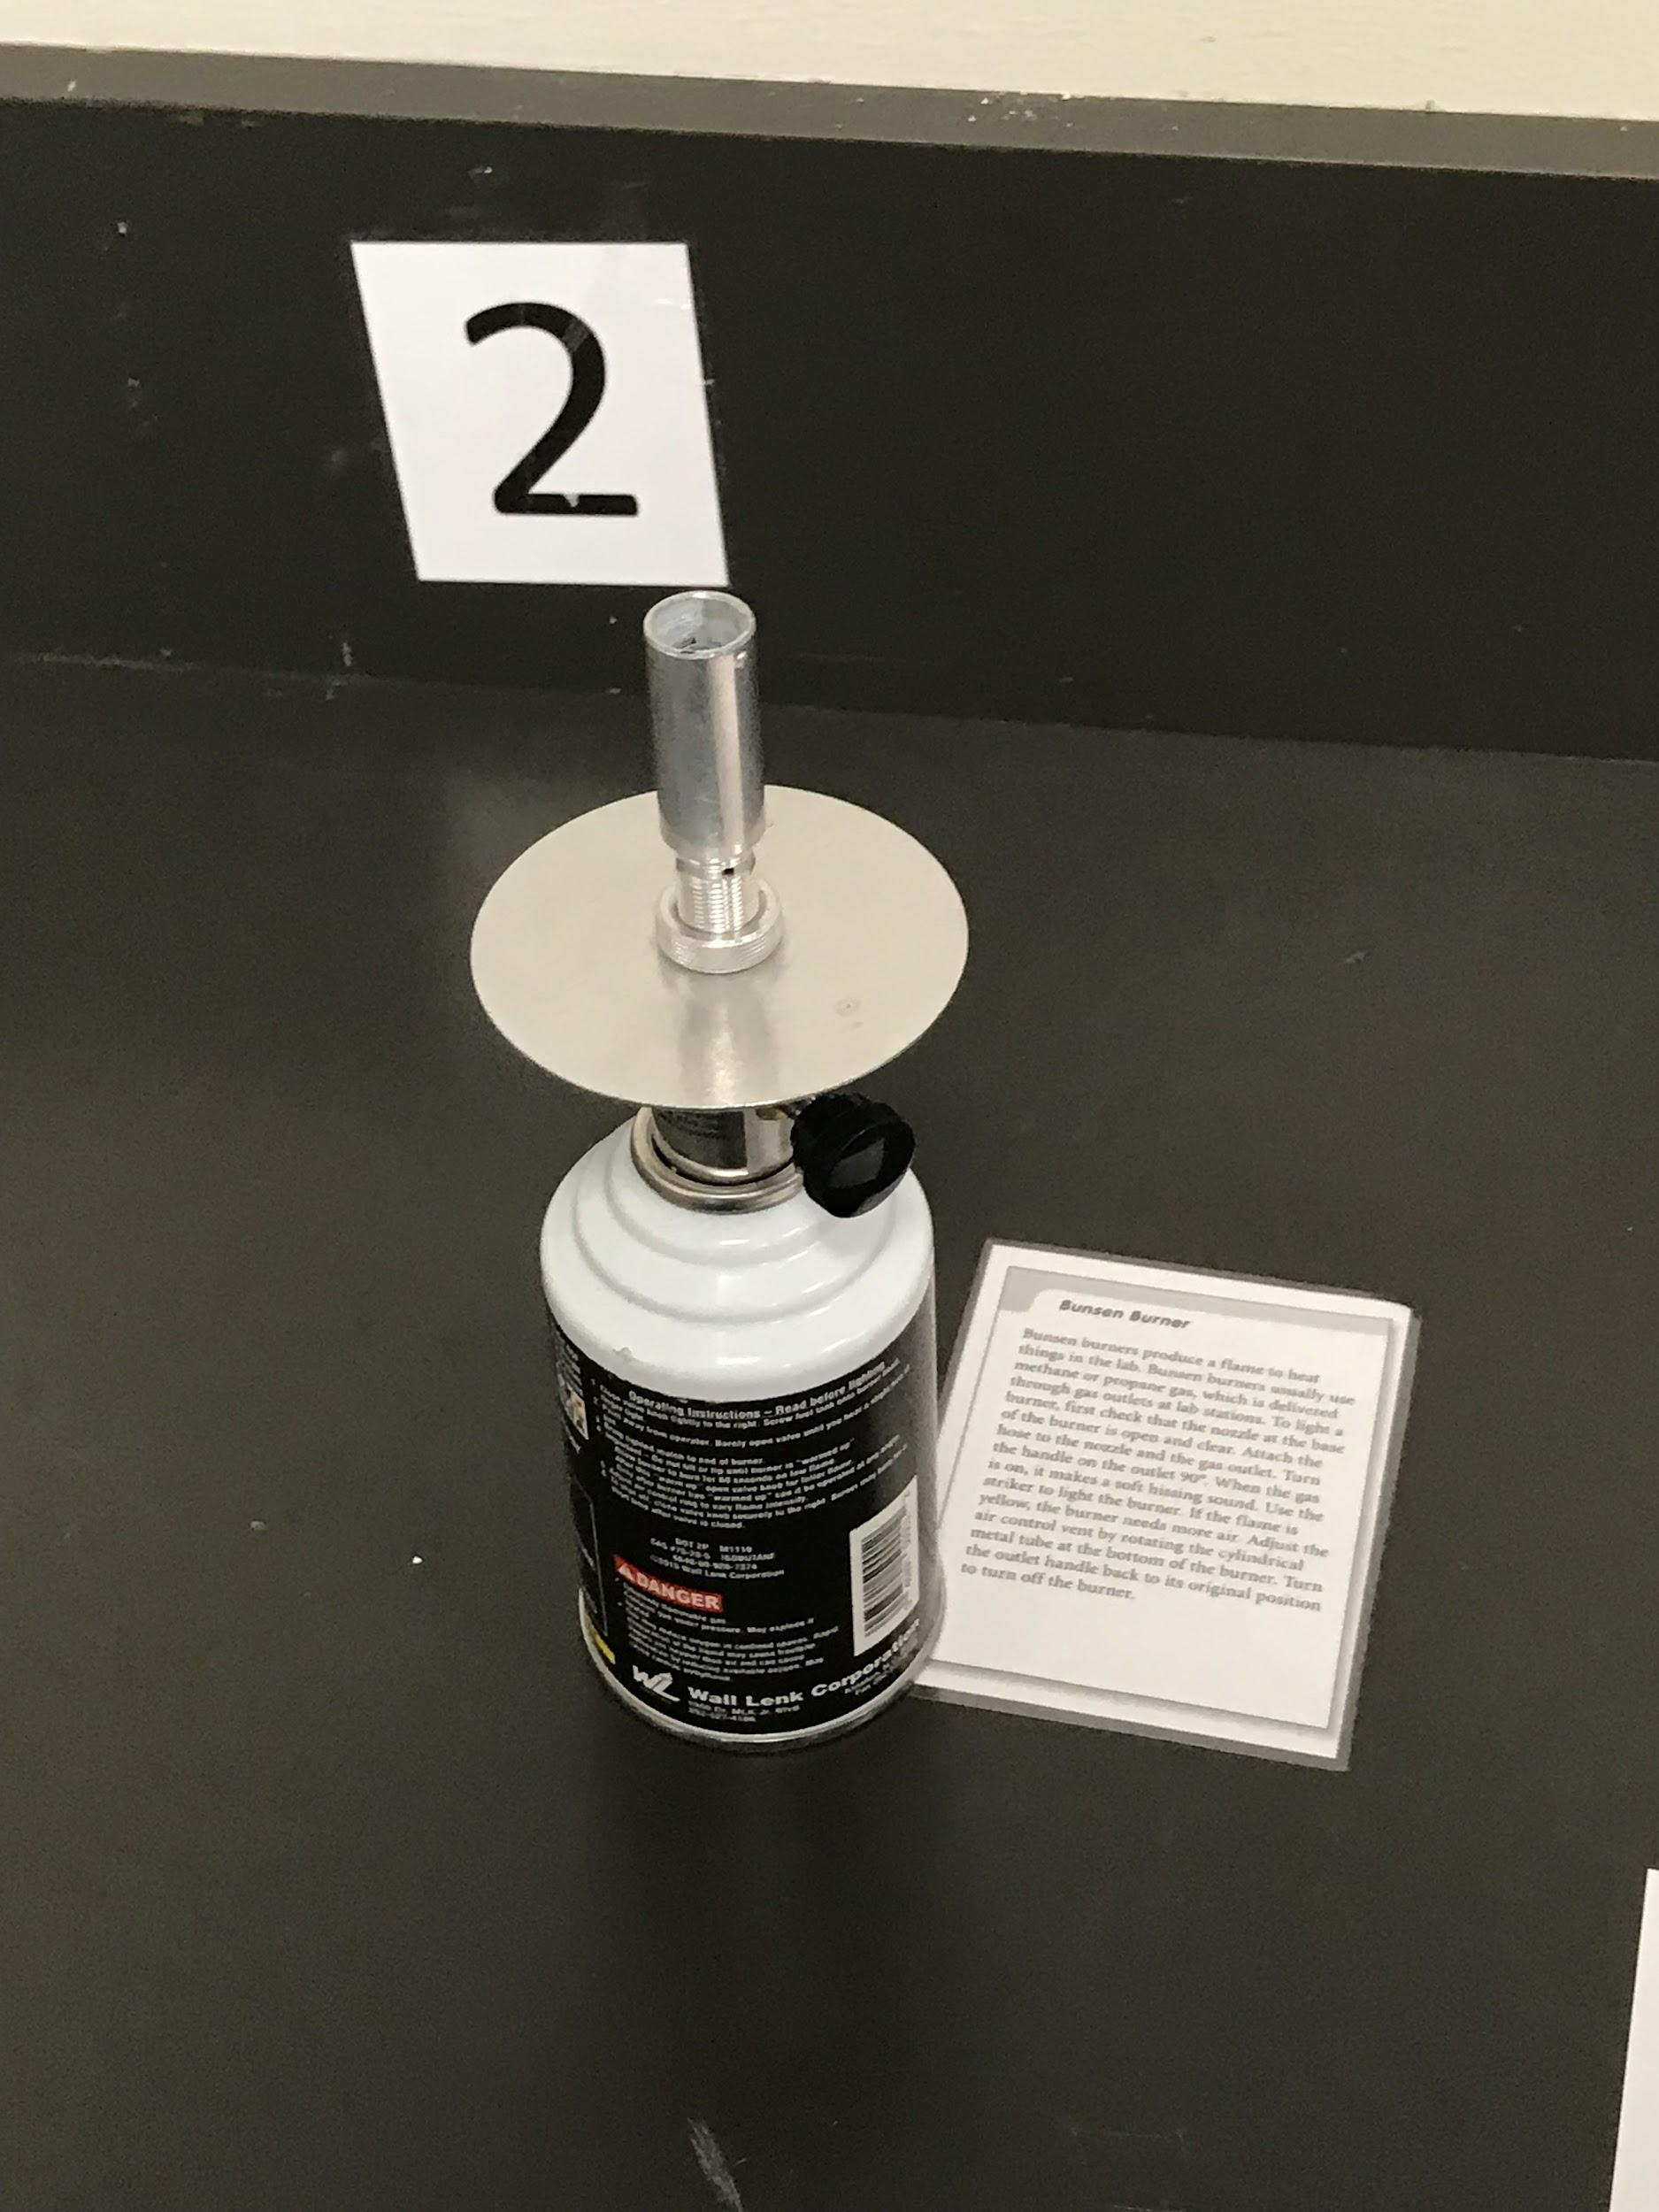
Bunsen Burner
Bunsen burners produce a flame to heat things in the lab. Bunsen burners usually use methane or propane gas, which is delivered through gas outlets at lab stations. To light a burner, check that the nozzle at the base of the burner is open and clear. Attach the hose to the nozzle and the gas outlet. Turn the handle on the outlet 90 degrees. When the gas is on, it makes a soft hissing sound. Use the striker (last slide in this section) to light the flame. If the flame is yellow, it needs more air. Adjust the air control vent by rotating the cylindrical metal tube at the bottom of the burner

Slide 30
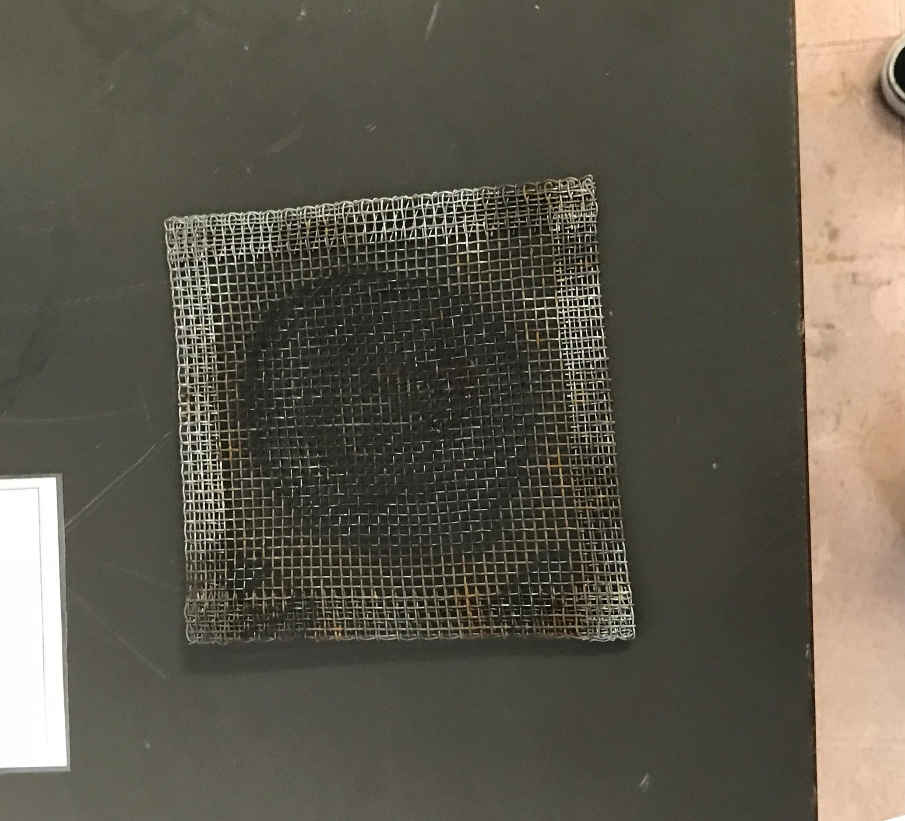
Wire Gauze
Wire gauze is a square piece of metal mesh used to support a beaker on a metal ring. Wire gauze is very durable and can take extensive heating. To heat a beaker and it’s contents, clamp the metal ring to a ring stand, place the wire gauze across the ring, and set the beaker on the gauze. Place a Bunsen burner under the wire gauze.

Slide 31
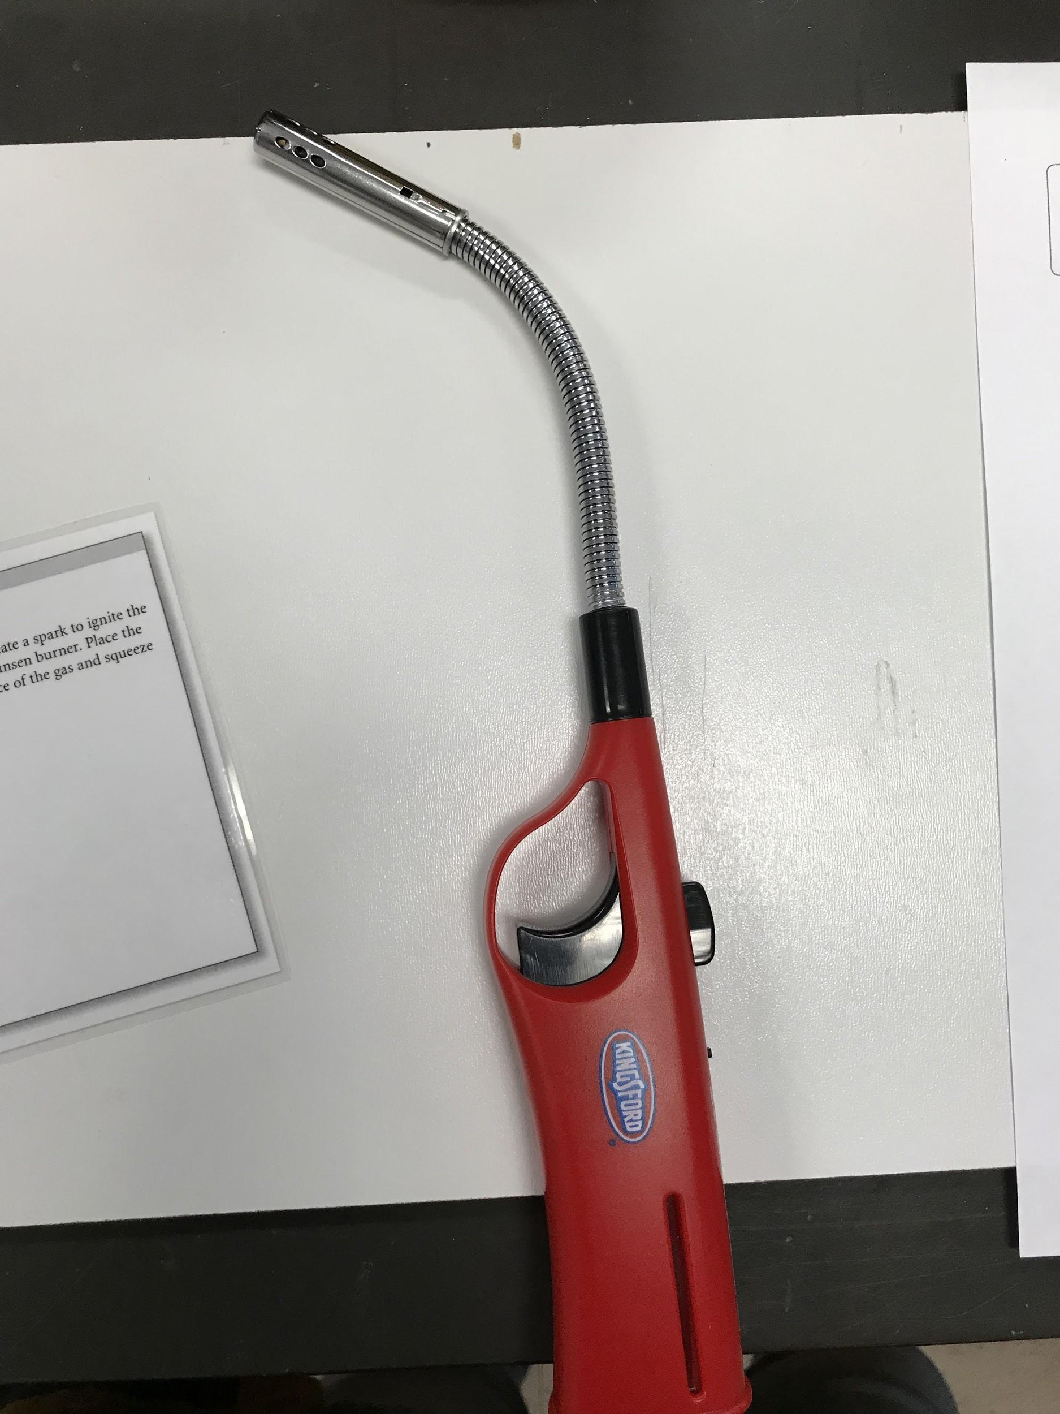
Striker
A striker is used to create a spark to ignite the gas coming from a Bunsen burner. Place the striker over the source of the gas and squeeze the handle.

