Slide 1
Lesson 54: Sorry Charlie
Charles’s Law

Slide 2

ChemCatalyst
A lava lamp contains a waxy substance and water, which do not mix, and a lightbulb at the base. As the bulb heats the waxy substance, it rises. Near the top of the lamp, the waxy substance cools and falls. Explain why this happens.

Slide 3
Key Question
How can you predict the volume of a gas sample?

Slide 4
You will be able to:
explain Charles’s law and use it to solve simple gas law problems involving volume and temperature
explain two methods for determining the volume of a gas if its temperature is known

Slide 5
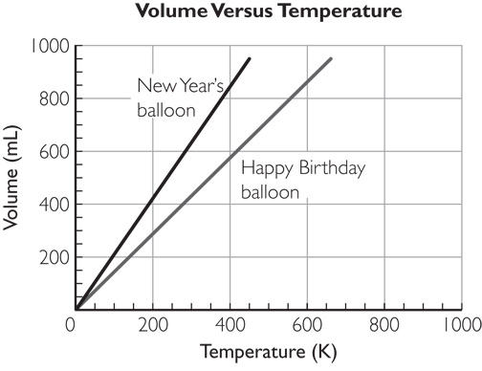
Discussion Notes
Charles’s law states that volume, V, is proportional to the Kelvin temperature, T.

Slide 6
Discussion Notes (cont.)
Charles’s law: For a given sample of gas at a certain pressure, the volume of gas is directly proportional to its Kelvin temperature.
The proportionality constant, k, indicates how much the volume of a gas changes per kelvin.
Because volume is proportional to temperature, the graph of volume versus temperature for a gas sample is a straight line that goes through the origin, (0, 0).

Slide 7
Wrap Up
How can you predict the volume of a gas sample?
  You can use the proportionality constant to calculate the volume of a gas sample at any temperature if the temperature is in kelvins and the amount of gas and the gas pressure don’t change: V = kT. This is known as Charles’s law.
  The proportionality constant, k, depends on the amount of gas in a sample and the pressure of the gas.
  As the temperature increases, the volume of a gas sample increases and the density of the gas decreases. This is why warmer gas rises above cooler gas.

Slide 8
Check-In
A sample of gas has a volume of 120 L at a temperature of 40 °C. The temperature drops to –10 °C. If nothing else changes, what is the new volume of the gas?

