Slide 1
Entry Task
Apply: Suppose a template strand of DNA had the following wild-type gene sequence:
DNA: T A C G G A T A A C T A C C G G G T A T T C A A
What would be the complementary strand of mRNA?
RNA: A U G C C U AU U G A U G G C C C A U A A G U U

Slide 2
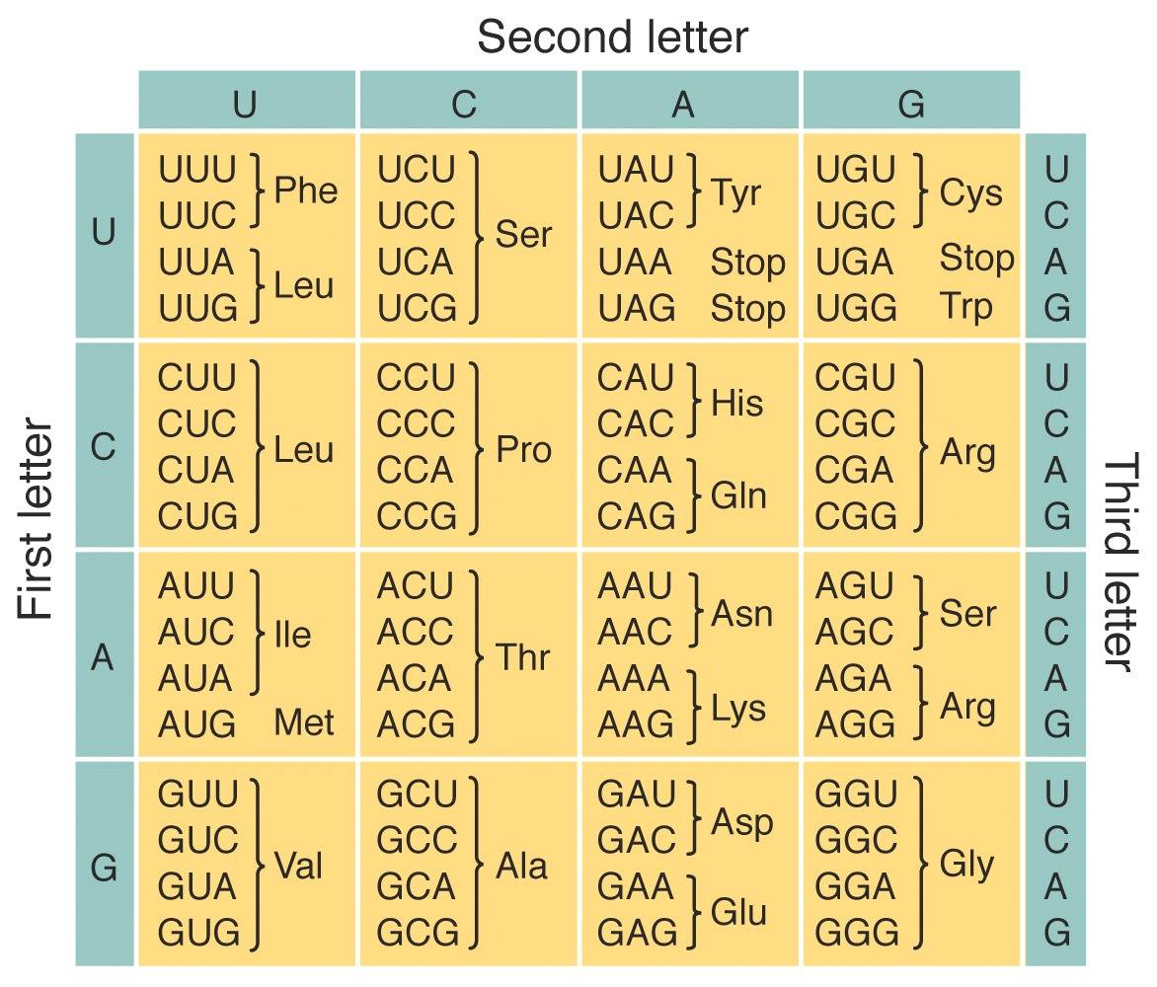
Translate!
RNA: A U G | C C U | A U U | G A U | G G C | C C A | U A A | G U U
Met Pro Ile Asp Gly Pro Stop
Convert your RNA sequence to Amino Acids

Slide 3
Types of Mutations
Silent Mutation (no effect on amino acid)
Missense Mutation (changes an amino acid)
Nonsense Mutation (premature stop codon)
Frameshift Mutation (InDel)
  Insertion Mutation (one or more DNA bases are added to a sequence, potentially resulting in all new amino acids)
  Deletion Mutation (one or more DNA bases are deleted from a sequence, potentially resulting in all new amino acids)

Slide 4
T A C G G C T A A C T A C C G G G T A T T C A A
Silent Mutation
T A C G G A T A A C T A C C G G G T A T T C A A
A U G C C U A U U G A U G G C C C A U A A G U U
Met Pro Ile Asp Gly Pro Stop
A U G | C C G | A U U | G A U | G G C | C C A | U A A | G U U
Met Pro Ile Asp Gly Pro Stop

Slide 5
Missense Mutation
T A C G G A T A A C T A C C G G G T A T T C A A
A U G C C U A U U G A U G G C C C A U A A G U U
Met Pro Ile Asp Gly Pro Stop
T A C C G A T A A C T A C C G G G T A T T C A A
A U G | G C U | A U U | G A U | G G C | C C A | U A A | G U U
Met Ala Ile Asp Gly Pro Stop

Slide 6
Nonsense Mutation
T A C G G A T A A C T A C C G G G T A T T C A A
A U G C C U A U U G A U G G C C C A U A A G U U
Met Pro Ile Asp Gly Pro Stop
T A C G G A A C T A C C G G G T A T T C A A
Note: In this example, two DNA bases are deleted from the wild type DNA sequence, resulting in the introduction of a premature stop codon
A U G | C C U | U G A |
Met Pro Stop

Slide 7
T A C G A G A T A A C T A C C G G G T A T T C A A
Frameshift Mutation (InDel)
T A C G G A T A A C T A C C G G G T A T T C A A
A U G C C U A U U G A U G G C C C A U A A G U U
Met Pro Ile Asp Gly Pro Stop
A U G | C U C | U A U | U G A | U G G | C C C | A U A | A G U | U
Met Leu Tyr Stop
Note: In this example, inserting a DNA base into the wild type DNA sequence resulting in the introduction of a premature stop codon

