Slide 1
Functional Groups
Definition: A structural feature of a molecule, consists of a specific arrangement of atoms, responsible for certain properties of the compound.

Slide 2
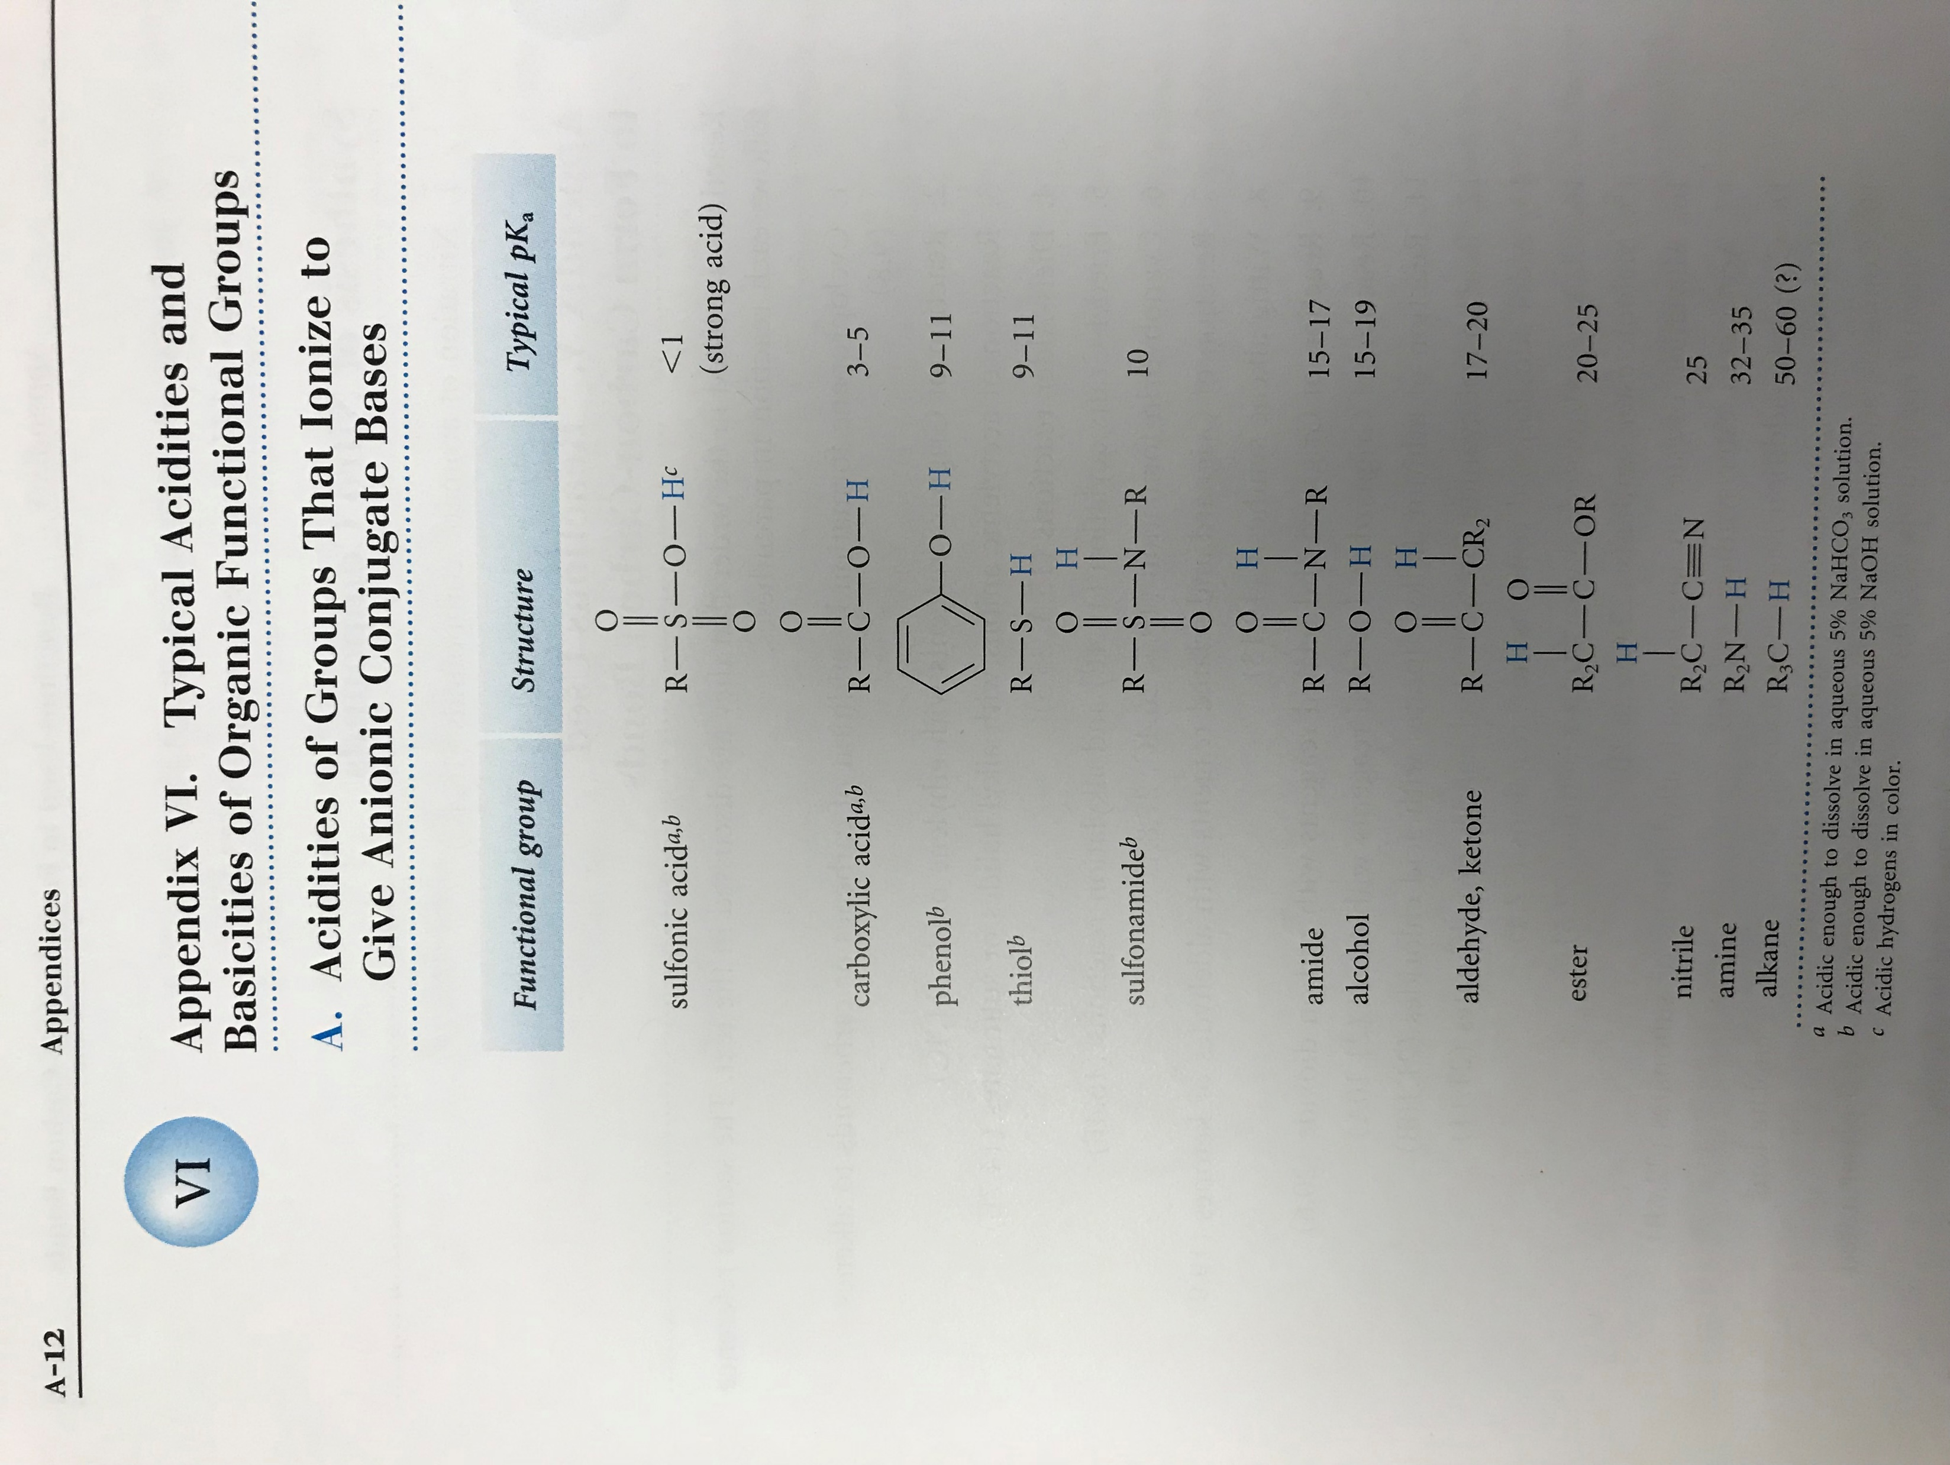

Common Functional Groups

Slide 3
What is R?
In organic chemistry, the letter R is used to represent additional chemical structure. It is a placeholder for “something else” similar to the way a mathematician would use the letter X in an equation to represent some number.
Unless you are told otherwise, R stands for an alkyl group (carbons and hydrogens).
Common alkyl groups include:
  methyl groups (-CH₃)
  ethyl groups (-CH₂CH₃)
  propyl groups (-CH₂CH₂CH₃)

Slide 4
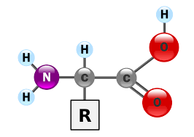
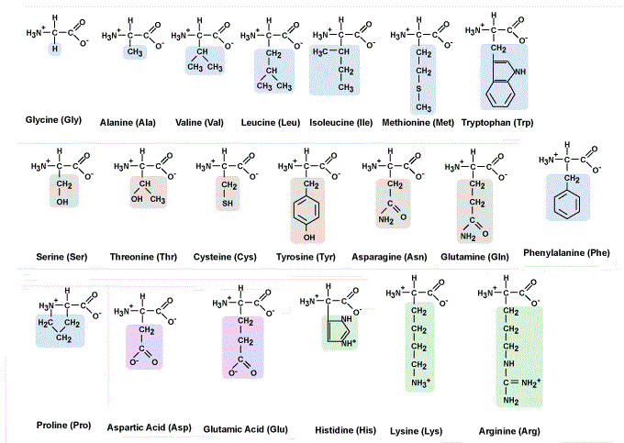
Amino Acids
Can you spot your functional group?

