Slide 1
Wednesday, November 15, 20167
Bonding Tendencies
Objective: I will create accurate structural models from molecular formulas, identify and differentiate between isomers and molecules oriented differently in space, and explain and use HONC1234 rule.
Entry Task -
Chem Catalyst 30

Slide 2
HONC 1234
1
1 bond
hydrogen | H |  | H atoms form
oxygen | O |  | O atoms form
nitrogen | N |  | N atoms form
carbon | C |  | C atoms form
2
2 bonds
3
3 bonds
4
4 bonds

Slide 3
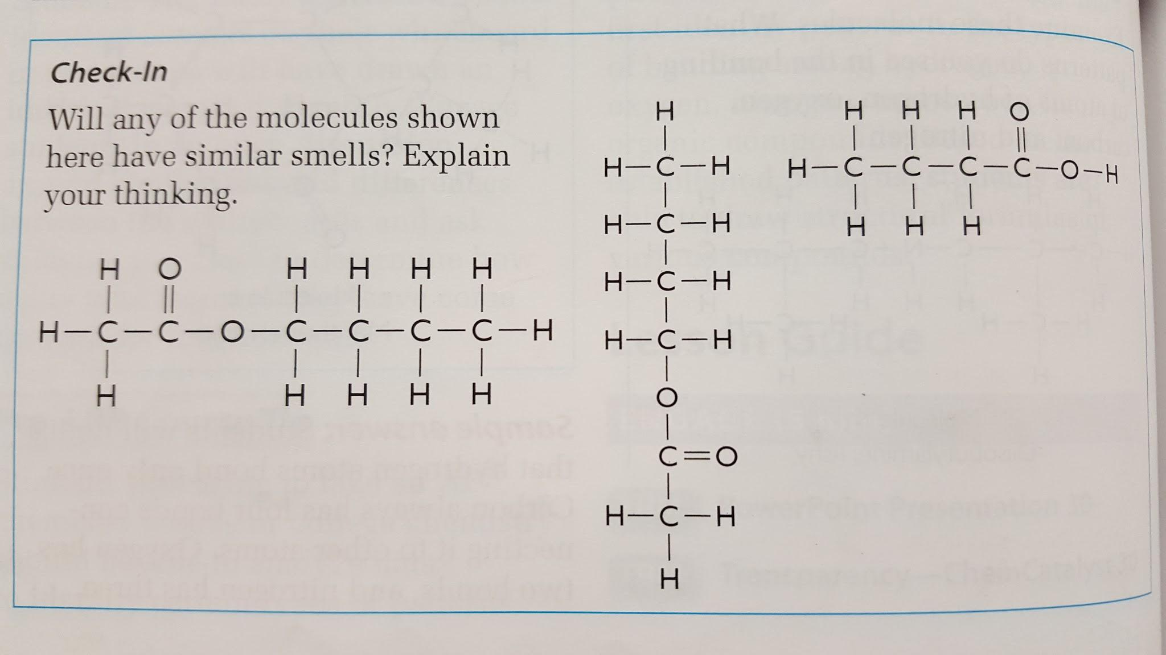
Check in
3
1
2

Slide 4
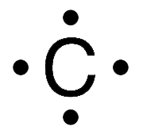
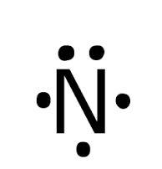


Exit Task
These diagrams are called Lewis Dot Diagrams.
What is the relationship between the number of dots, the number of valence electrons, and the HONC1234 rule?
Create a Lewis Dot Diagram for fluorine, F. How many bonds will fluorine make?
Notes:
As, arsenic

