Slide 1
Living By Chemistry
SECOND EDITION
Unit 1: ALCHEMY
Matter, Atomic Structure, and Bonding

Slide 2
Lesson 18: Life on the Edge
Valence and Core Electrons

Slide 3
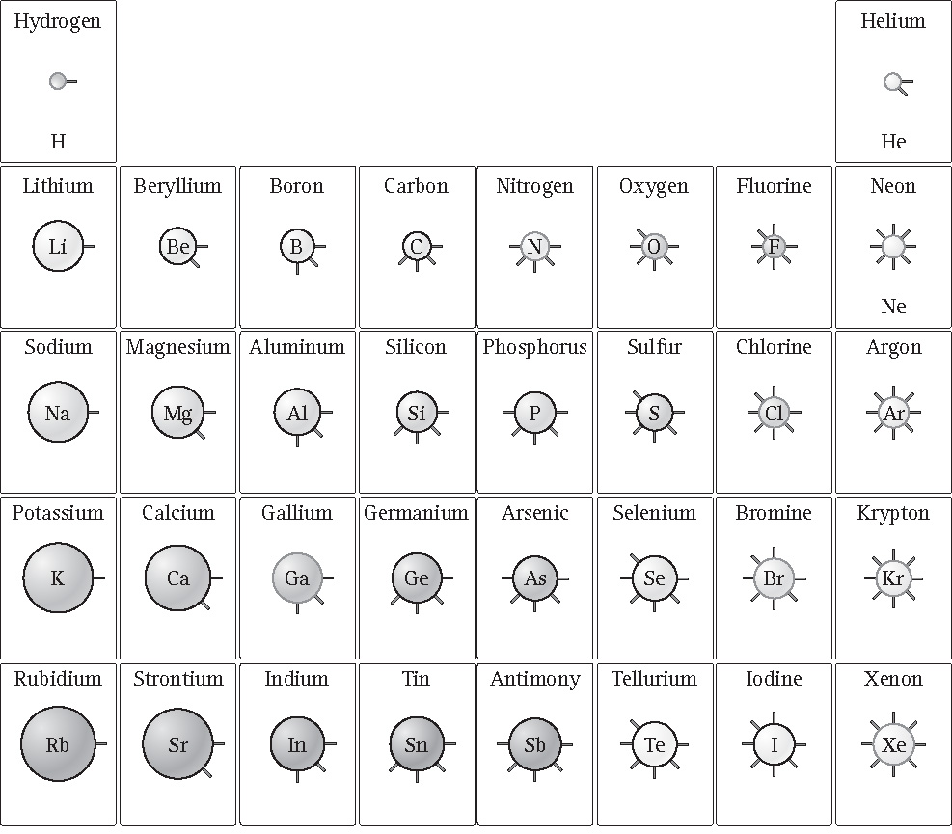
ChemCatalyst
What do you notice about the number of spokes on the circles?
The spokes represent electrons. Do the spokes represent the total number of electrons? Explain your thinking.

Slide 4
Key Question
Why do elements in the same group in the periodic table have similar properties?

Slide 5
You will be able to:
create a shell model diagram of an atom, placing the correct number of electrons in the correct shells
explain the difference between a valence electron and a core electron
describe the patterns in the periodic table associated with electron arrangements

Slide 6

Prepare for the Activity (cont.)
The Shell Model
The surface of each sphere represents an area where an electron
or a group of electrons
is most likely to be found.

Slide 7
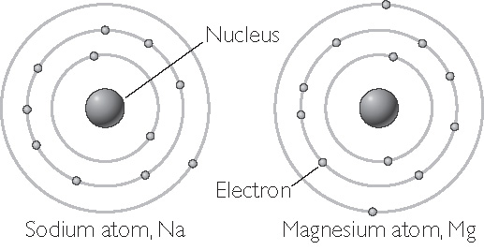
Prepare for the Activity (cont.)
Electron shells are the levels around the nucleus where electrons can be found.
Sodium and magnesium have electrons in three electron shells.

Slide 8
Discussion Notes
The atomic number of an element is the same as the total number of electrons for a neutrally charged atom.
The period (row) number of the element is the same as the number of electron shells.
For main-group elements, the group number of the element is the same as the number of electrons in the outermost shell.

Slide 9
Discussion Notes (cont.)
Valence shell: The outermost electron shell in an atom.
Valence electrons: The electrons located in the outermost electron shell of an atom.
Core electrons: All other electrons in an atom besides the valence electrons.

