Slide 1
Thursday, September 14, 2017
Chemical Names and Symbols
Objective: I will begin to memorize the most common chemical names and symbols
Entry Task:
WITHOUT looking at ANY periodic table, complete the six pairs below:
 | Ag
lead
 | H
aluminum
 | C
neon

Slide 2
Definitions to write down:
Element: A unique substance that cannot be broken down into simpler substances through chemical processes. Elements serve as the building materials of all matter
Compound: A pure substance that is a chemical compound of two or more elements in a fixed ratio.
Examples:
Cu = copper = element
CuO = copper oxide = compound

Slide 3
Language of Chemistry
What can you tell about the chemical formula below?
Chemical symbol for copper
Chemical symbol for oxygen
CuSO_{4(aq)}
Means the substance is dissolved in water (aqueous)
Chemical symbol for sulfur
Means there are 4 oxygen atoms

Slide 4
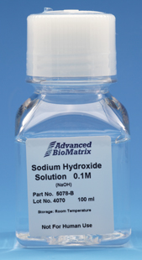
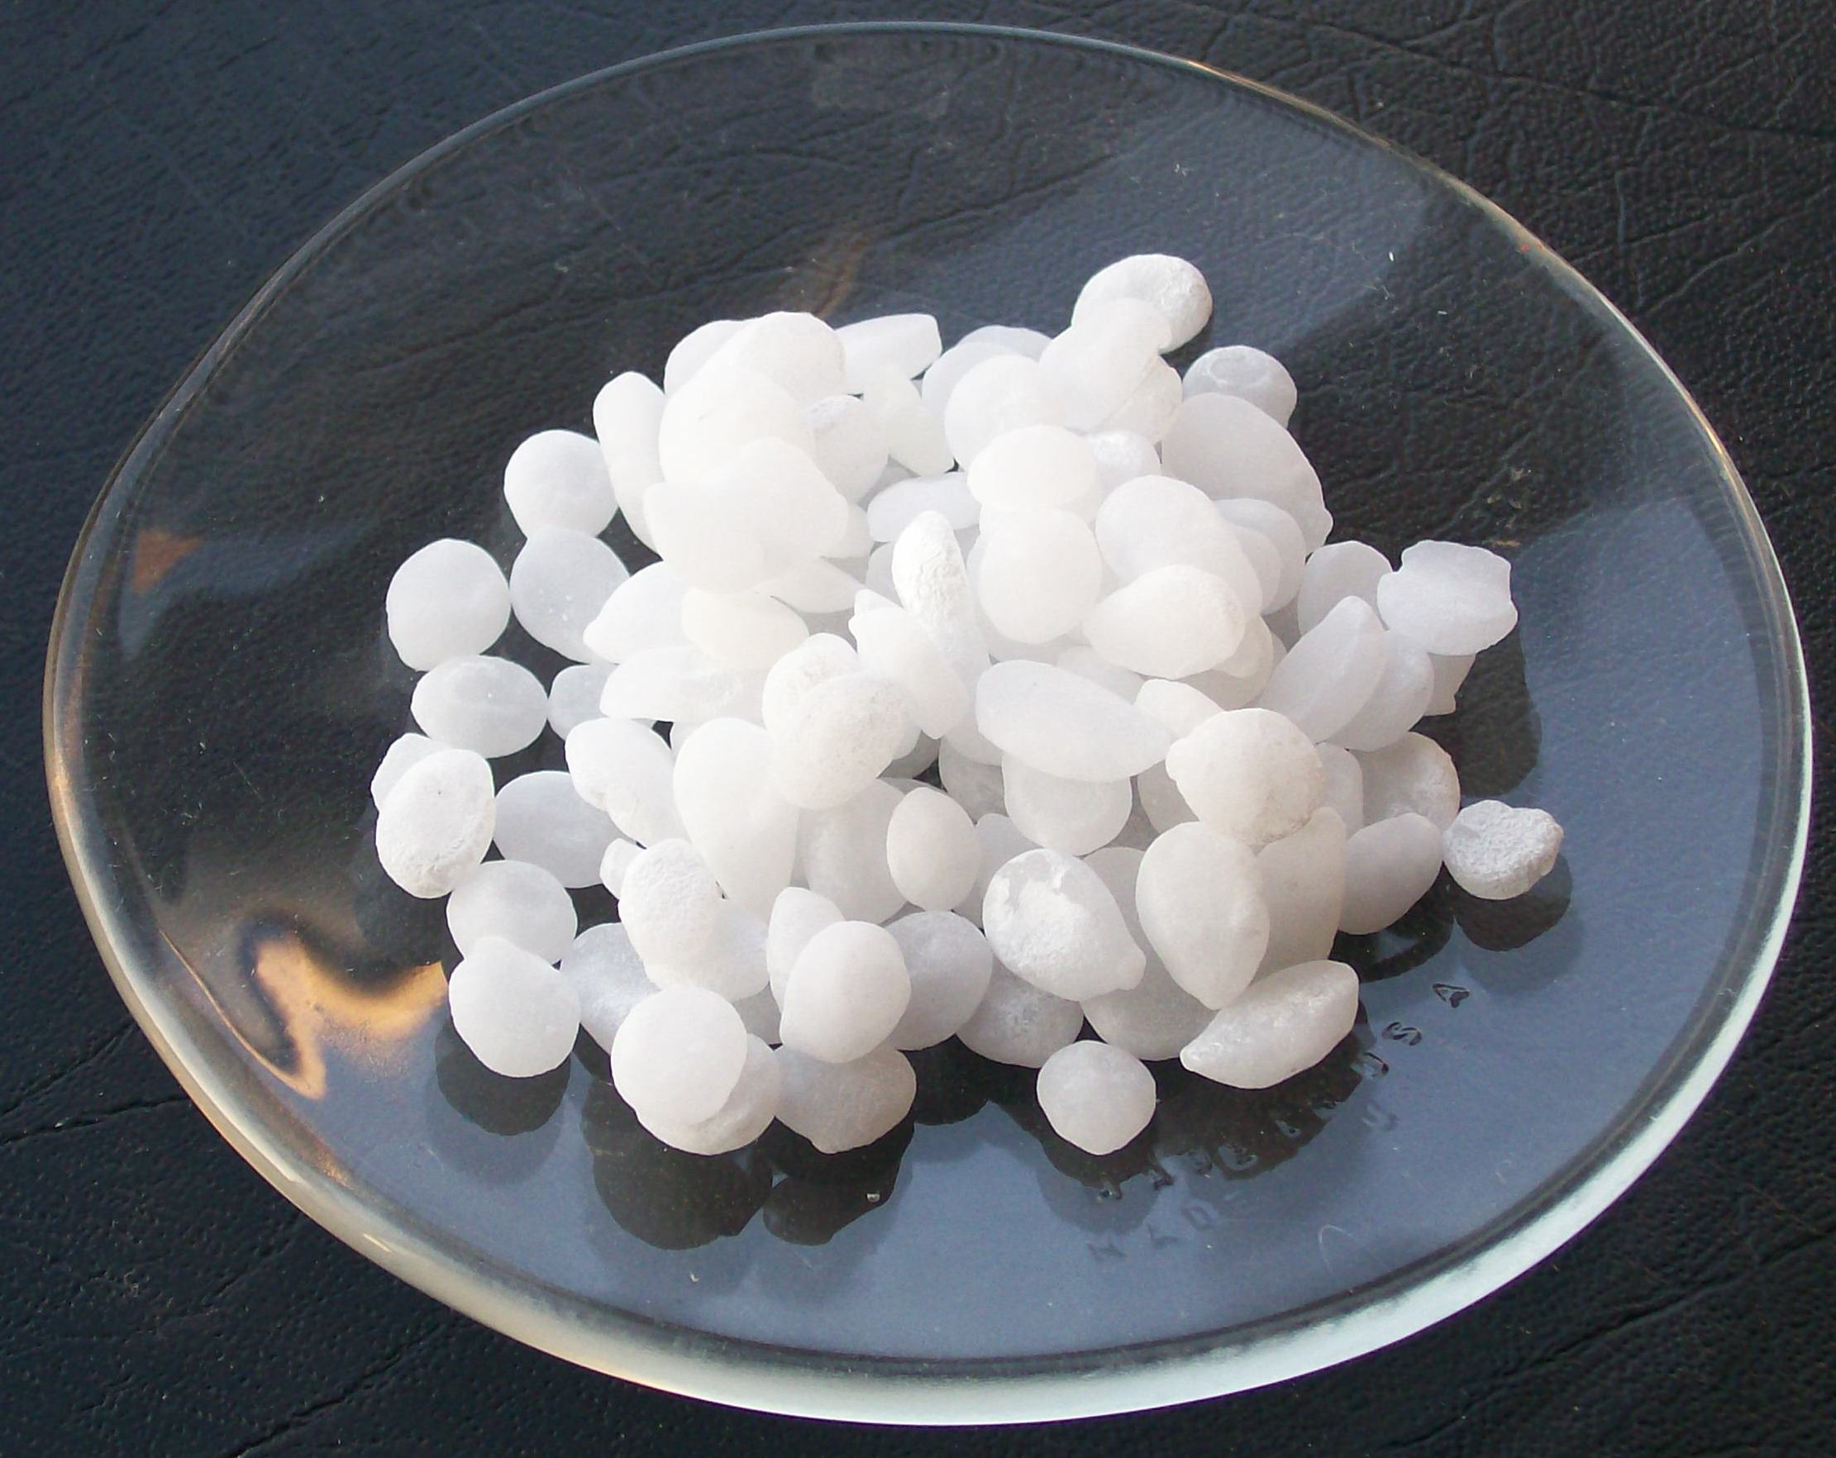
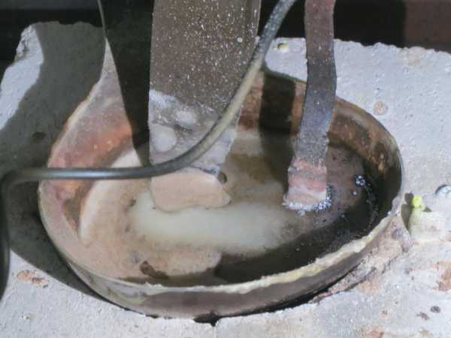
Difference between liquid and aqueous?
Liquid - the pure substance in liquid form
Aqueous - a substance that has been dissolved in water
For example: NaOH

Slide 5
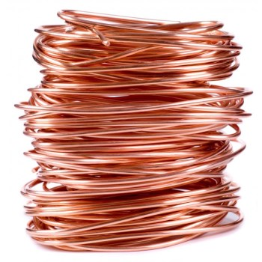
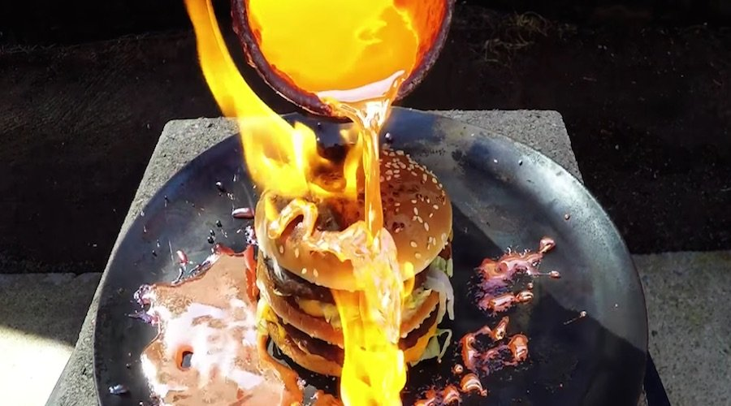
Difference between liquid and aqueous?
Liquid - the pure substance in liquid form
Aqueous - a substance that has been dissolved in water
For example: Copper

Slide 6
Definitions to write down:
Chemical Formula: A combination of symbols and subscripts that indicates the number and type of elements in a compound
Phase: The physical form a substance is in, such as solid, liquid, or gas. Very dependent on temperature of the substance.
Aqueous: a substance dissolved in water

Slide 7
Mystery Vials Activity
There are two identical sets of 18 vials around the room.
DO NOT uncap the tubes
Only handle tubes GENTLY, over the counter (in case they fall/break)
Observe each vial and complete the table, then answer the questions

Slide 8
Exit Task
Is copper sulfate (CuSO₄) an element or a compound?
How do you know?
Homework: Read chapter 6 in the textbook, then complete problems 1-6 (p. 26) on a loose sheet of paper that can be turned in tomorrow

