Slide 1
Lesson 11: Atomic Pudding
Models of the Atom

Slide 2
Entry Task for 9/26/17
What is an atom?
Draw a picture of a carbon atom and label the parts.

Slide 3
Key Question
How are the smallest bits of matter described?

Slide 4
You will be able to:
describe the historical development of the current atomic model
describe and draw an atomic model and explain the evidence that supports the existence of atomic structures
describe the dynamic nature of scientific models

Slide 5
Key Vocabulary
Model: A simplified representation of something more complex, that facilitates understanding certain aspects of a real object or process.
Atoms: The smallest unit of an element that retains the chemical properties of that element.

Slide 6
More Key Vocabulary
Nucleus: The dense, positively charged structure found in the center of the atom. It is composed of protons and neutrons.
Proton: A particle with a positive charge, found in the nucleus of atoms.
Electron: A particle with a negative charge. Electrons move very fast around the outside of the nucleus of atoms.
Neutron: A particle that does not have a charge, found in the nucleus of atoms.

Slide 7
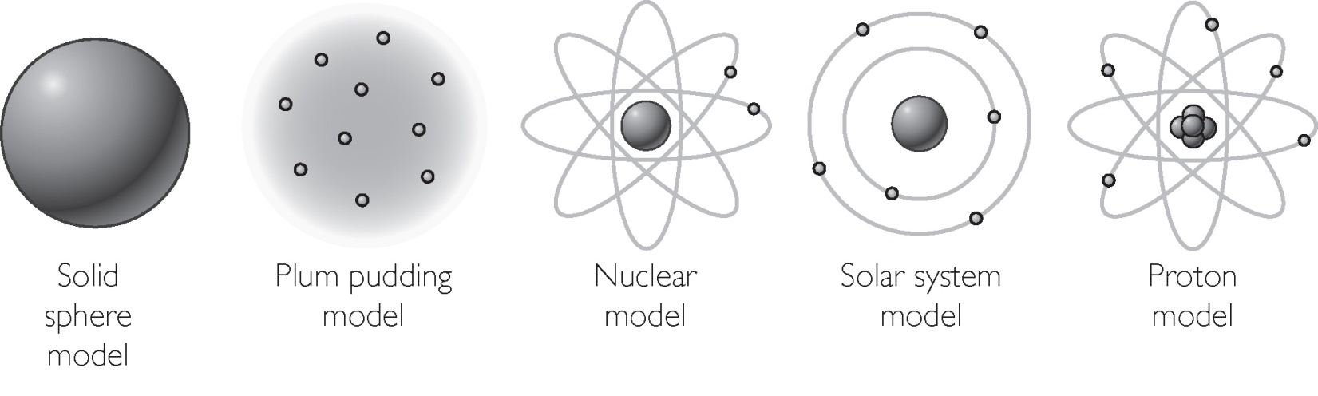
Discussion Notes
The Atomic Model Through Time

Slide 8
Discussion Notes (cont.)
Contemporary scientists are in agreement that matter is made up of tiny particles called atoms.
Scientists have created models to describe atoms.
Scientific evidence is a collection of observation that everyone agrees on.
Science is theoretical and dynamic.
Models and theories are continually being revised or replaced with new models and theories as new evidence is gathered.

Slide 9
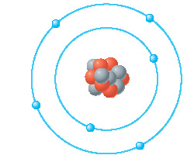
Check-In
Here is a model of a carbon atom.
1. List two things this model tells you about the carbon atom.
2. List something this model does not tell you about the carbon atom.

